Slide 1


The European landscape on Ocean Observations
George Petihakis
Hellenic Centre for marine research
15 June 2021

Slide 2
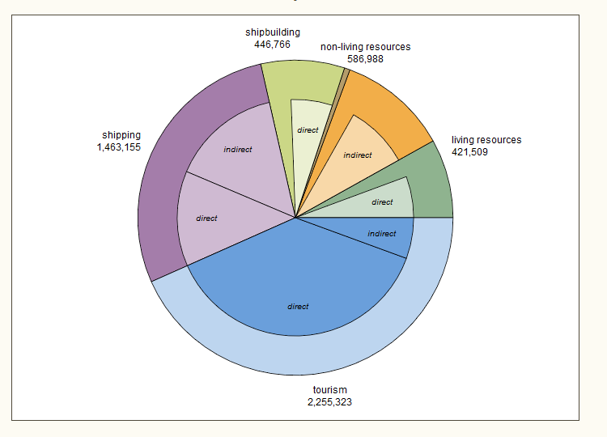
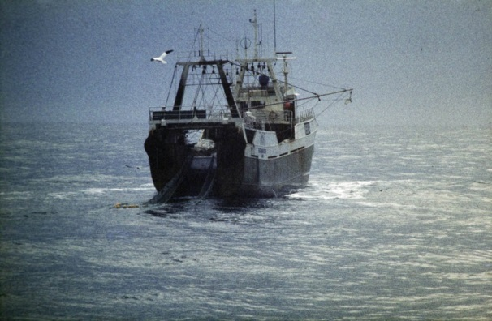
Why do we need ocean observations?
5 million jobs in EU
Offshore wind now employs about half the number as fishing
Traditional jobs are decreasing
The ocean is the new economic frontier
Grand challenges
  Climate change
  Human impact (loss of diversity, pollution, limited resources, etc)
Increased investment risk
We need effective Management

Slide 3
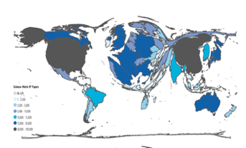
Observing
Understanding
Predicting
Capacitating
Managing

Slide 4
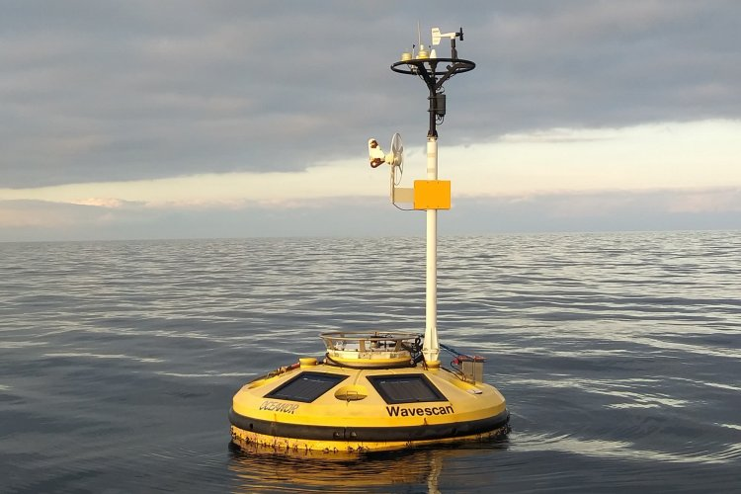
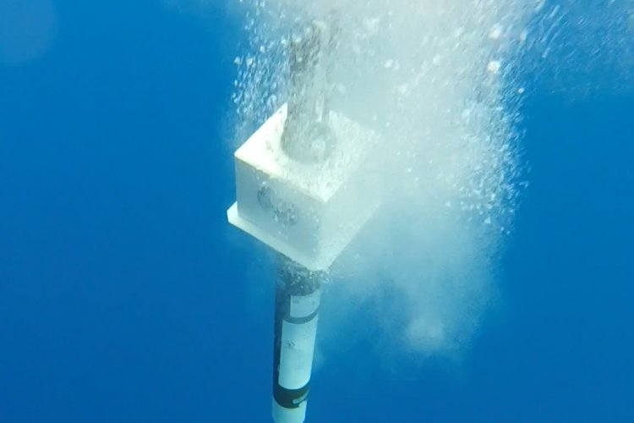
Understanding
Knowledge of the system:
State
Functioning
Underlying Dynamics
Drivers
Ocean’s role
In order to:
Manage pressures / impacts
Apply effective policies
Raise awareness
Provide services & products
Questions:
What to measure?
Frequency?
Spatial & Temporal resolution?
With which platforms?

Slide 5
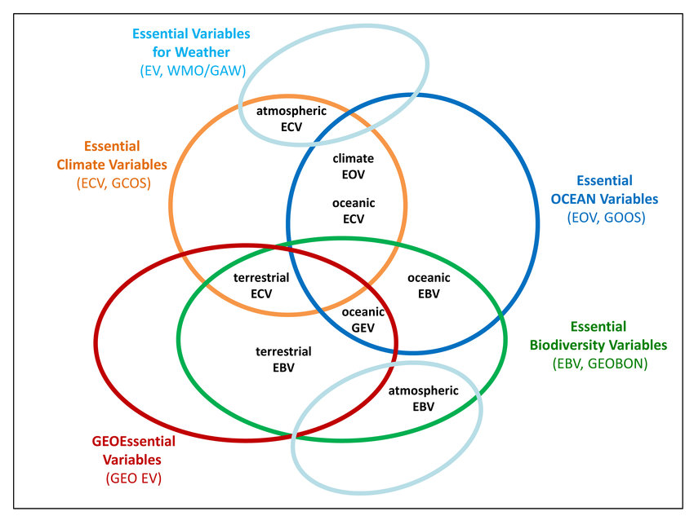
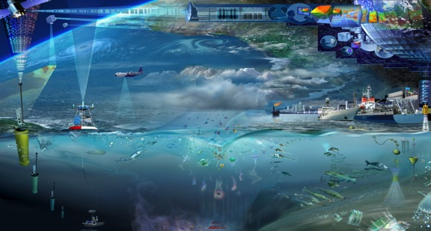
Observing
What variables to measure:
Essential Ocean Variables (EOVs)
Essential Biodiversity Variables (EBV)
Essential Climate drivers
Indicators
Issues (Scientific and societal drivers)
Requirement
What to Measure
Essential Ocean Variables
Satellite
Constellation
…
Argo
SOOP
…
Data Assembly
VOS
…
Data/Info. Products
Issues Impact
Satellite
IMOS
OceanSITES
IOOS
…
…
…
…
…
…
Observations Deployment and Maintenance
OceanObs 2009 Venice, Framework of Ocean Observations

Slide 6
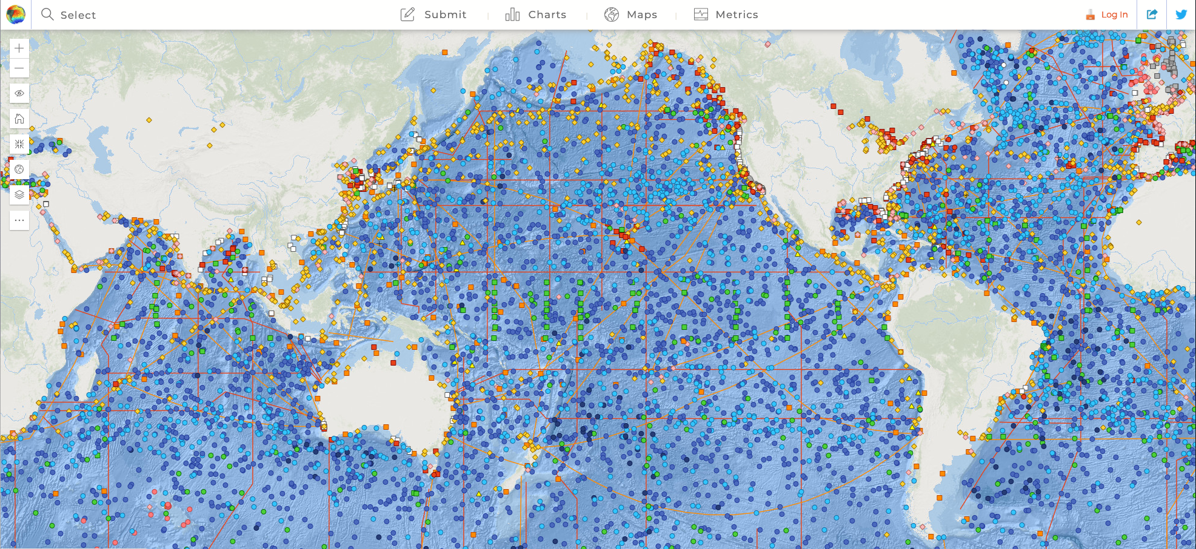
Observing - effort
OceanOPS (https://www.ocean-ops.org/board#)

Slide 7
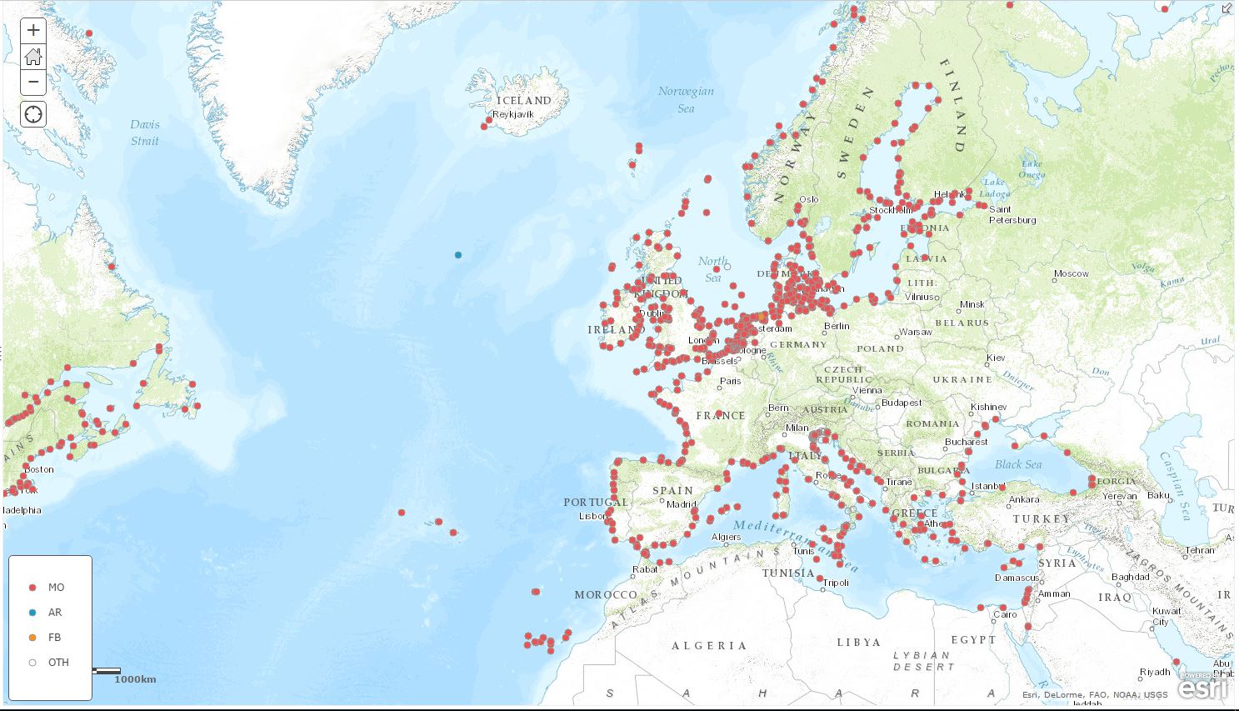
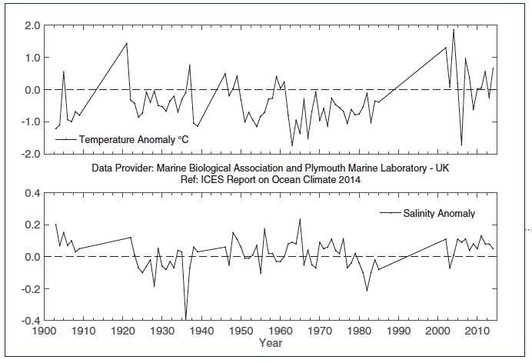
Observing - what is missing ?
Spatial gaps
  horizontal – SE European seas;
  vertical – deep sea is under-sampled;
Temporal gaps
  few complete time series;
Parameter gaps
  biogeochemical; sensors are now
  available;
Long term commitments
  more than 70% based on short term research funding;
Integrated monitoring strategy at
European level
  Reduce overlaps; maximize synergies

Slide 8
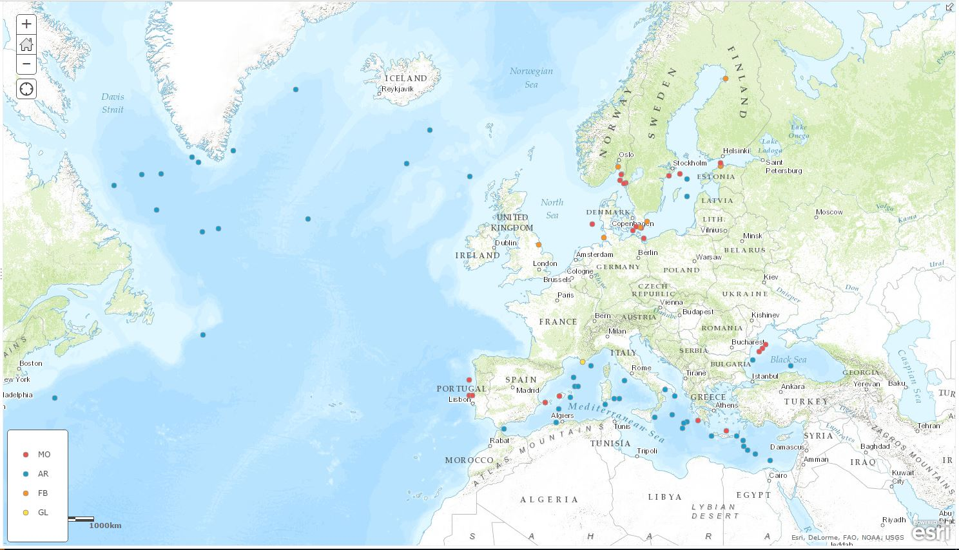
Observing - Chlorophyll measurements
About 10% of platforms at sea measure some biology

Slide 9
Observing - EOVs and Readiness Levels
CONCEPT PILOT MATURE
Physics
Sea State
Ocean surface vector stress
Sea Ice
Sea level
SST
Subsurface temperature
Surface currents
Subsurface currents
SSS
Subsurface salinity
Biogeochemistry
Oxygen
Inorganic macro nutrients
Carbonate system
Transient tracers
Suspended particulates
Nitrous oxide
Carbon isotope (¹³C)
Dissolved organic carbon
Biology and Ecosystems
Phytoplankton biomass and productivity
HAB incidence
Zooplankton diversity
Fish abundance and distribution
Apex predator abundance and distribution
Live coral cover
Seagrass cover
Mangrove cover
Macroalgal canopy cover

Slide 10
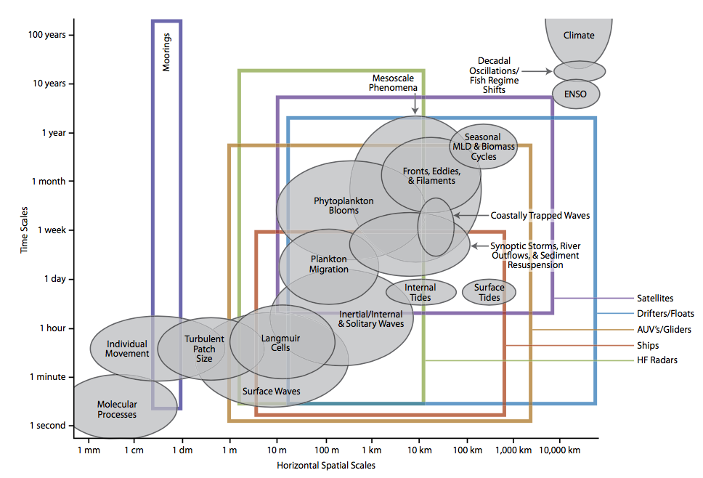





Observing – appropriate scales
Karl et al 2010

Slide 11
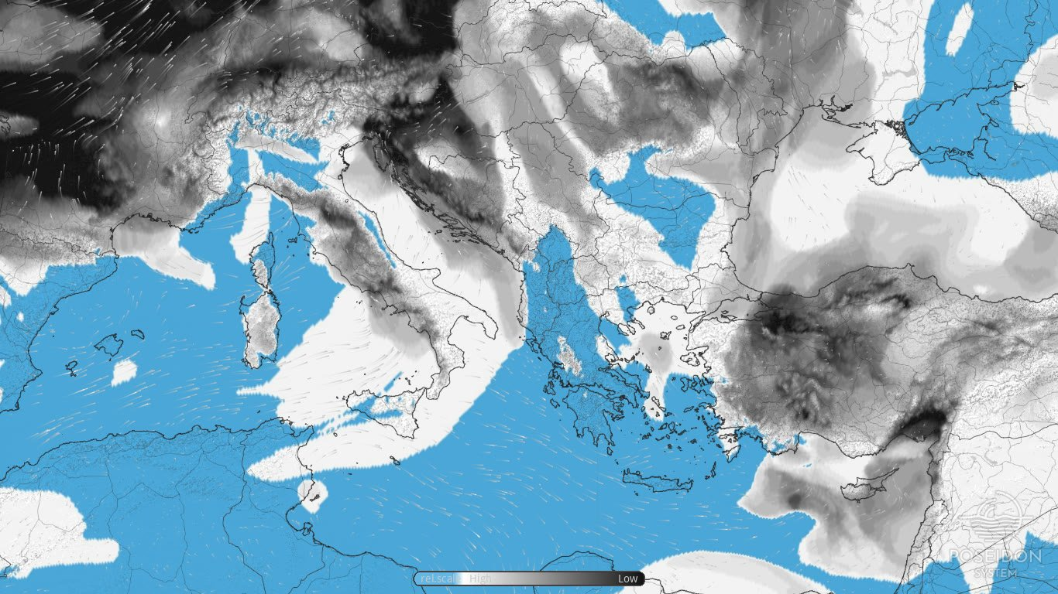
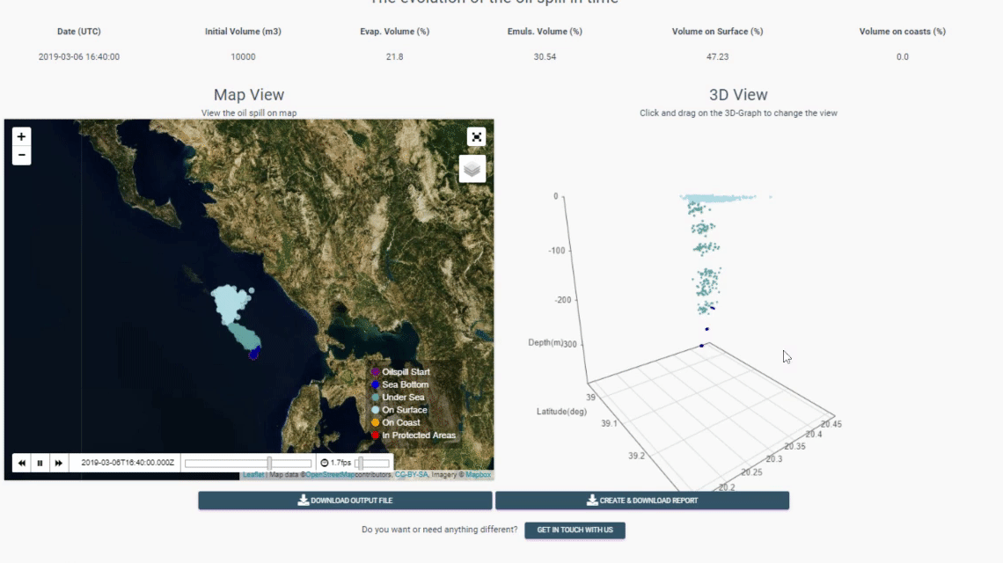
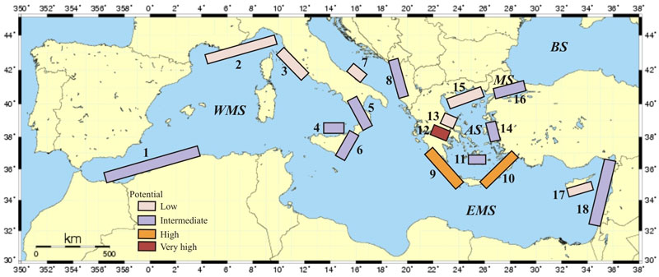
Predicting
Information
Protection
Early warning
Risk assessment
……

Slide 12
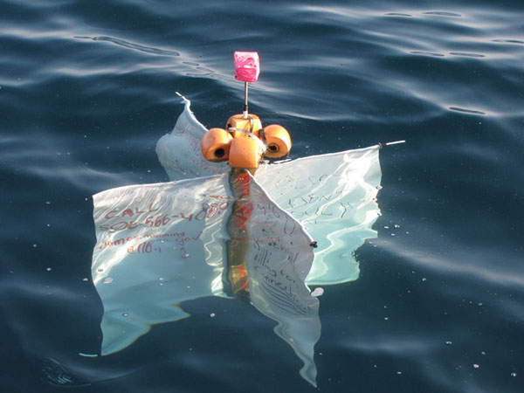
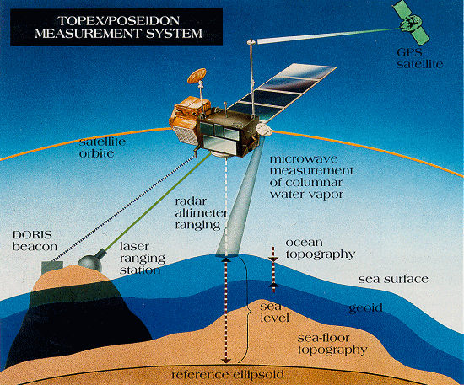

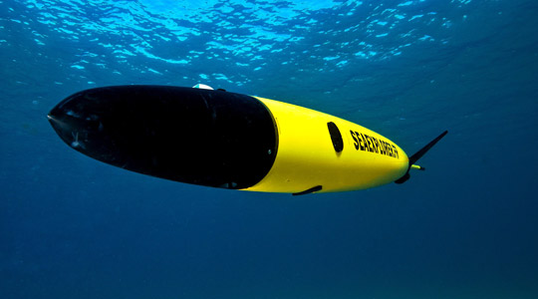
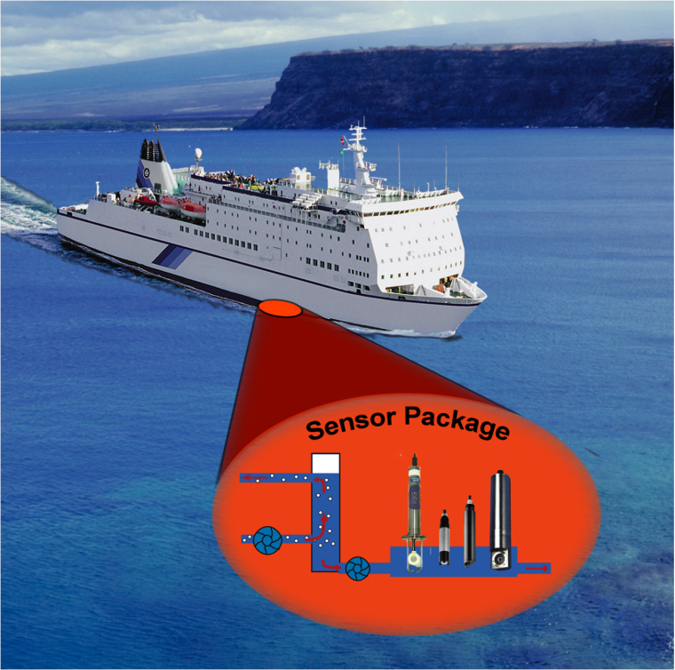
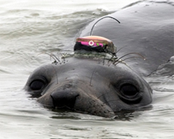
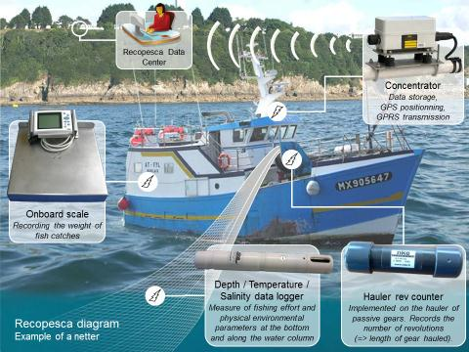
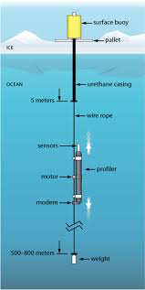
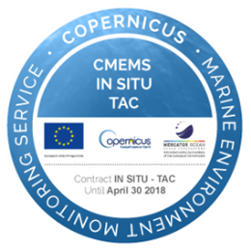
Where we are today ?
Observations
National Level
Regional Level
European Level
Commissions
EU Directives/Policy/Strategy
WFD
Organisations
ROOSs
Drifters
Satelilte
ERICs
R/V Vessels
Gliders
Buoys
HF-radar
Projects/Programs
FerryBox
Mammals
Projects/Programs
Cabled
Data Aggregators
Fishery & Ocean.
Observing System
Profilers
AUV’s

Slide 13
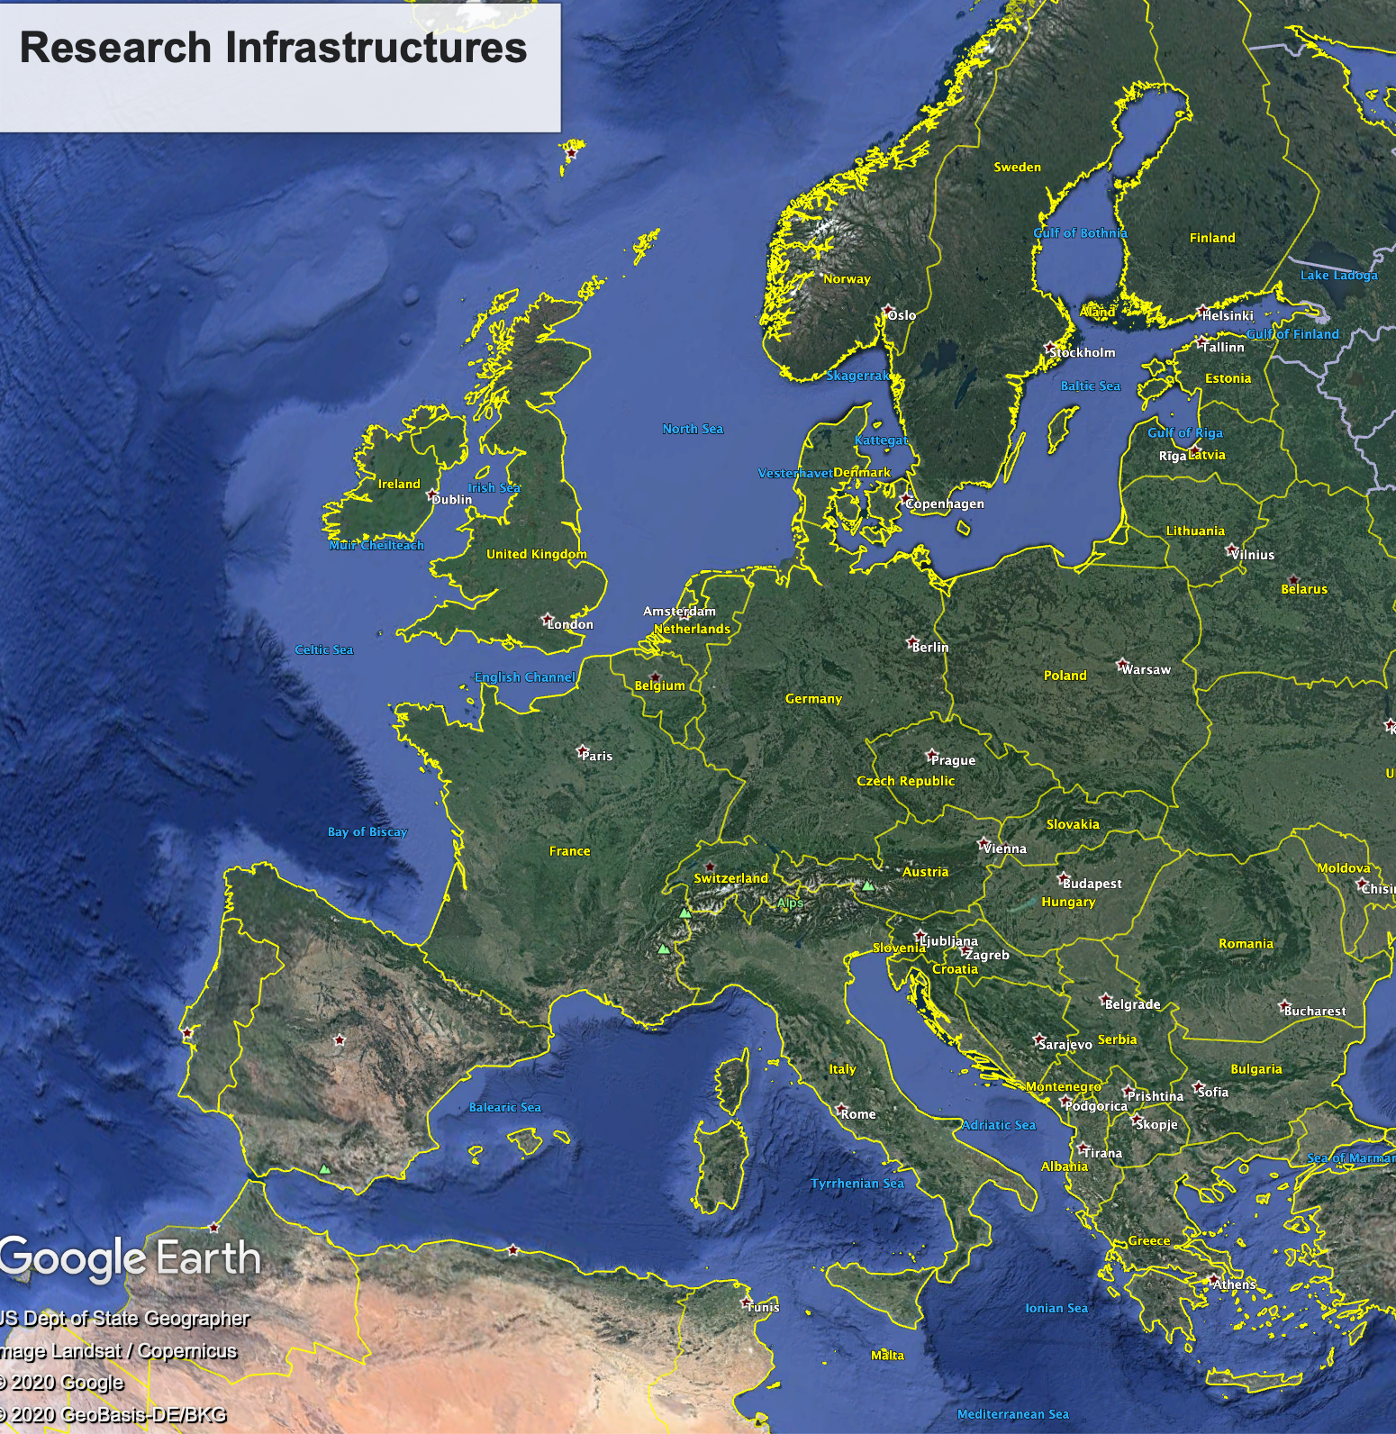
Challenges
Operational Observing Systems
Competition
Fragmentation
Complexity
Overlapping
Waste of resources
Capacity imbalance

Slide 14
The Marine RIs – an important component
Contribution of National efforts
ERICs
EU Contribution to Global efforts`
Platform
Specific
Environment
Specific
Process
Specific
Discipline
Specific
Projects/ Programs
Area
Specific

Slide 15
Sustainability
Funding sustainability | Ocean | Meteo. | Atm. Composition
Solved today, no problems foreseen in the future | 28% | 68% | 30.00%
Solved today, but problems foreseen in 2-3 years | 52% | 27% | 40.00%
No funding today, but plans for funding in the near future is under way | 7% | 3%
No funding today and no plans for funding in the near future | 9% | 2% | 30.00%
Other | 4%
Problems at: National Systems ←→ EU RIs.
Quite often there are funds to acquire very expensive equipment but there are problems maintaining them.
EU RIs → funding from MS and EU but hard to raise funds from services
https://insitu.copernicus.eu/library/reports/Sustainabilitysurveyupdatedreportfinal.pdf

Slide 16
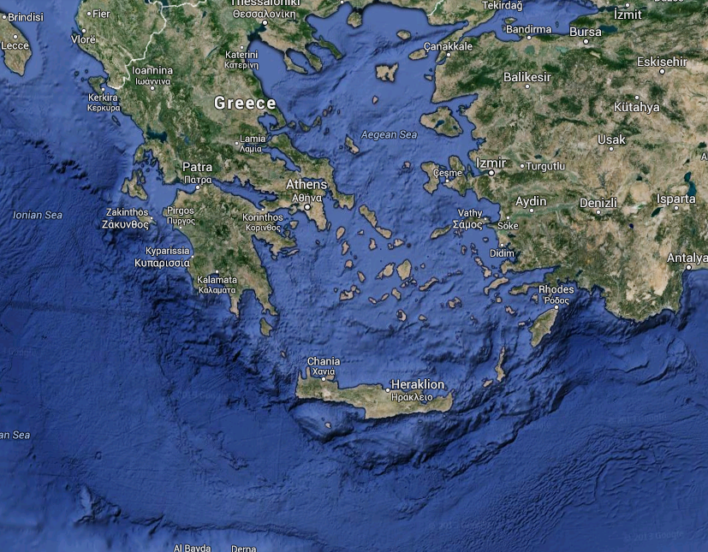


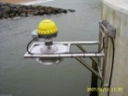

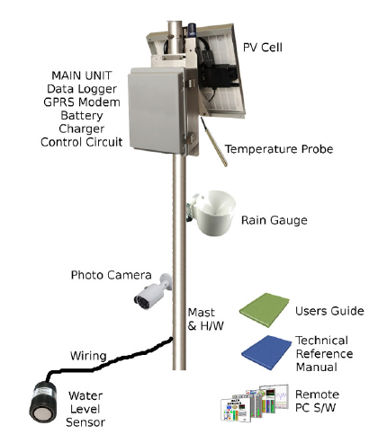
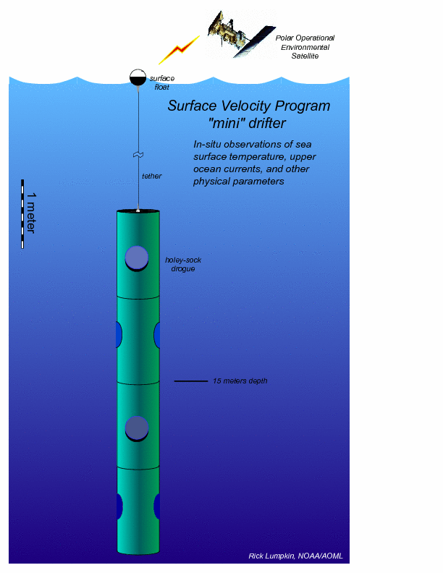
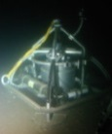
Collaboration at National Level
HIMIOFoTS

Slide 17
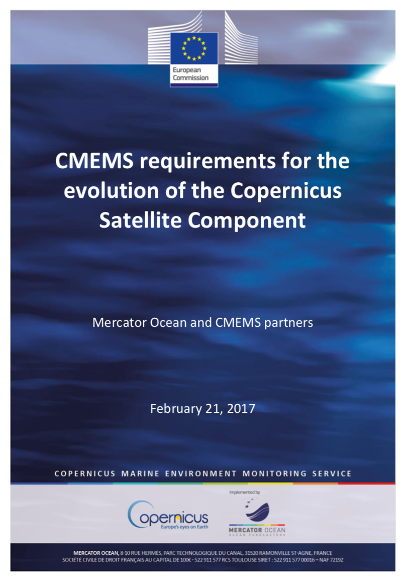
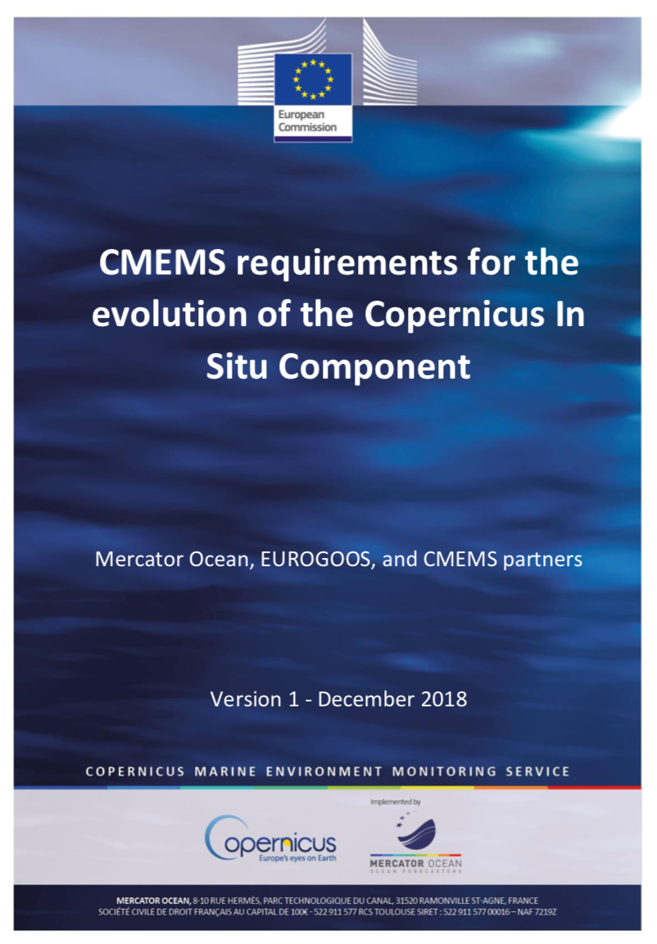
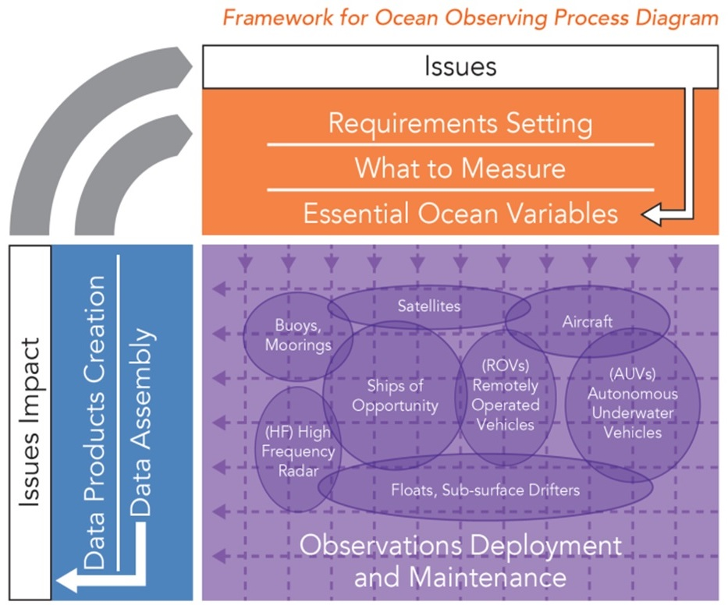
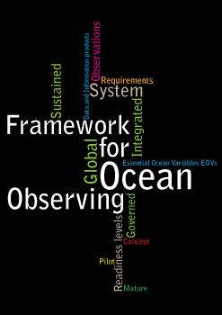
Requirements
Connection with users and stakeholders → Need to know the requirements (not always the case).
First set up an RI and then we try to find the users.
Open Access – We need to brake barriers and especially with industry

Slide 18
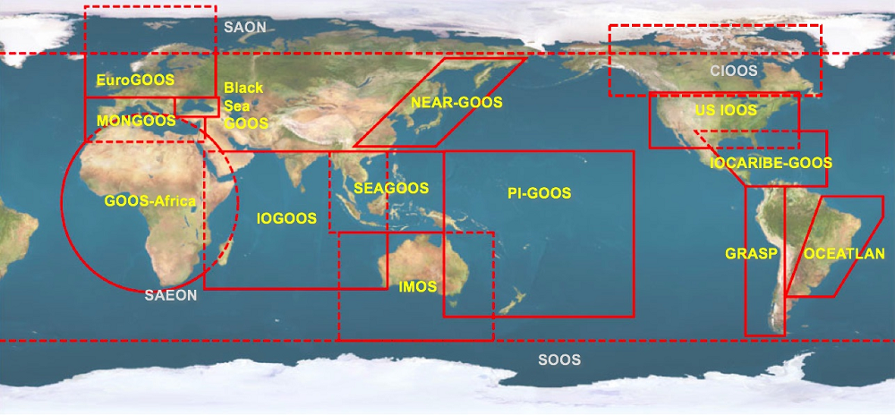
Structure

Slide 19

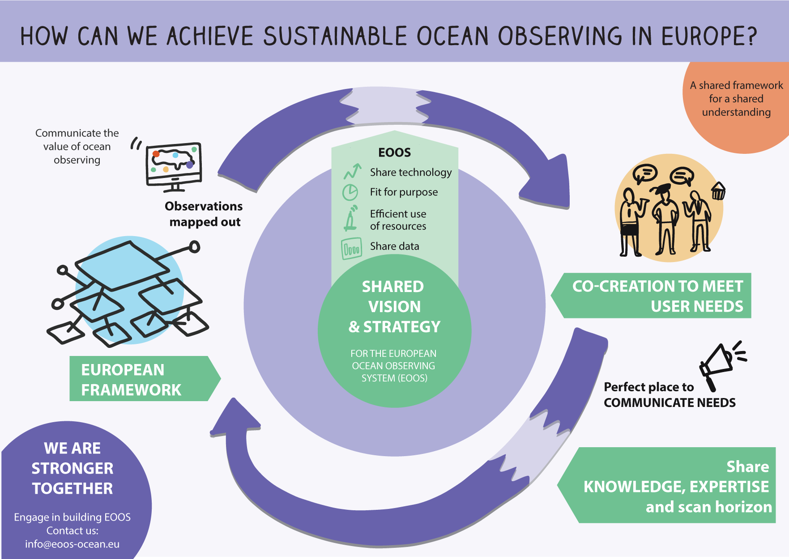


What is EOOS?
A community-driven initiative
Steering Group: co-Chaired by EuroGOOS and EMB
Vision: Connect Europe’s diverse ocean observing stakeholders and make ocean observation a public utility in Europe, by strengthening coordination, strategy and sustainability in
ocean observation.
www.eoos-ocean.eu

Slide 20
EOOS Strategy & Implementation Plan
EOOS is a coordinating framework designed
To align and integrate Europe’s ocean observing capacity for the long term;
To promote a systematic and collaborative approach to collecting information on the state and variability of our seas and oceans;
To underpin sustainable development, protection and conservation of the marine environment and its resources.
www.eoos-ocean.eu

Slide 21
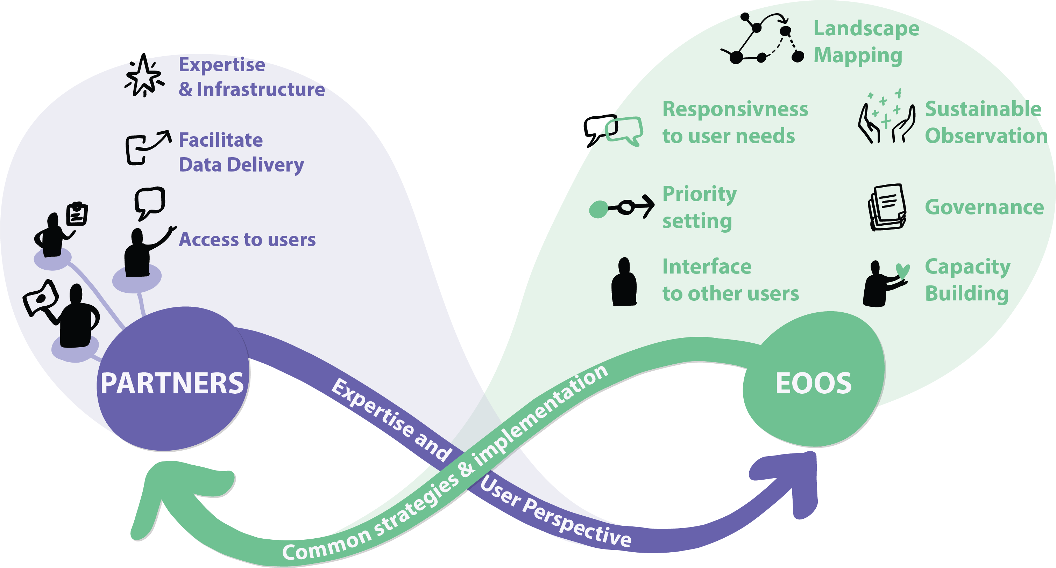
Partnership
How can you get involved?

Slide 22
EOOS Governance
Steering Group
Advisory Committee
Funder/Resources Committee
Operations Committee
Forum
& other stakeholder engagement mechanisms (consultations, events, workshops, webinars, etc.)
www.eoos-ocean.eu

Slide 23
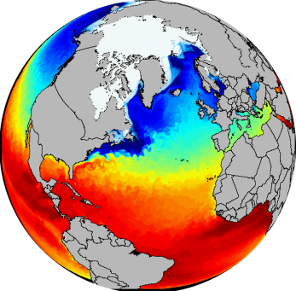
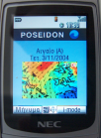
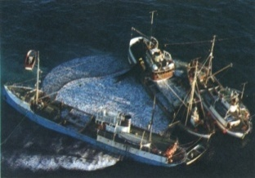
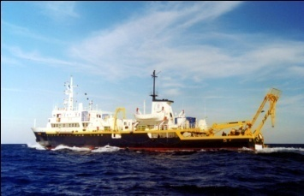
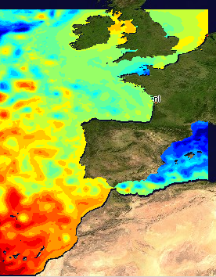
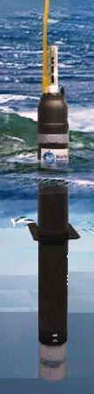
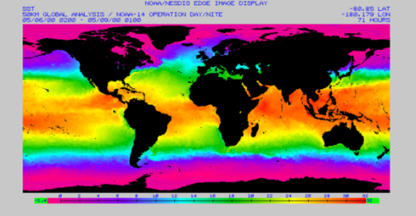
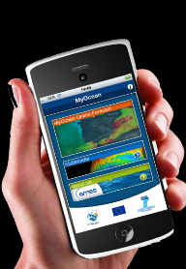
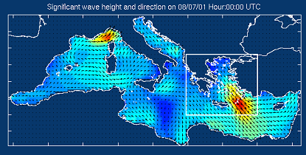
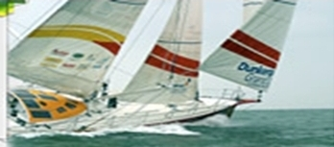
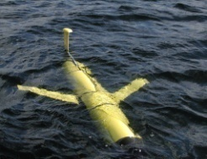
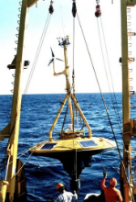
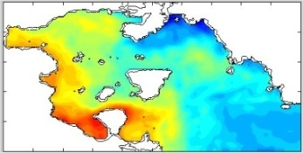
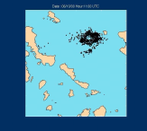

The Value Chain
Observations
Processing & Modeling
Services
Open Data
Open Access

Slide 24

Data

Slide 25



Information and services

Slide 26

Thank you for your attention
www.hcmr.gr
gpetihakis@hcmr.gr

