Slide 1


CHNet cloud: an EOSC-based cloud for physical technologies applied to cultural heritages
Alessandro Bombini
INFN CHNet, Firenze

Slide 2

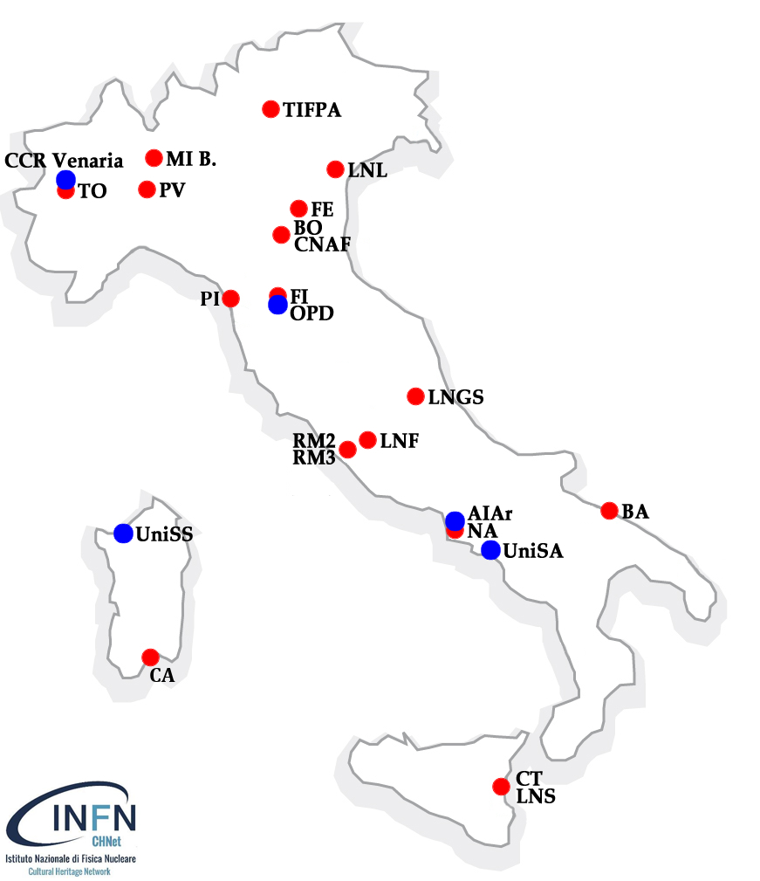
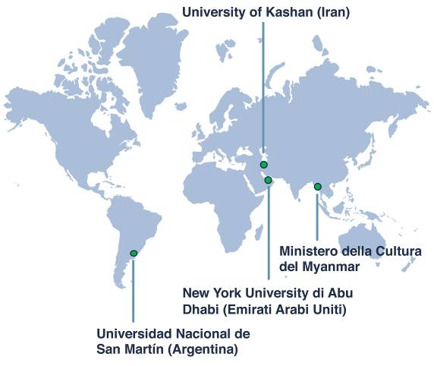
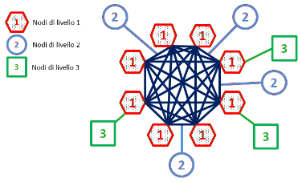
The INFN
Cultural Heritage Network
1st level nodes:
Laboratories in INFN facilities
2nd level nodes:
Universities, Restoration Centres, Associations, with complementary competencies
INFN-CHNet
Research
(50%)
Education
(20%)
Third Mission
(30%)
INFN
Public
Engagement
(40%)
Access to
Laboratories and
Instrumentation
(30%)
Technology
Transfer
(30%)
External Projects
3rd level nodes:
Foreign research centres/Universities outside Europe.
- Each 3rd level node is
bound to a 1st level node
- Each 3rd level node is encouraged to create a
local network with different competencies in its own country
CHNet cloud: an EOSC-based cloud for physical technologies applied to cultural heritages - Alessandro Bombini - INFN CHNet, Firenze
‹#›

Slide 3



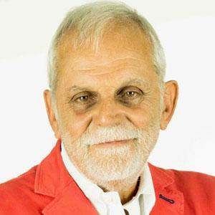
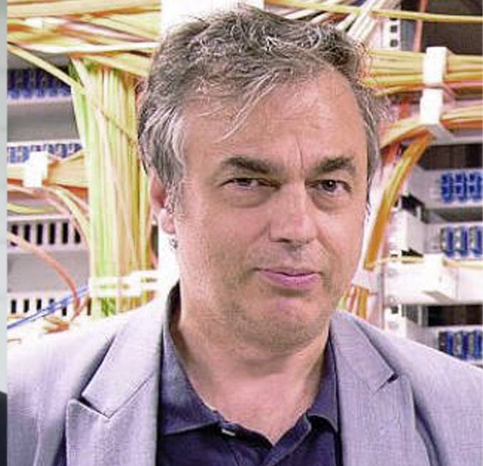



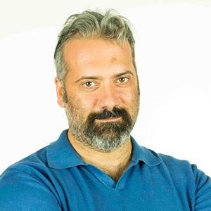

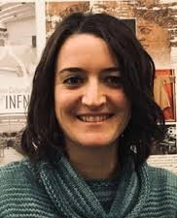


F. Taccetti
F. Niccolucci
L. dell’Agnello
Scientific director
Task Director
Technical Director
Research & Development
Web Full Stack
development
DATA
Artificial Intelligence
Cloud Architecture
&
CyberSecurity
A. Felicetti
Alessandro Bombini
F. Giacomini
Development
L. Castelli
Thespian-Mask
XRF Analyser
C. Ruberto
A. Mazzinghi
...
M. E. Fedi
Thespian-NER
L. Liccioli
S. Barone
Testing
Research
CHNet cloud: an EOSC-based cloud for physical technologies applied to cultural heritages - Alessandro Bombini - INFN CHNet, Firenze

Slide 4

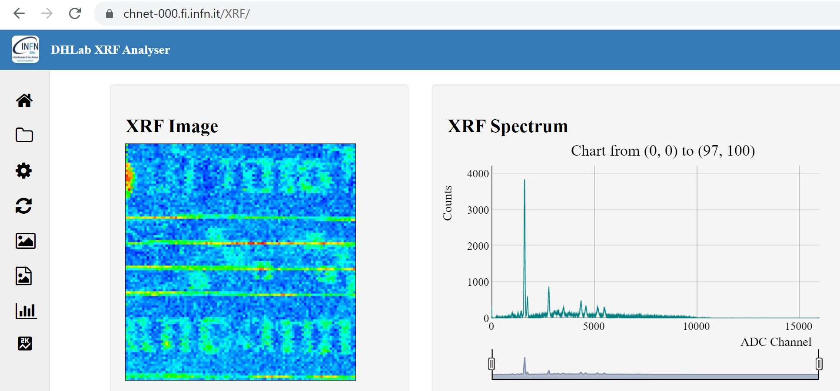
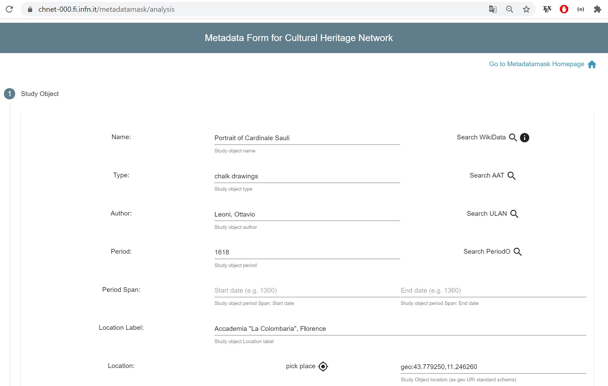
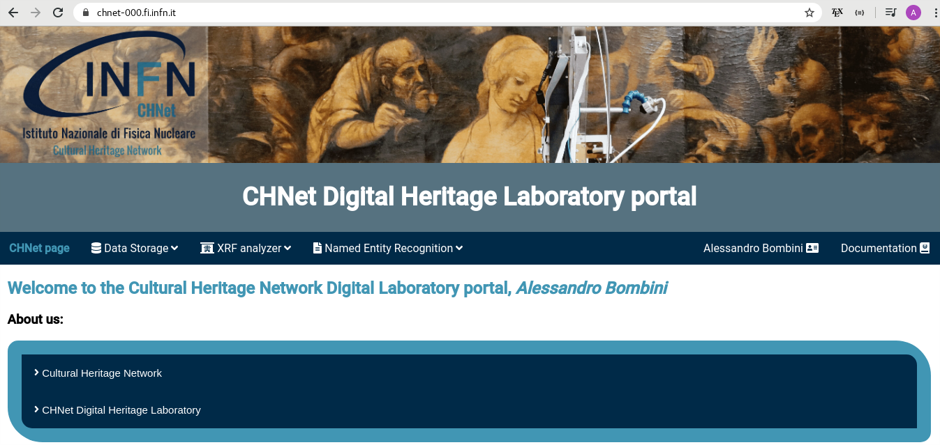
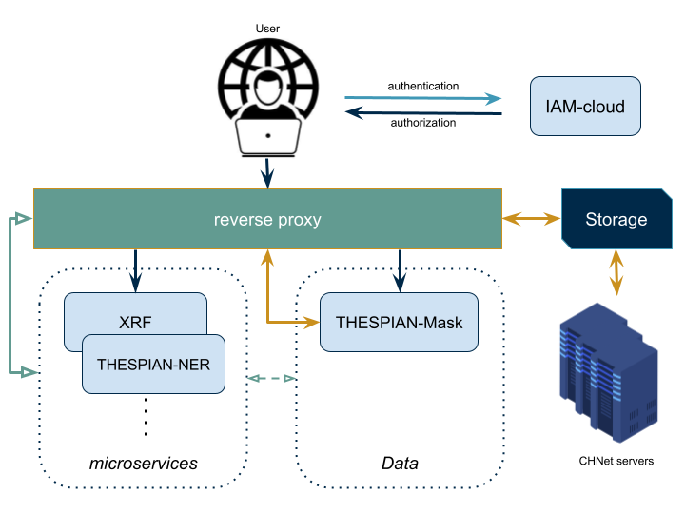
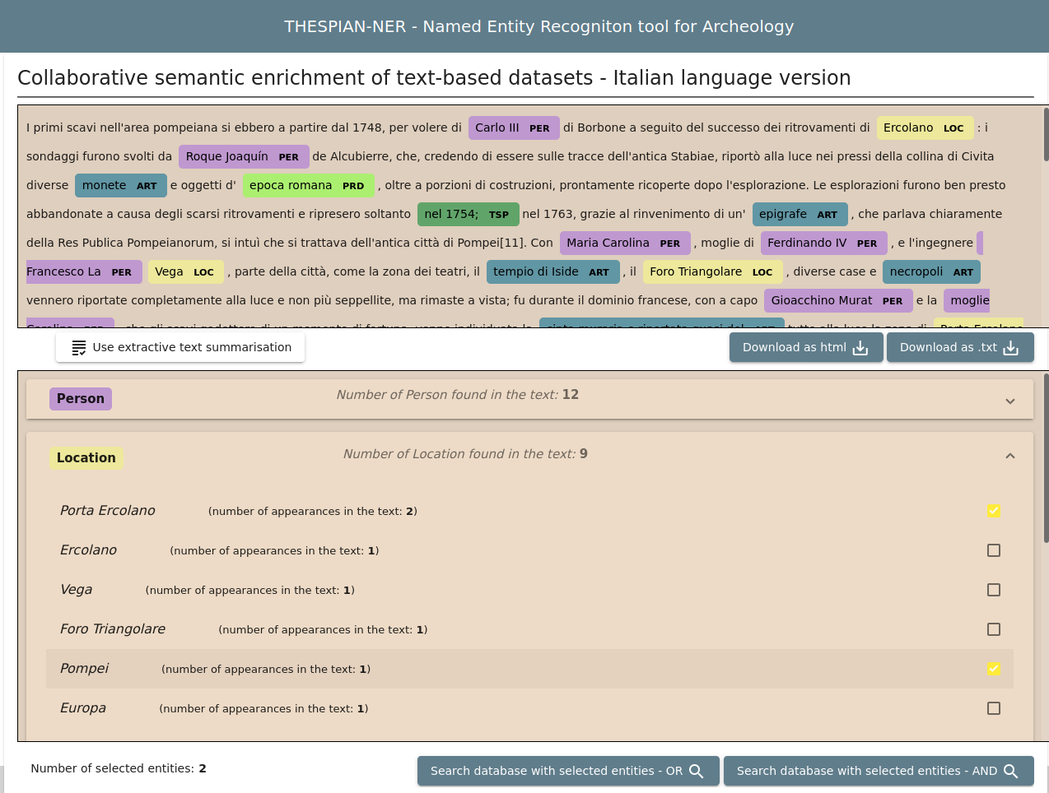
CHNet cloud: an EOSC-based cloud for physical technologies applied to cultural heritages - Alessandro Bombini - INFN CHNet, Firenze

Slide 5

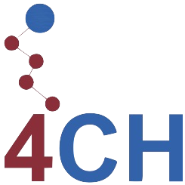







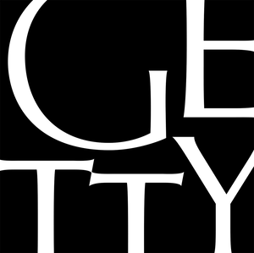


The Cultural Heritage Network Cloud
Authentication
IAM-cloud
1
Authorization
Front End
2
2
. . .
2
Back End
3
CHNet cloud: an EOSC-based cloud for physical technologies applied to cultural heritages - Alessandro Bombini - INFN CHNet, Firenze

Slide 6

CHNet is the INFN network dedicated to the application of physical technologies on Cultural Heritages.
It is currently developing, jointly with CNAF and PIN, a set of ontology-enabled web-based services for FAIR-based data storage & analysis, available in its cloud.
It currently offers cloud services developed within 2 european projects,
and . In the near future, they will be integrated into the competence center on Cultural Heritages.
DHLab, the digital group of CHNet, is currently developing further (micro)services, but it is also involved in few research projects on Digital technologies applied to Scientific Analysis on Cultural Heritages.
The goal is to move (almost) all CHNet software and data in the cloud.
CHNet cloud: an EOSC-based cloud for physical technologies applied to cultural heritages - Alessandro Bombini - INFN CHNet, Firenze

Slide 7
Thank you for your attention!
Alessandro Bombini
INFN CHNet, Firenze

Slide 8
Extra slides
Alessandro Bombini
INFN CHNet, Firenze

Slide 9














Back
End
Front
End
Third-party APIs
Authorization
Reverse Proxy
IAM-cloud
Authentication
CHNet cloud: an EOSC-based cloud for physical technologies applied to cultural heritages - Alessandro Bombini - INFN CHNet, Firenze

Slide 10







Rest
API
1
Front
End
Third-party APIs
Authorization
Reverse Proxy
Rest
API
2
IAM-cloud
Neural Network
Authentication

Slide 11

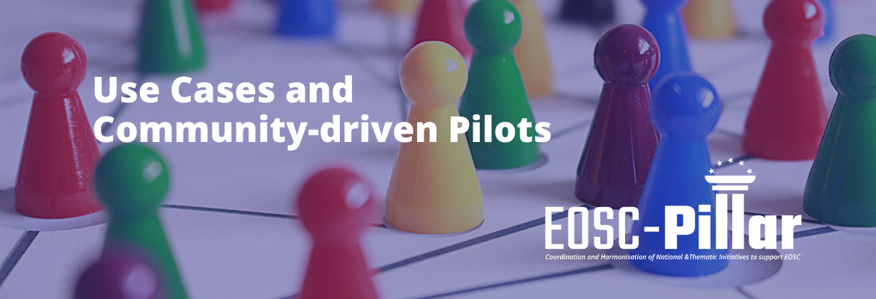

DHLab in EU Projects:
EOSC-Pillar WP 6
WP 6.5
WP 6.9
TEXTCROWD
THESPIAN-NER
CHNet cloud: an EOSC-based cloud for physical technologies applied to cultural heritages - Alessandro Bombini - INFN CHNet, Firenze

