Slide 1
La rete in fibra come sensore: attività e prospettive per un monitoraggio geofisico globale
Cecilia Clivati
Ist. Naz. Ricerca Metrologica (INRIM)

Slide 2
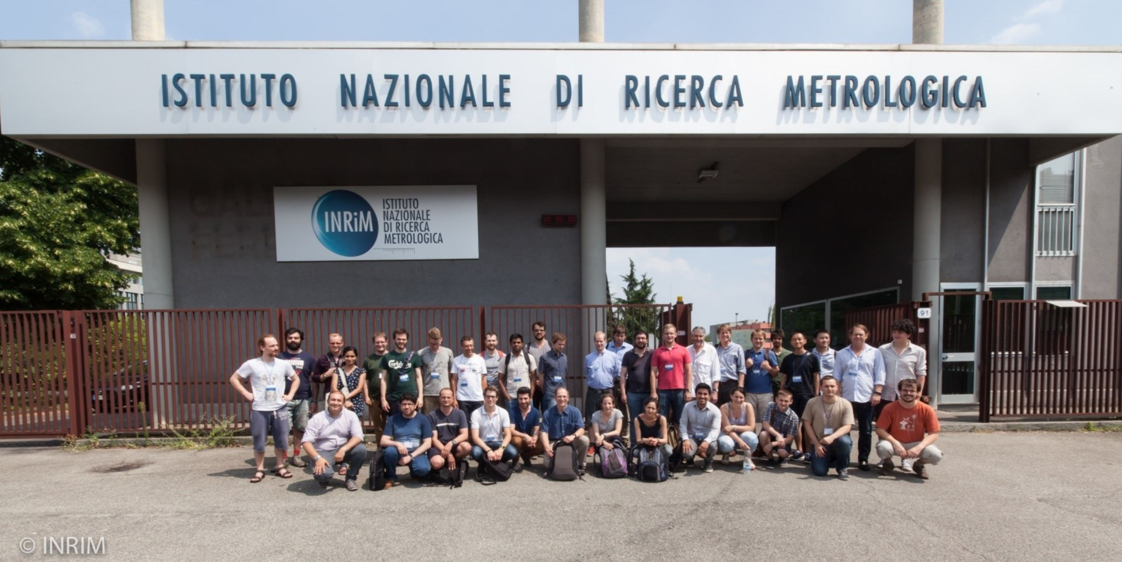


The Italian Metrology Institute
INRIM realizes and maintains in Italy the Units of the International System
It realizes the Italian National Timescale UTC(IT) and distributes it to the users
Optical fiber

Slide 3
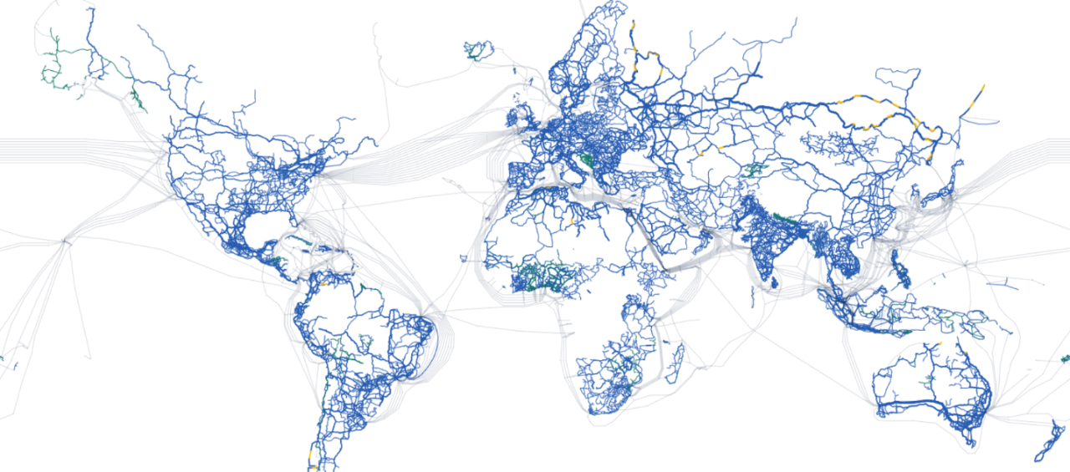
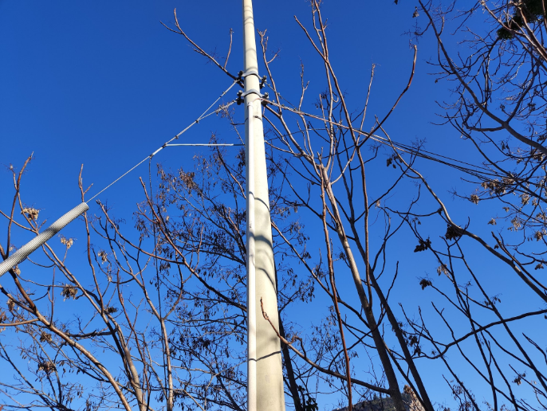
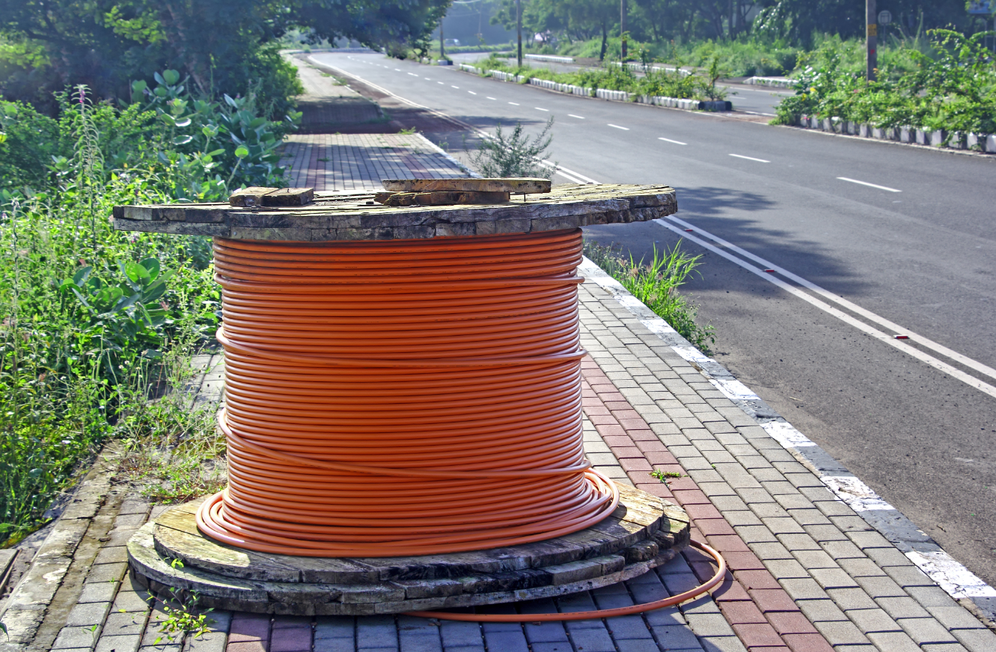
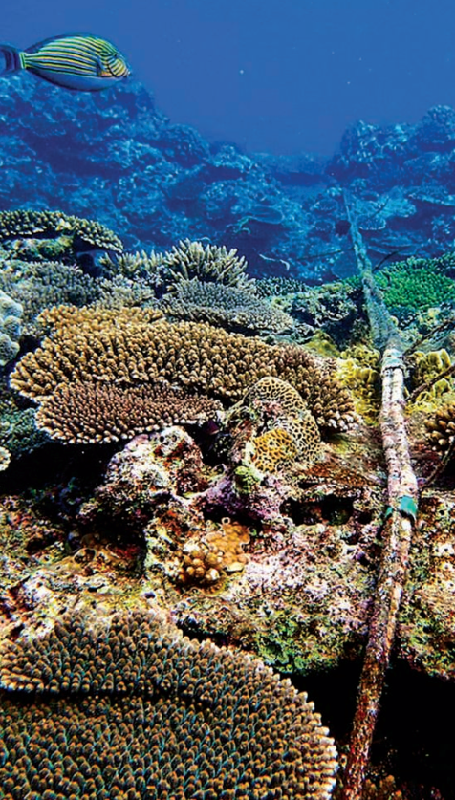
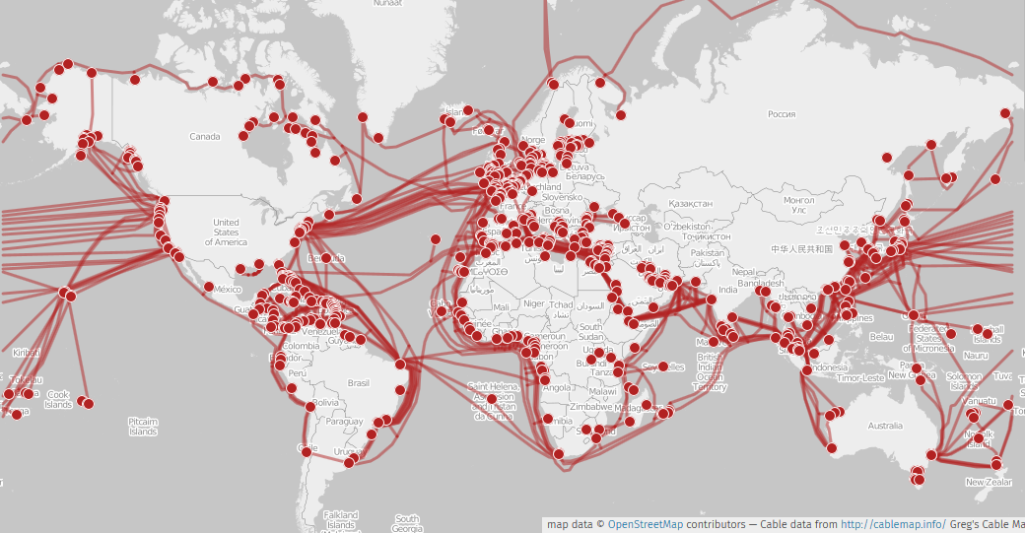
Optical Networks today
http://cablemap.info
https://bbmaps.itu.int/bbmaps/

Slide 4



The fiber as a sensor
Optical fiber
Strain
Pressure
Temperature
Change in fiber length
Change in glass density

Slide 5
The fiber as a sensor
Launched optical field
Phase
Transmission disturbances
Polarization
Optical fiber
Strain
Pressure
Temperature
Change in fiber length
Change in glass density

Slide 6













The fiber as a sensor
Infrastructures,
Vehicles, people flows …
Atmospherical events,
sea waves,
tsunamis
Marine
mammals…
wind,
Optical fiber
Volcanos,
Earthquakes

Slide 7
Distributed Fiber Optic Sensing
1981:
OTDR
invention
1988:
1st fiber cable
in Atlantic Ocean
2008:
Coherent Optical
Communications
1975-1978:
1st discrete
fiber sensors
1986-1989:
Brillouin/Raman-
scattering sensors
2005:
OTDR used
for sensing
2013-2014:
Fiber sensing
in geosciences
2021:
Telemetry-based
sensing
2018:
Coherent Laser
Interferometry
E. Ip, proc. of the IEEE, 110, 1853 (2022)
Z. Zhan, Seism. Res. Lett. 91, 1 (2020)

Slide 8

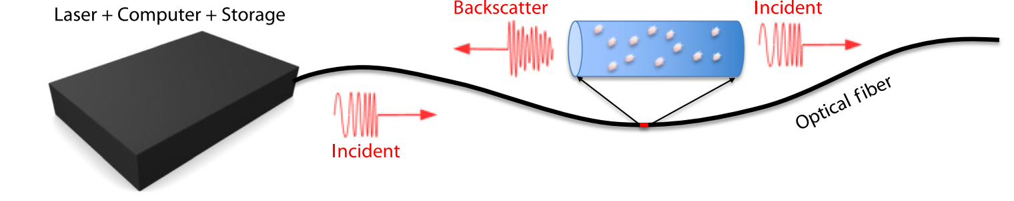

Optical Time-Domain Reflectometry
1981:
OTDR
invention
1988:
1st fiber cable
in Atlantic Ocean
2008:
Coherent Optical
Communications
1975-1978:
1st discrete
fiber sensors
1986-1989:
Brillouin/Raman-
scattering sensors
2005:
OTDR used
for sensing
2013-2014:
Fiber sensing
in geosciences
2021:
Telemetry-based
sensing
2018:
Coherent Laser
Interferometry
Optical Time Domain Reflectometry:
Scattering #1
Scattering #2
Point-by-point acoustic map along cable
Laser pulse

Slide 9
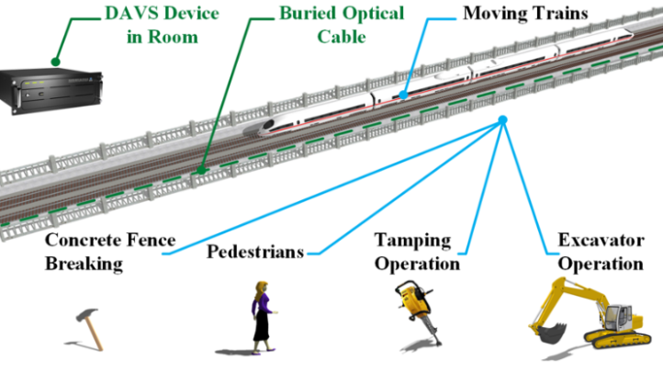
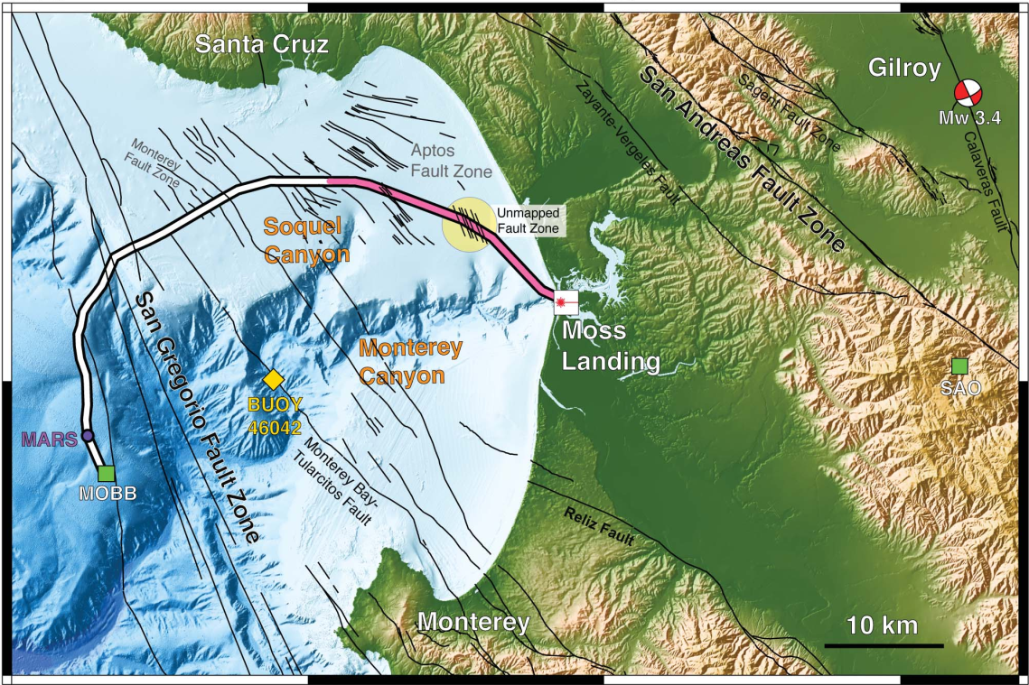
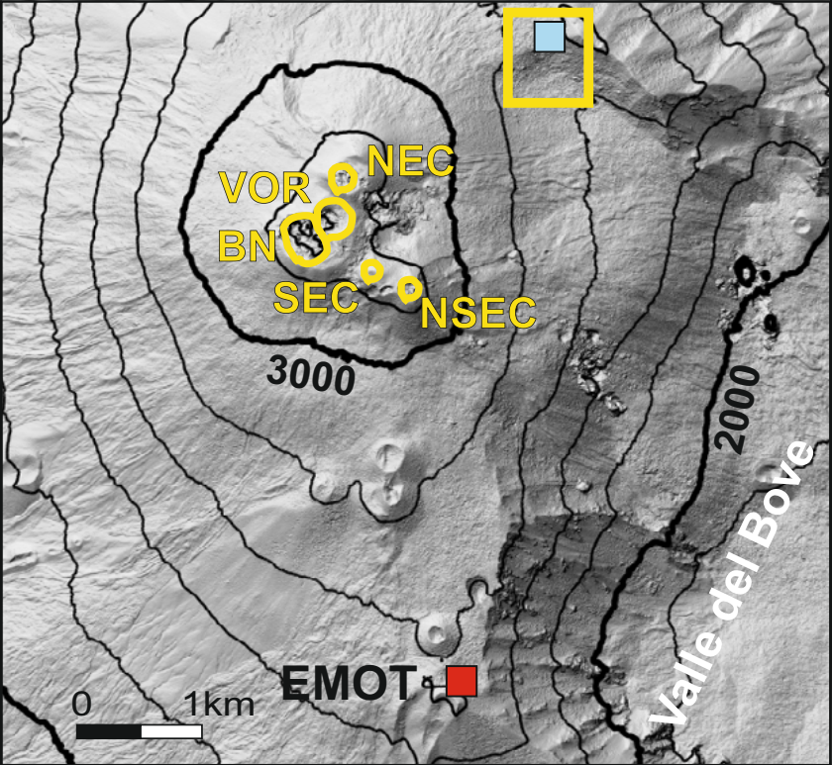
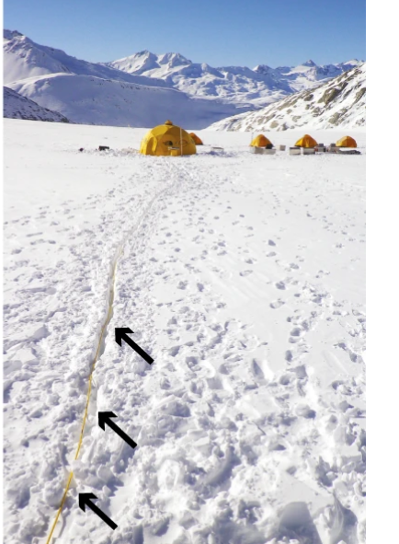
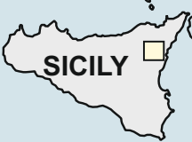
Optical Time-Domain Reflectometry
Z. Wang et al.,
Opt. Expr. 27, 23682 (2019)
N. Lindsey et al.,
Science 366, 1103 (2019)
P. Jousset, G. Currenti et al.,
Nat. Comm. 13, 1753 (2022)
Optical Time Domain Reflectometry:
F. Walter et al.,
Nat. Comm. 11,
2436 (2020)
Scattering #1
Scattering #2
Point-by-point acoustic map along cable
Laser pulse

Slide 10
Optical Time-Domain Reflectometry
Z. Wang et al.,
Opt. Expr. 27, 23682 (2019)
N. Lindsey et al.,
Science 366, 1103 (2019)
P. Jousset, G. Currenti et al.,
Nat. Comm. 13, 1753 (2022)
Optical Time Domain Reflectometry:
F. Walter et al.,
Nat. Comm. 11,
2436 (2020)
Scattering #1
Scattering #2
Point-by-point acoustic map along cable
Not compatible with data traffic
$$$, not scalable
Laser pulse

Slide 11
Sensing while carrying data
1981:
OTDR
invention
1988:
1st fiber cable
in Atlantic Ocean
2008:
Coherent Optical
Communications
1975-1978:
1st discrete
fiber sensors
1986-1989:
Brillouin/Raman-
scattering sensors
2005:
OTDR used
for sensing
2013-2014:
Fiber sensing
in geosciences
2021:
Telemetry-based
sensing
2018:
Coherent Laser
Interferometry

Slide 12
Coherent laser interferometry
OADM
EDFA
Highly-coherent laser
Phase comparator

Slide 13
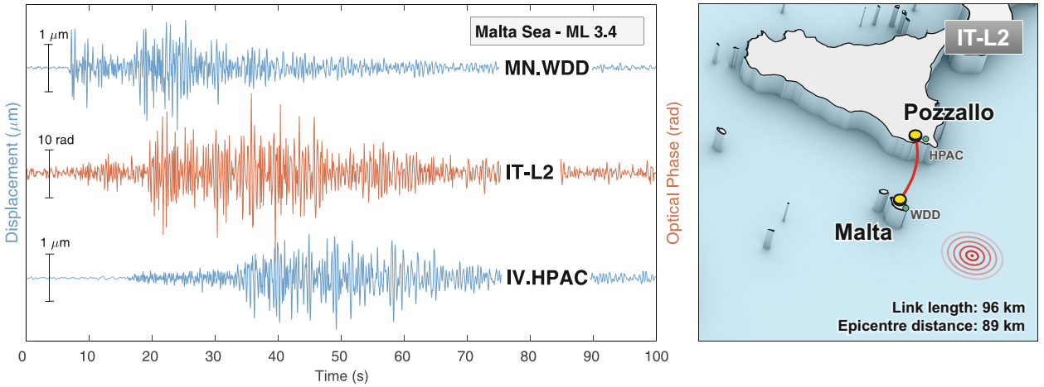
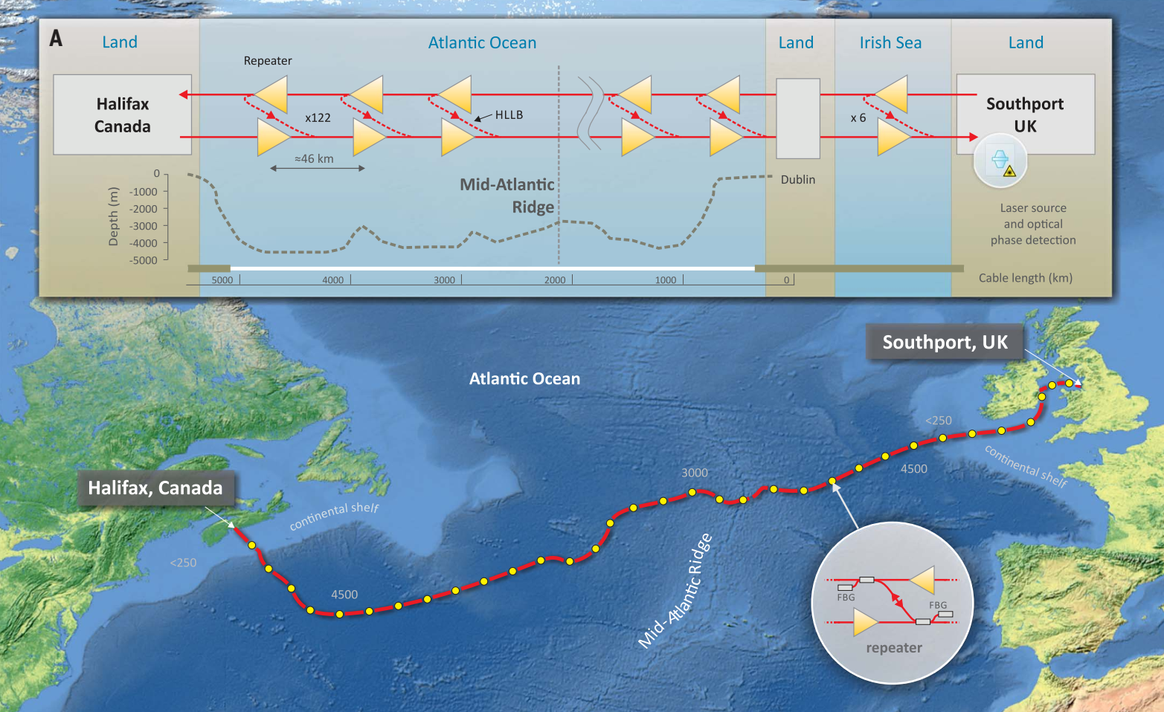
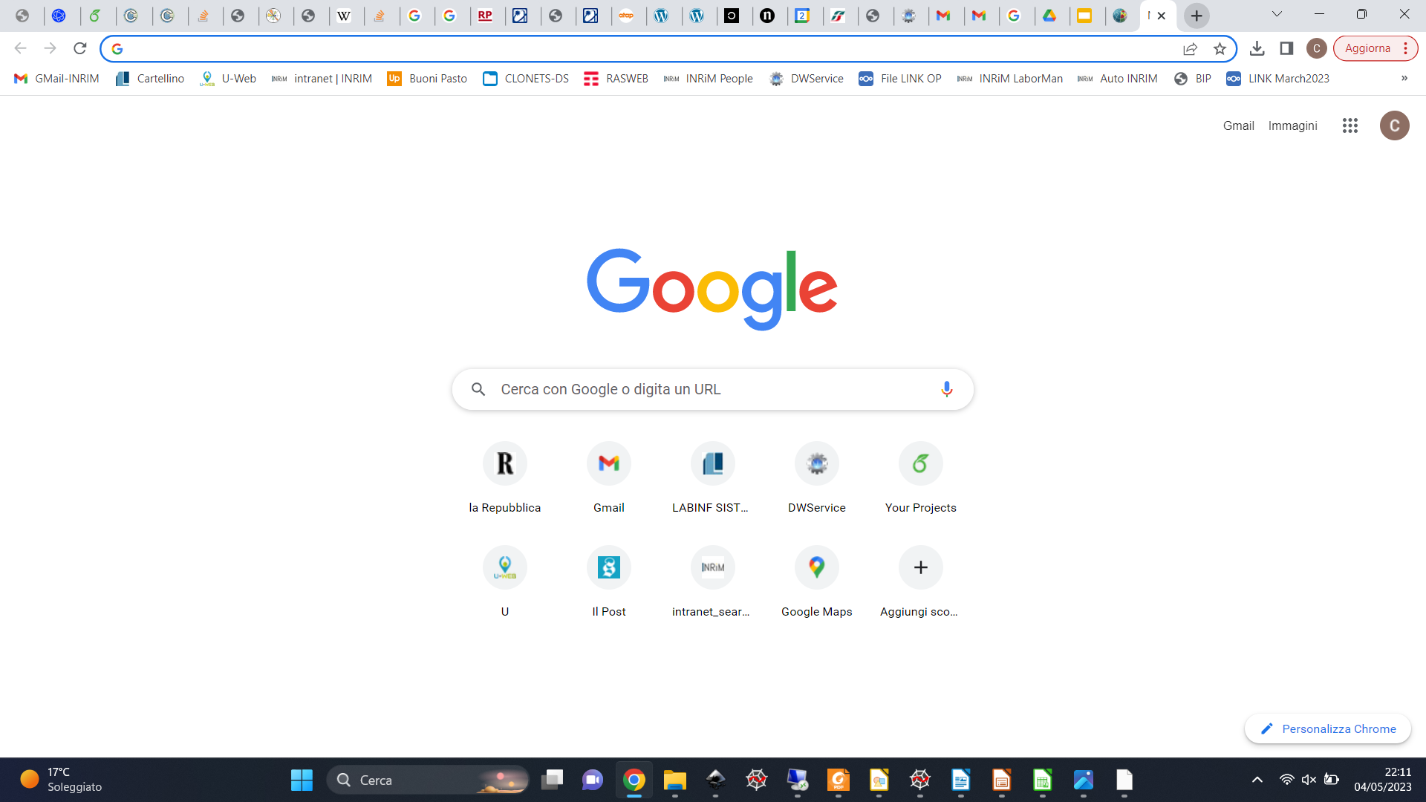


Accessing remote areas with coherent laser interferometry
Fiber
+ span-wise resolution!
Fully-compatible with data networks
Gives access to unexplored areas
Poor resolution (100 km), work in progress
G. Marra et al., Science 361, 6401 (2018)
G. Marra et al., Science 376, 874 (2022)

Slide 14
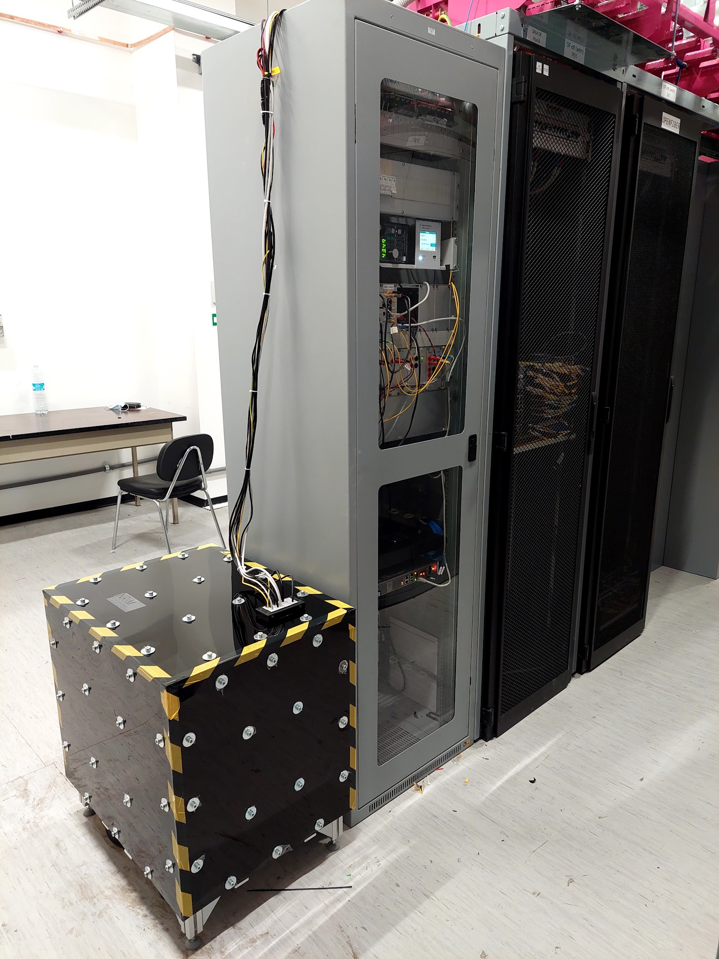
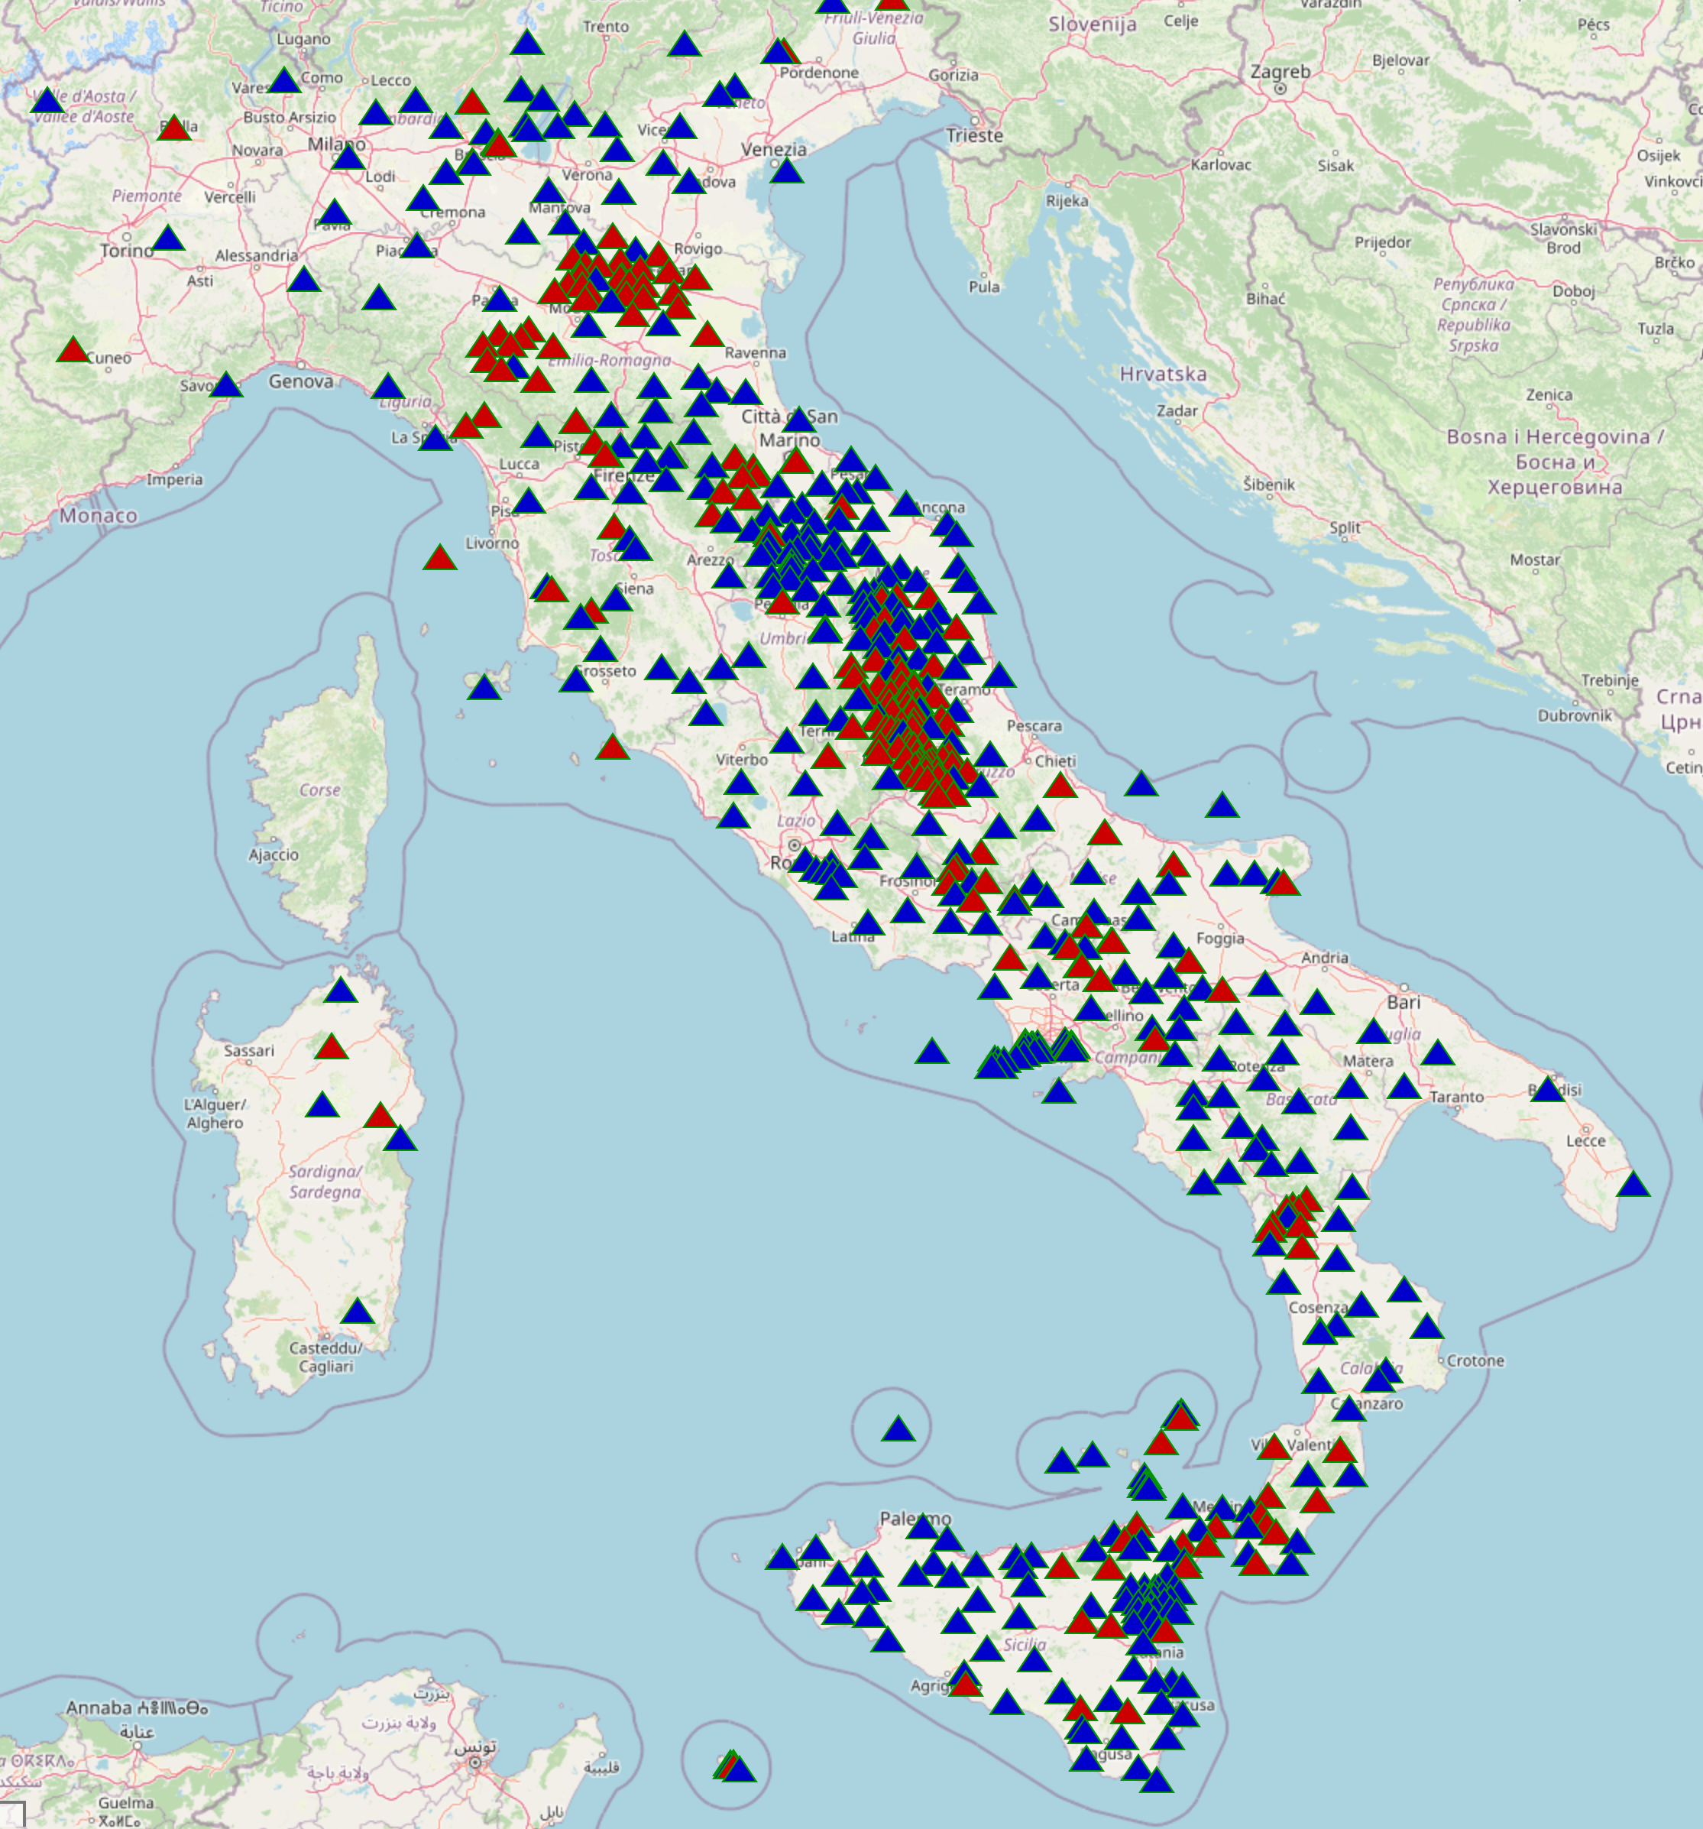
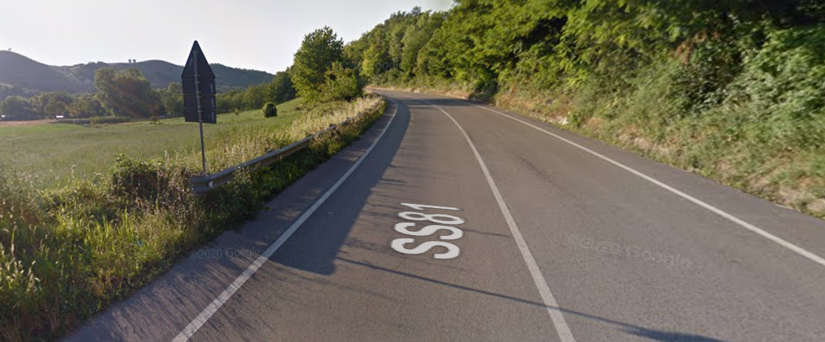
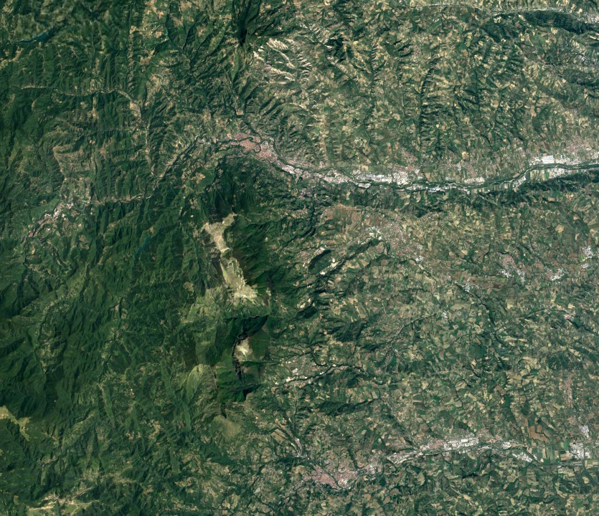



Coherent laser interferometry on land
10 km
Ascoli
Laser interrogator
in network shelter
The link:
32-km long,
100 Gb/s QPSK
Fibers complement & enhance
the existing sensor networks
Teramo

Slide 15
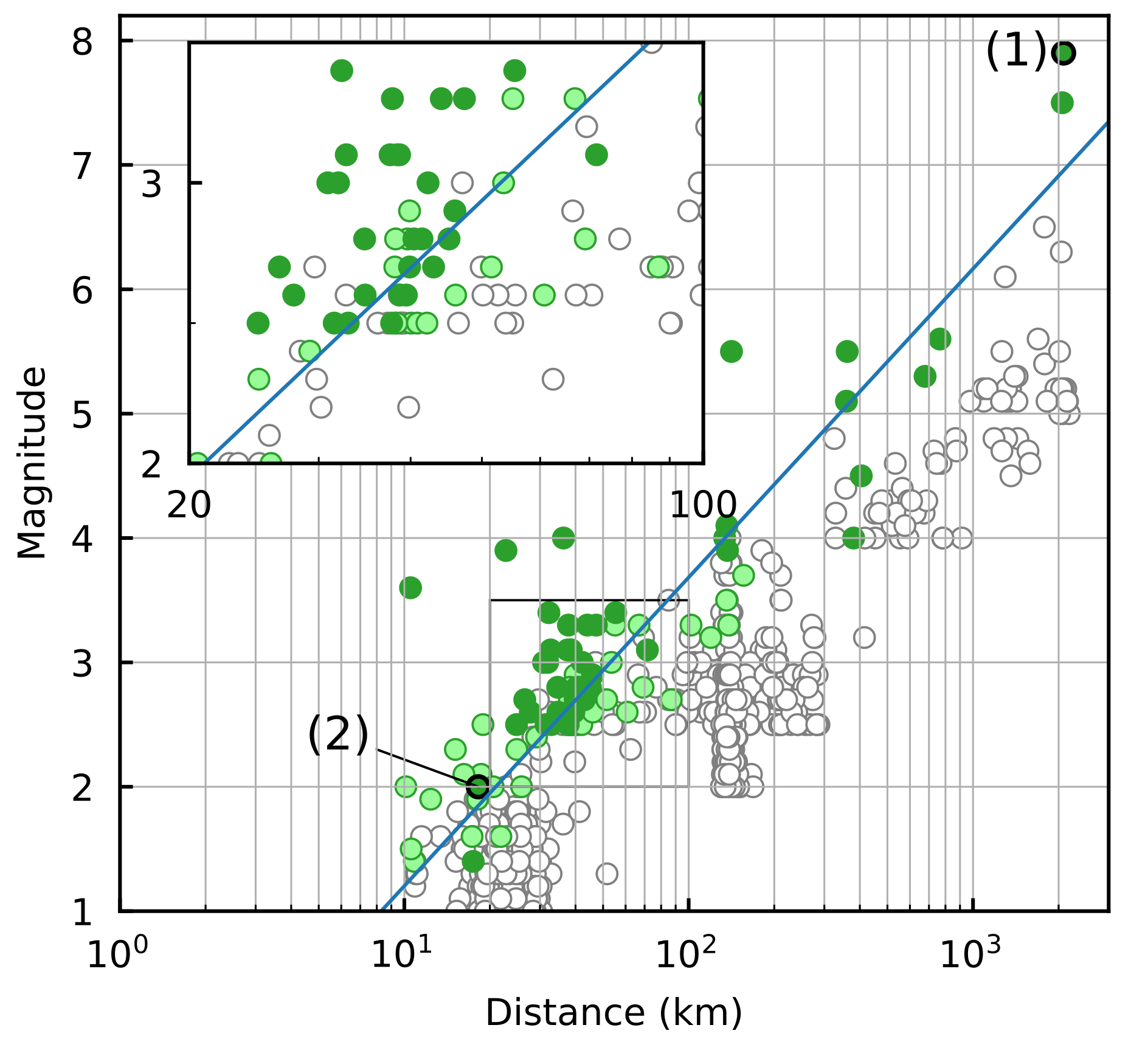
Coherent laser interferometry on land
2-year-long acquisition
No disturbance to data traffic
Very rich dataset of events
Detection probability related to distance and magnitude
Very weak events are detectable!
S. Donadello et al., (2023), arXiv:2307.06203

Slide 16
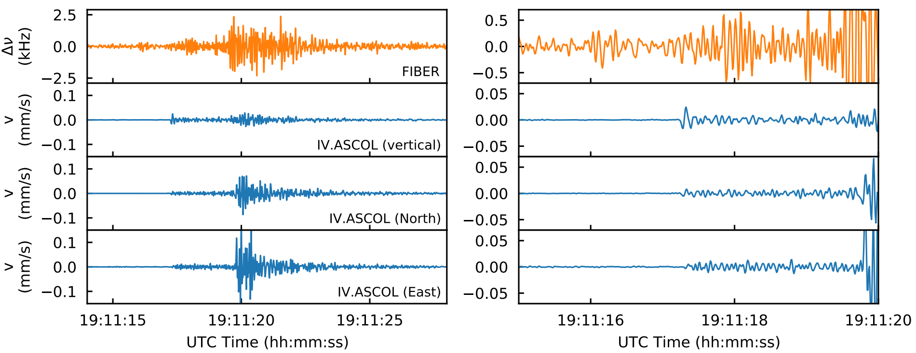
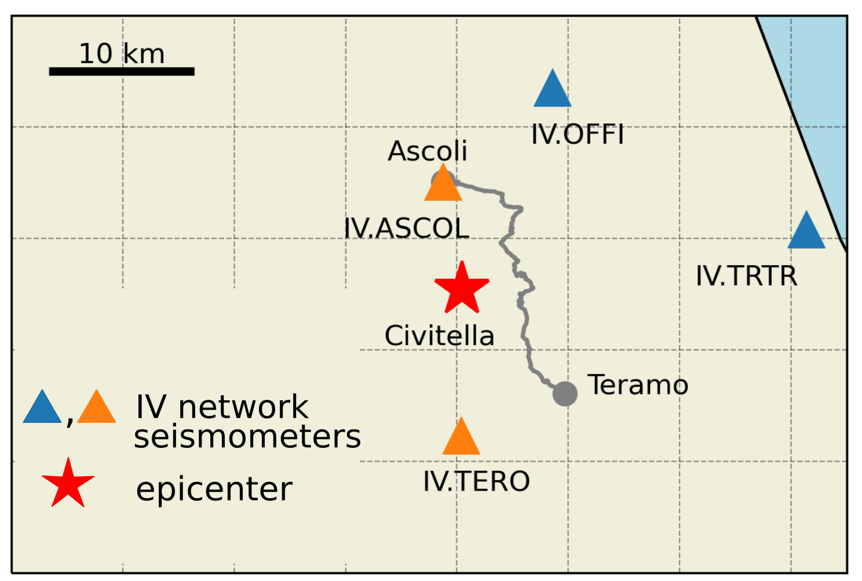
Detecting weak, local earthquakes
Civitella (TE), Feb. 19th, 2022
magnitude 2.0, distance 18 km
S. Donadello et al., (2023), arXiv:2307.06203

Slide 17
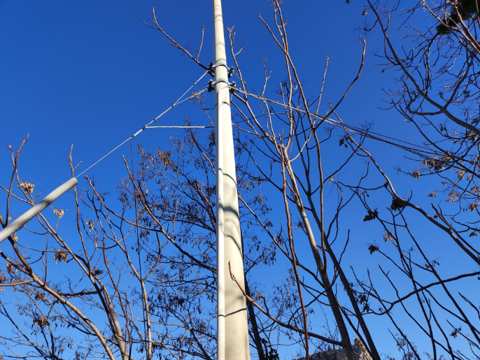
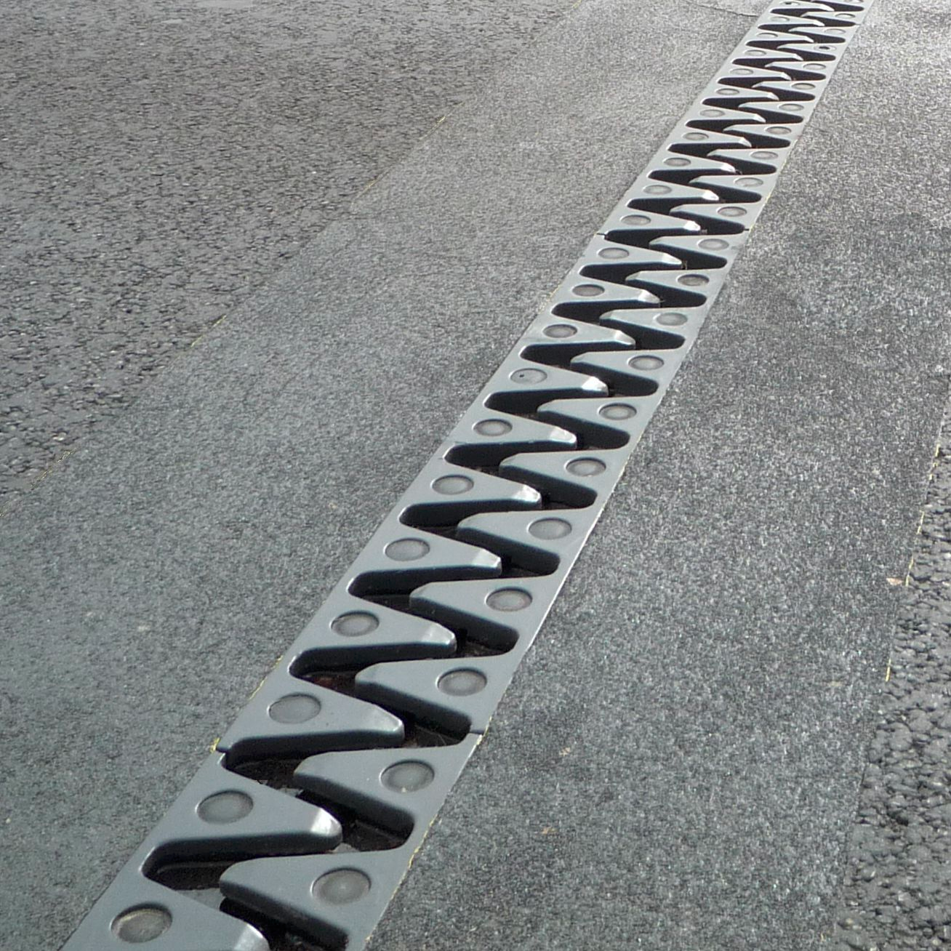
Besides earthquakes
Periodical resonances: aerial cables shaken by wind
Strong day/night variations: human activities
Impulsive events: vehicles on road joints

Slide 18
Integration and scalability
Weak event detection on a pervasive network helps seismic monitoring
Scalable, $$ ( ), reaches remote regions
Laser interrogator is complex and bulky
(<600 L)
(< 1 L)
(< 0.001 L)
Yesterday:
Lab equipment brought to the field
Today: Commercial devices,
partly suitable
Tomorrow:
On-chip laser integration

Slide 19
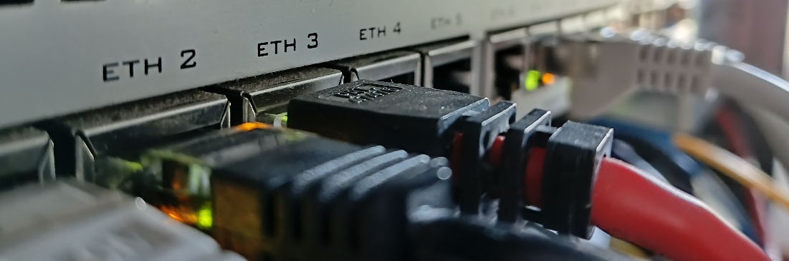
Sensing while carrying data /2
1981:
OTDR
invention
1988:
1st fiber cable
in Atlantic Ocean
2008:
Coherent Optical
Communications
1975-1978:
1st discrete
fiber sensors
1986-1989:
Brillouin/Raman-
scattering sensors
2005:
OTDR used
for sensing
2013-2014:
Fiber sensing
in geosciences
2021:
Telemetry-based
sensing
2018:
Coherent Laser
Interferometry
Telemetry-based sensing:
In coherent communication, huge amount of info computed (State of polarization, Phase, Dispersion, GVD …)
«Re-use» them for sensing
Takes advantage of laser integration
Z. Zhan et al., Science 371, 931 (2021)
E. Virgillito et al., ICTON 2023, Mo.D1.3 (2023)

Slide 20
Concluding remarks
Each technique (OTDR, laser interferometry, telemetry…) has peculiar strengths and optimal field of application
Fiber offers great opportunities for global monitoring
Earthquakes, volcanic, tsunamy early warning
Mobility management, infrastructure monitoring in smart cities
A complement, not an alternative, to traditional sensing
Sensitive
OTDR
Laser
Interferometry
Telemetry
Scalable
Cheap

Slide 21
Thank you
Cecilia Clivati
INRIM, Torino
c.clivati@inrim.it
www.inrim.it

Slide 22
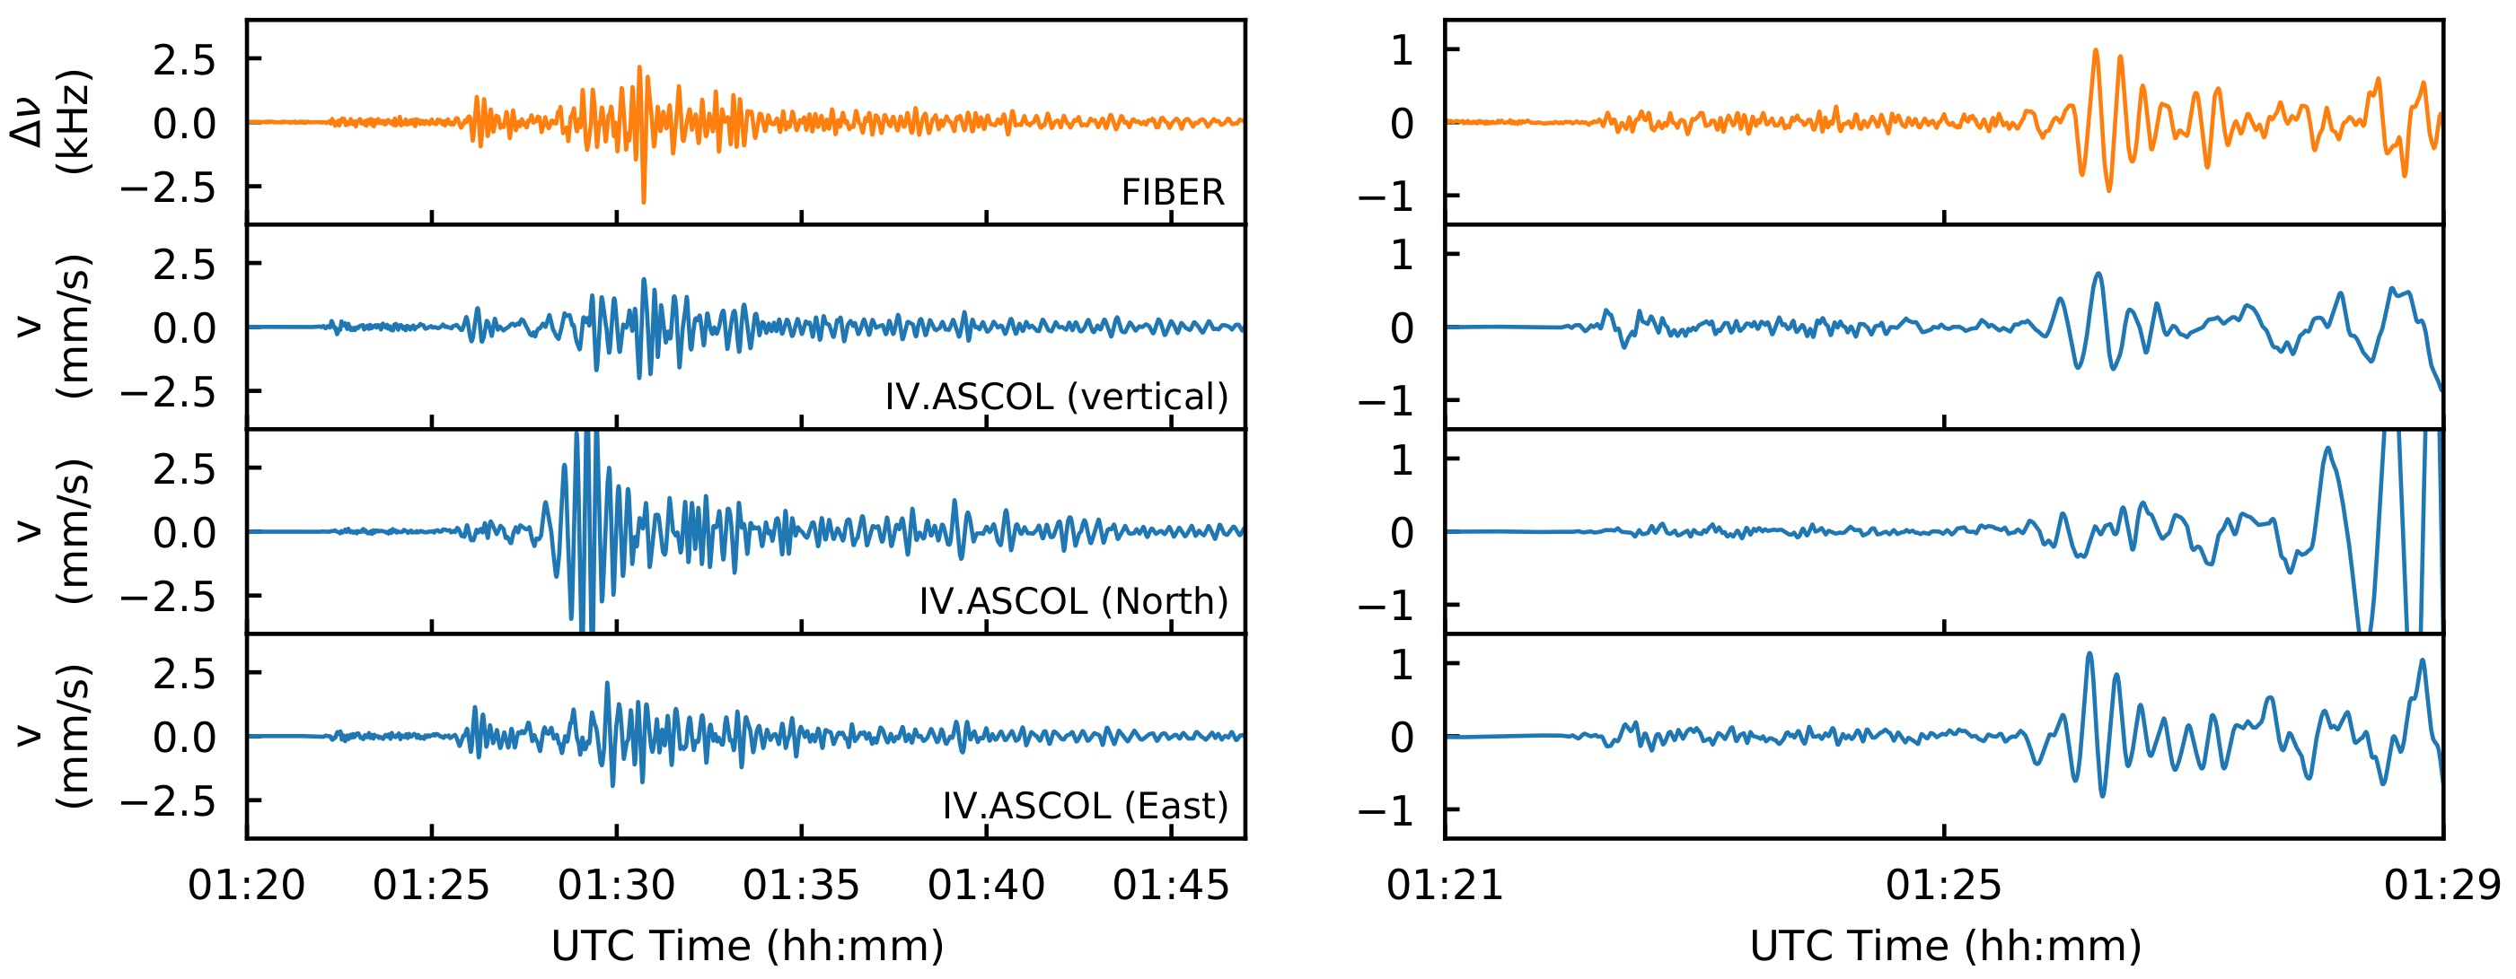
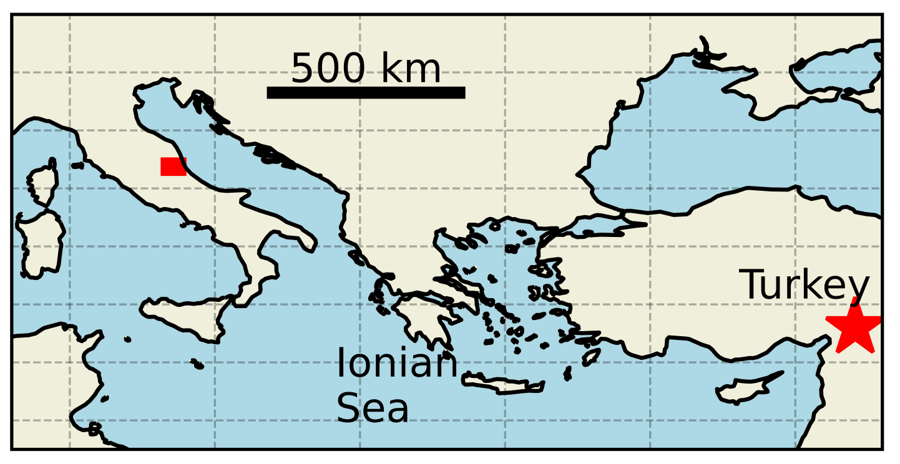
Detection of strong, distant earthquakes
Turkey, Feb. 6th, 2023:
magnitude 7.9, distance 2100 km
S. Donadello et al., (2023), arXiv:2307.06203

