Slide 1


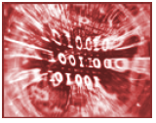

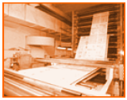

neuGRID
A Grid Based e-Infrastructure
for data archiving/communication and computationally intensive applications in medical sciences

Slide 2



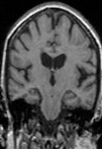





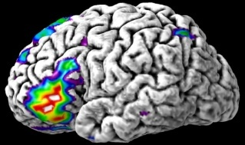





Project Introduction
Clinical Expertise
Basic Neuroscience
Physical Sciences
High-performance Infrastructure
Imaging Technology
National Alzheimer’s Centre Fatebenefratelli, Brescia, ITALY
GB Frisoni, Coordinator
University of the West of England, Bristol, UK
Richard McClatchey, Technical Supervisor
Karolinska institutet, SWEDEN
Lars-Olof Wahlund
Vrije Universiteit Medical Centre, THE NETHERLANDS
Frederik Barkhof
Prodema GmbH, SWITZERLAND
Christian Spenger, Alex Zijdenbos
Maat Gknowledge SL, SPAIN
David Manset
HealthGrid, FRANCE
Yannick Legré, Tony Solomonides
CF consulting s.r.l., ITALY
Carla Finocchiaro

Slide 3
Problem Description & Objectives

Slide 4
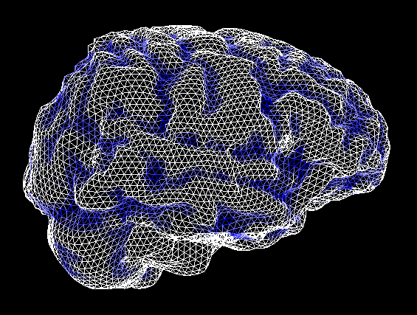
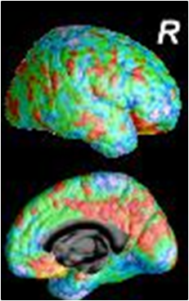
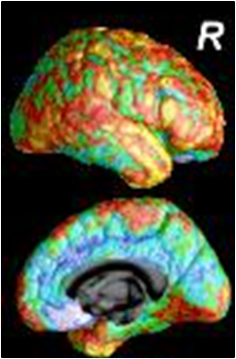
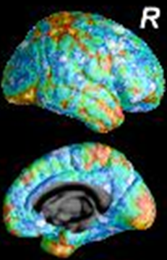
Imaging Markers for Alzheimer’s
Gray Matter Loss
Isolated Early Consolidated
Memory Disability Disability
Problems

Slide 5

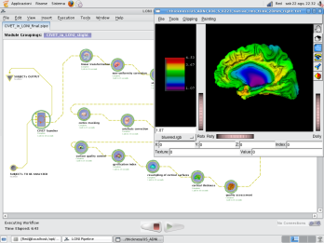
Imaging Markers & Pipelines
Toolkits
What are markers used for?
  To support physicians in diagnosing diseases,
  To measure disease evolution,
  To assess treatment(s)/drug(s) efficacy,supporting pharma
  industries in drug developments,
  To further understand diseases and brain anatomy and functions
How do such markers materialize?
  Data mining Algorithms and Pipelines of Algorithms
  Heterogeneous Algorithms and Pipelines toolkits (I.e. FSL, MRIcron, FreeSurfer, MNI/BIC, LONI, SPM, etc..)

Slide 6
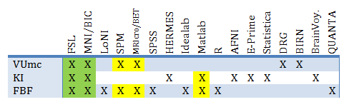



Imaging Markers Pipelines
Characteristics
Pipeline
Anatomy
Pipelines encompass Knowledge
Pipelines are Heterogeneous
Pipelines are sometimes Interactive
Pipelines are Iterative and Recursive
Pipelines are mainly Task-based
Pipelines are mainly Sequential
Pipelines are Computing Intensive
Pipelines are Data Intensive

Slide 7
Objectives

Slide 8
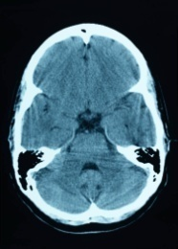
TODAY
COMPUTATIONAL
CENTRE

Slide 9

TOMORROW
neuGRID

Slide 10
TOMORROW
neuGRID

Slide 11
Architecture & Infrastructure

Slide 12
System Architecture (3/3)
Service Oriented Architecture
Highly Specialized
Interfaces
Portal
(A series of *web* interfaces exposing the functionality to end-users from login, to data acquisition, quality control,
Workflow authoring ... and much more! The Portal approach beyond accessibility advantages, allows harmonizing the software offer)
Web
Common Purpose Interfaces
Business Logic
(NeuroSciences Specific Services)
Specific to Project
(can theoretically be partly reused in
similar projects since
abstracted from underlying IT)
Privacy
(All services necessary to guaranty privacy
Over medical data storage, access and
Sharing. Privacy related services must
conform with ethical EU/National regulations)
Workflow Management
(SOA Governance is in charge of defining, accessing,
executing, operating and maintaining reusable services
with appropriate quality of services and conforming with
all other requirements, e.g. Security, privacy...)
Security
(All services concerned with authentication, authorization
within the neuGRID platform)
Domain Logic
(Medical Generic Services)‏
Monitoring, Logging and Accounting
(Provides the mechanisms to store, archive and sort all log information.
The layer is concerned with services which allow efficient monitoring
of all infrastructure resources , and from which higher level logic such
as Provenance can extract useful historical data)
Generic to Medical domain
(can theoretically be reused in other medical applications)
Backends Abstraction
(Software abstraction from databases, grid, enactment environments...)
Generic to ALL domains
(can theoretically be fully reused)
Backends Middleware
(Underlying IT legacy assets, e.g. EGEE gLite, mySQL, LONI, Oracle 11g...)
Notes:
Regular SOA layers have been described here and when felt necessary split in separate layers (e.g. Security and Privacy are here materialized in 2 distinct layers since privacy actually stops at the abstraction level unlikely to security)

Slide 13
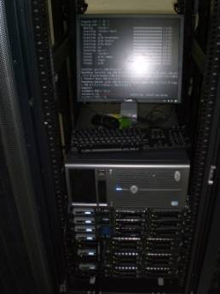

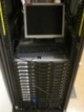
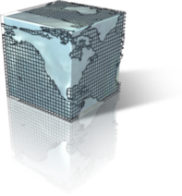


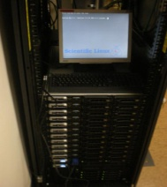
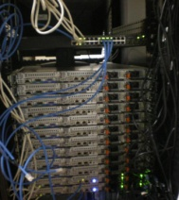
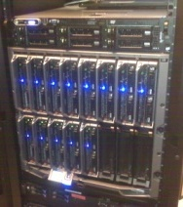
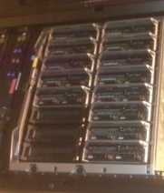


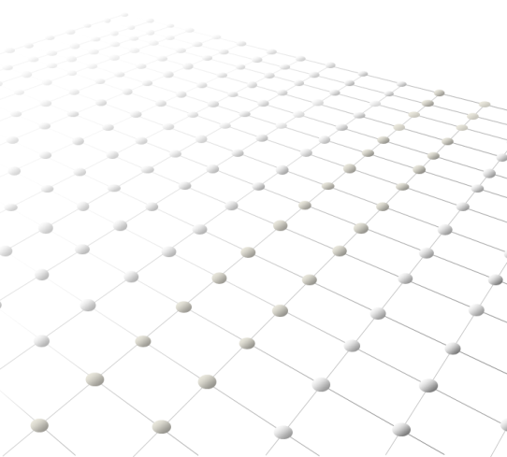






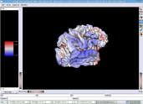
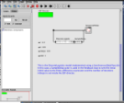
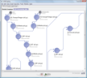
neuGRID Infrastructure
LEVEL 0
Deployed since Sept 2008
Data Coordination Center
LORIS
Grid Coordination Center
20 Mb/s
DEPLOYED
AUG 2009
DEPLOYED
APR 2009
Expected SEP 2009
Provenance Pipeline
LEVEL 1
Grid SOA Workflow
Slave LORIS
Slave LORIS
Slave LORIS
All DACS Sites connected to GEANT2 Network
Scalable Robust Distributed
DACS1
DACS2
DACS3
100 Mb/s
100 Mb/s
1 Gb/s
USERS
Exploitation 2010
Pipelining
Corelab
New Markers

Slide 14
Web Portal

Slide 15
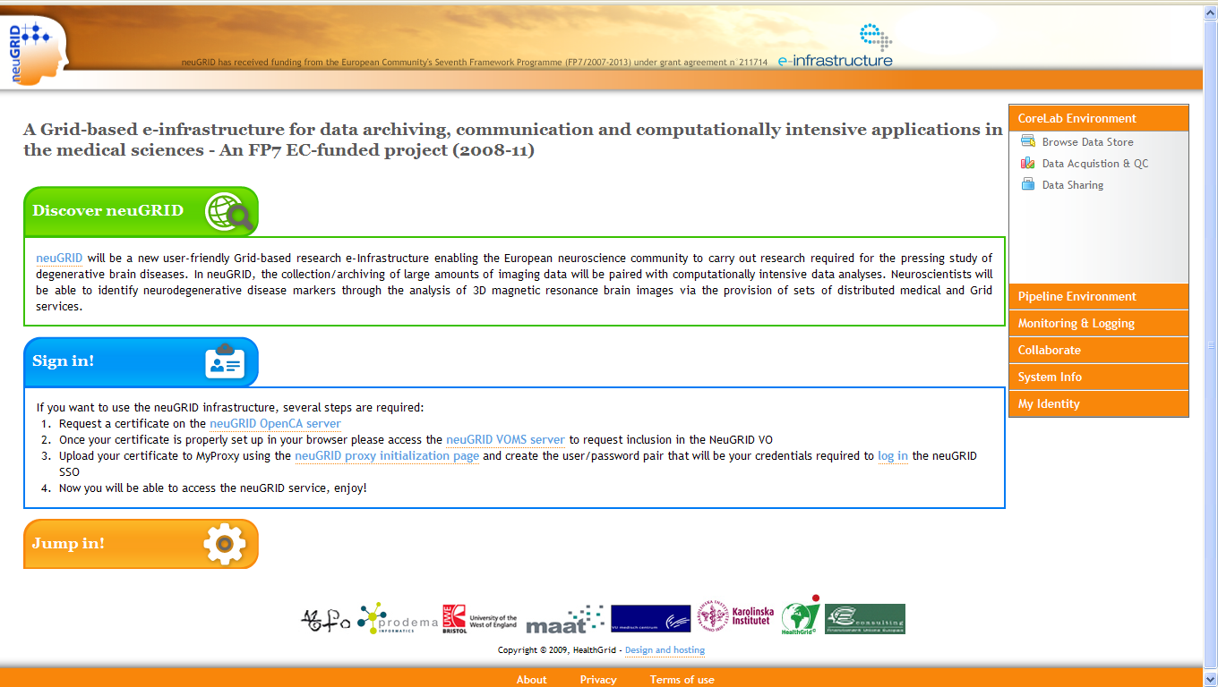



Prototype Web Portal (2/3)
Web Interface
Web Portal
AJAX-based Portal
CAS SSO Framework
  Grid Proxy Applet
  MyProxy Session
Solution Highlights
  Simple and standard Web portal
    No third party software installations required,
    Cross-OS solution,
  Lightweight access to large Grid infrastructure,
  Integrates latest security and Web standards

Slide 16
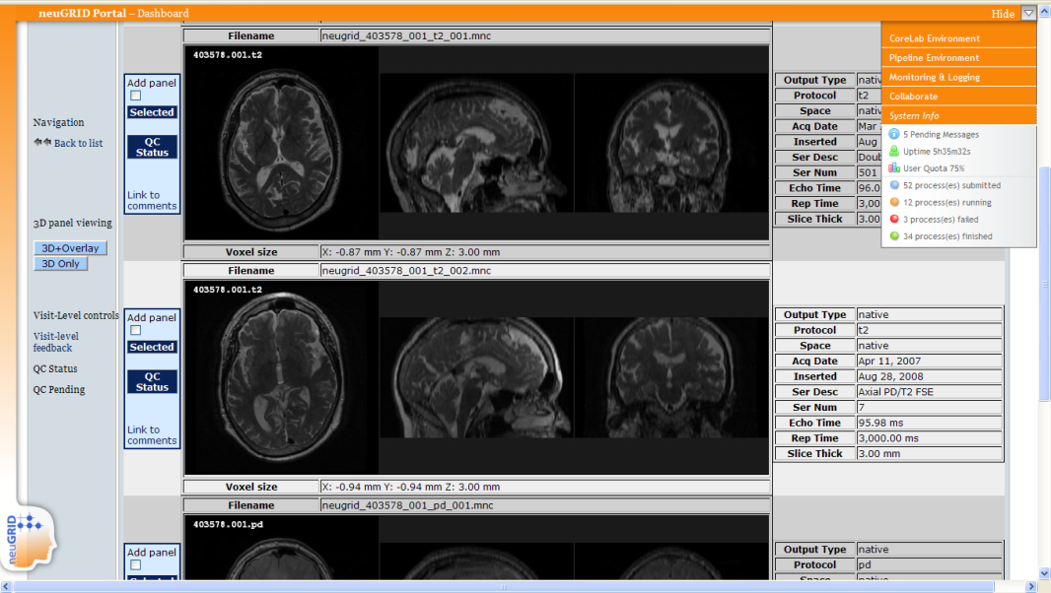
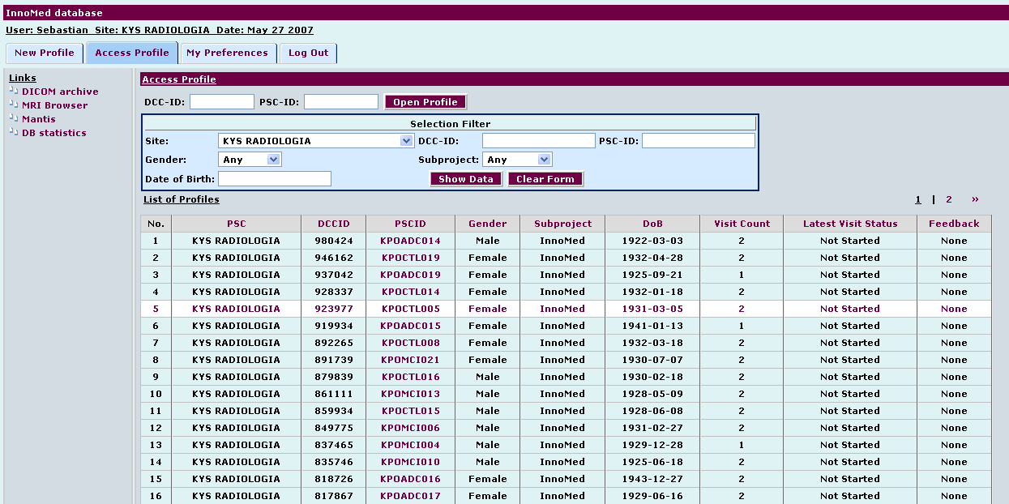
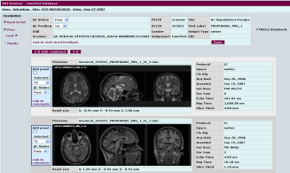
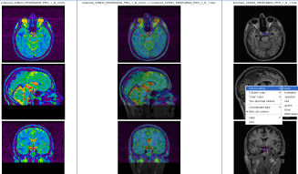
Data Acquisition & Quality Control (1/3)
LORIS Database
LORIS Database
Connected to SSO
Interfaces to Data Acq
Interfaces to Data QC
Basic Data Visualisation
Solution Highlights
  Data acquisition and management interfaces,
    CLIs provided for use in the Grid,
  Quality Control interfaces
    MANTA tracking system,
  JIV Viewer for displaying scans,
  Simple query interface to interact with the archive.

Slide 17
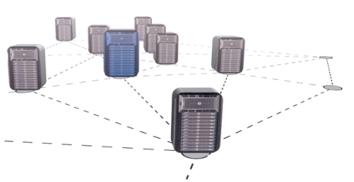


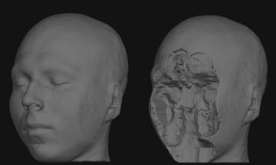
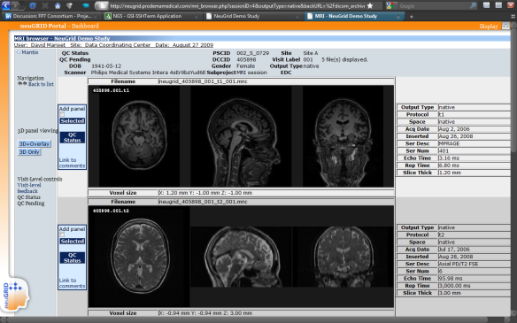
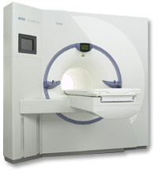
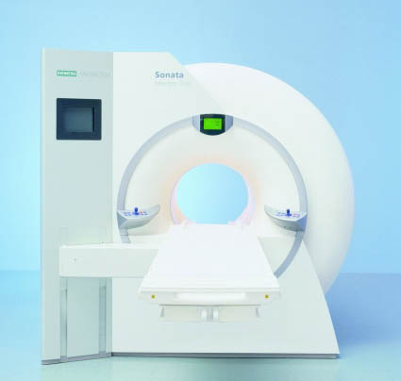
Data Acquisition & Privacy (3/3)
Pseudonymization & Defacing
LEVEL 1
Abstraction
Abstraction
Abstraction
Slave LORIS
Slave LORIS
Slave LORIS
DACS2
DACS3
DACS1
DPM
CE
SE
WNn
1. From Imaging
Appliances to the Grid:
Pseudonymization
2. Within the Grid:
Defacing (face scrambling by
removing nose/mouth areas
from the images
3. Data import from the Grid to
the LORIS Database.
Data quality control.
2-level anonymization to avoid backward traceability of patients’ identity from metadata and/or 3D face reconstruction

Slide 18
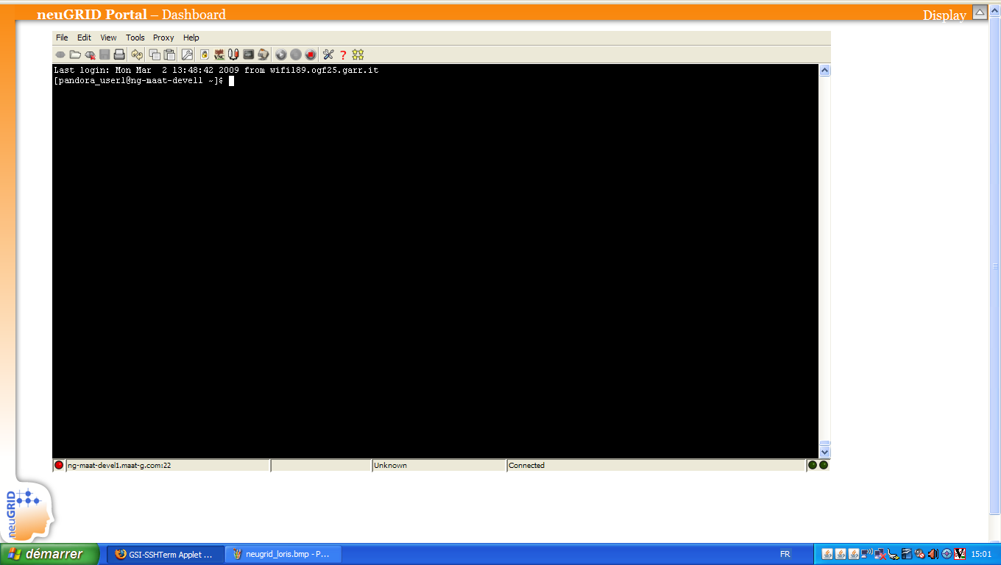
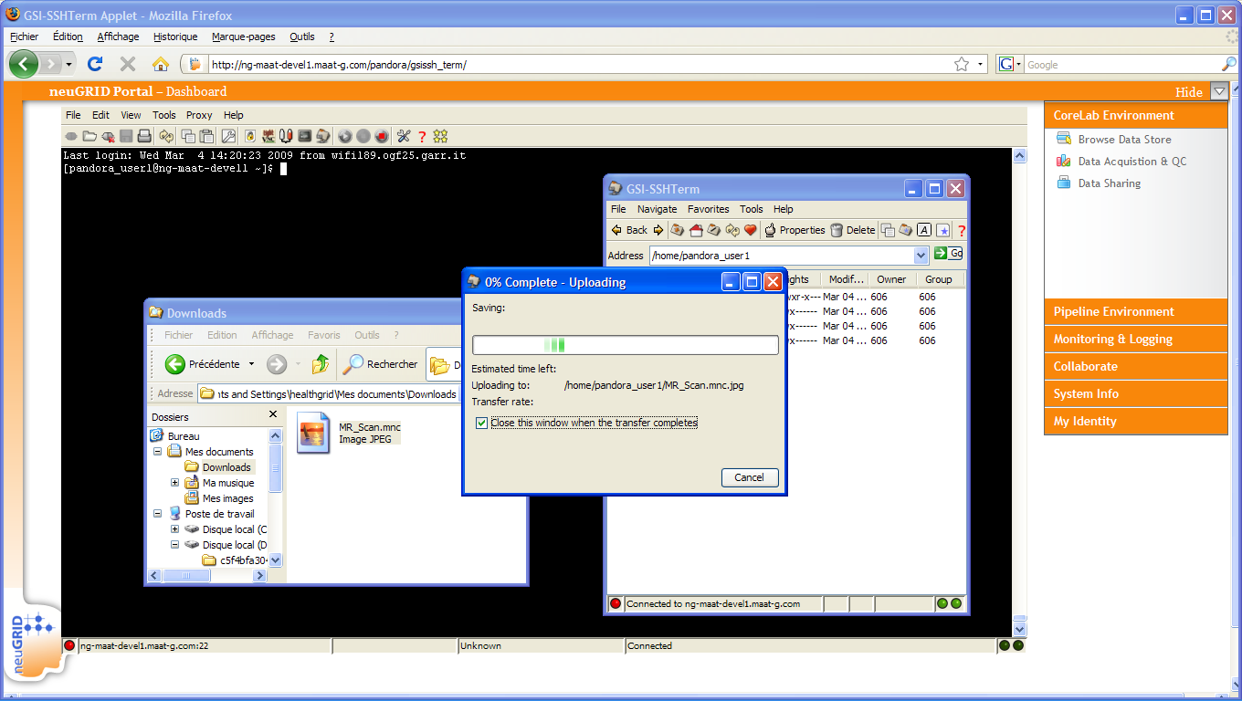
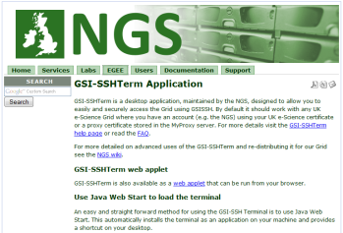
Accessing the Grid (1/2)
Online Grid Shell
Online Shell Access
GSISSH Applet
  Access to Grid Infra.
CIVET Pipeline gridified
SFTP Facility to Upload
Solution Highlights
  Shell-like facility, full scripting environment,
  Outside researchers can upload and process their own data without installing any Grid related software,
  Direct access to gridified pipelines and algorithms,
  GSISSH applet from NHS

Slide 19
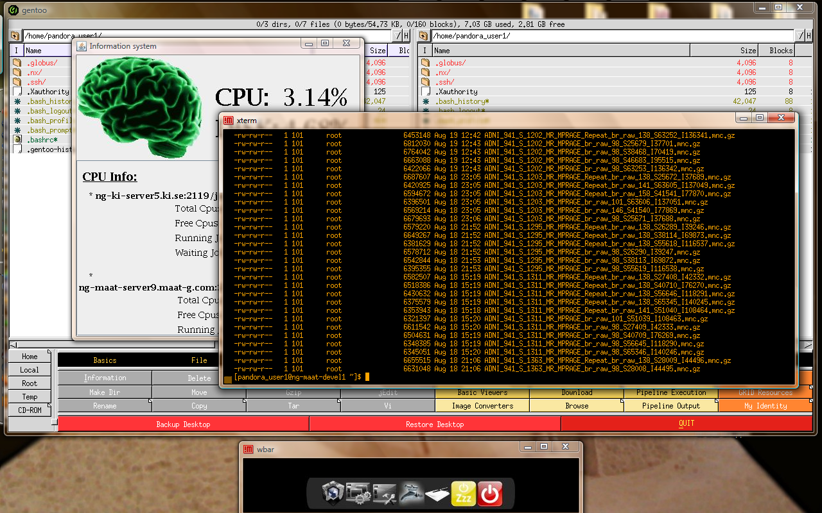

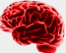
Accessing the Grid (1/2)
Desktop Fusion
Desktop Fusion
Remote Desktop
VO Box to use the Grid
File Sharing
Post-processing tools
Solution Highlights
  Combines a high performance remote desktop
  technology (i.e. NX Nomachine) with VO-Box, file sharing
  and advanced data mining tools:
  - Neuroimaging toolkits: MRIcron, FSL, BIC, LONI Pipeline
  - Scripting environment: gLiteUI, generic file browser etc
  Gentoo generic file browser used as a switchtender to more advanced applications
  Allows researchers to automatically share their desktop and thus upload seamlessly medical data to be processed

Slide 20
Neuroscientific Pipelines
Gridification
The CIVET Example

Slide 21
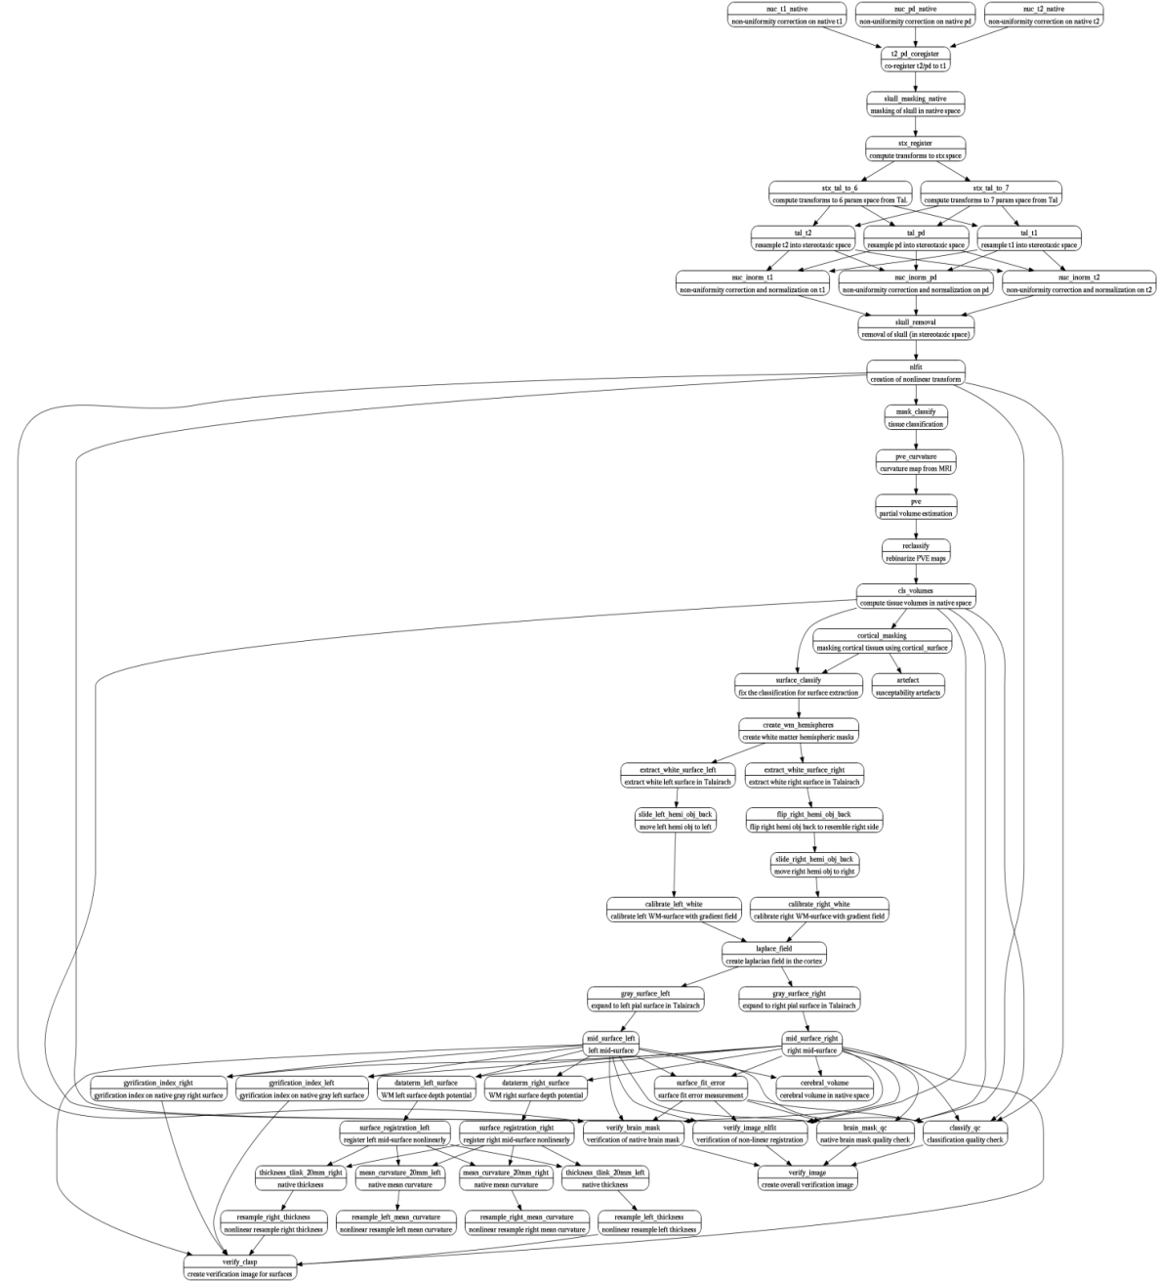

CIVET Pipeline
Gridification
CIVET Pipeline Characteristics
7 hours of processing on 1 single scan using standard CPU
Data intensive, can create up to 10x input data. Output of 1 processed scan ~100MB
Various software dependencies have been identified
Gridified both 32/64-bit versions
* CIVET Execution Trace

Slide 22
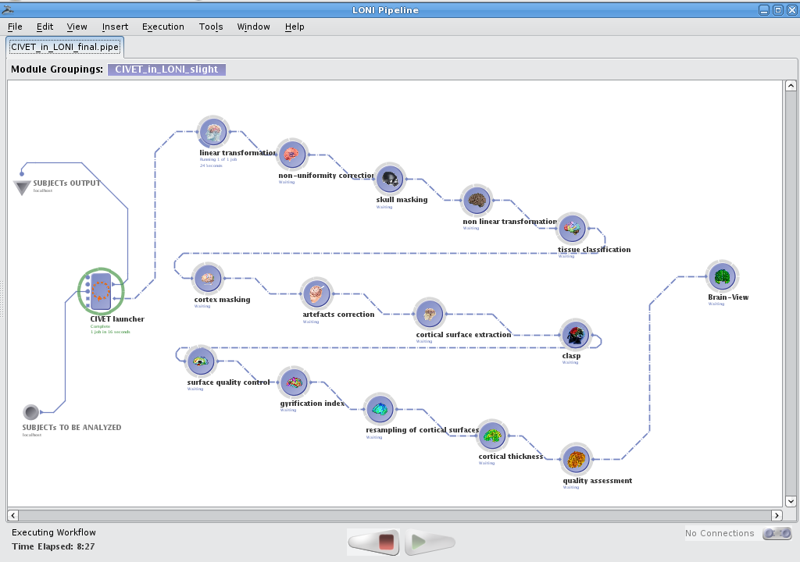
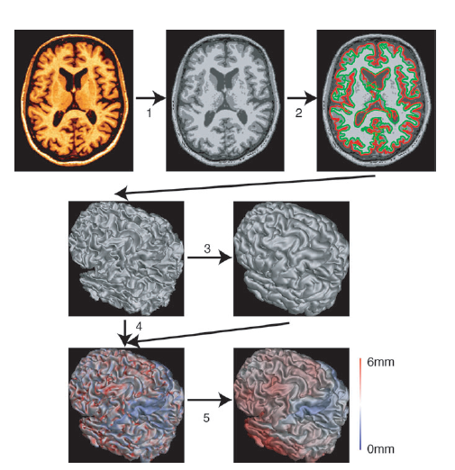
CIVET Pipeline
Pipeline Description
Alzheimer's characterized by heterogeneous distribution of pathological changes
throughout the brain.
One marker for the disease-specific atrophy is the thickness of the cortical mantle
across the brain
Non uniformity correction, skull
masking and tissue classification
* CIVET Representation in LONI Pipeline
Cortex masking and surface extraction
Gyrification index, resampling of
surface and cortical thickness
46 processing steps,
  Involving 59 modules using a combination of MINC routines (22 routines in total)
Various software dependencies (i.e. R, MINC, BIC etc)

Slide 23
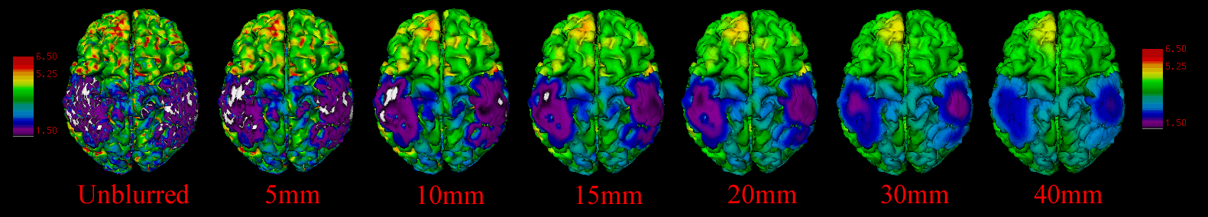
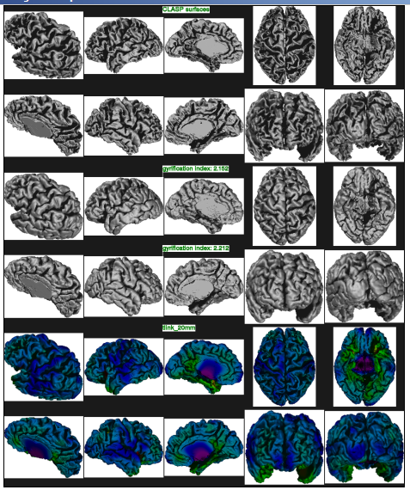
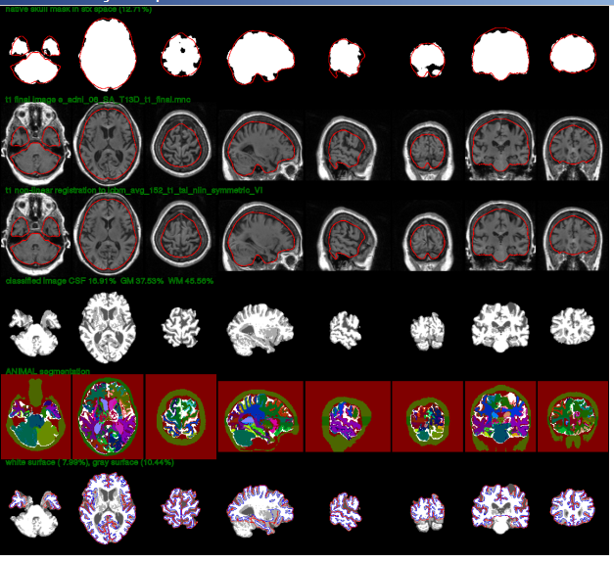
CIVET Output (2/2)
Alzheimer’s Disease
LINK to the neuGRID PORTAL

Slide 24
NeuGRID Data Challenge

Slide 25
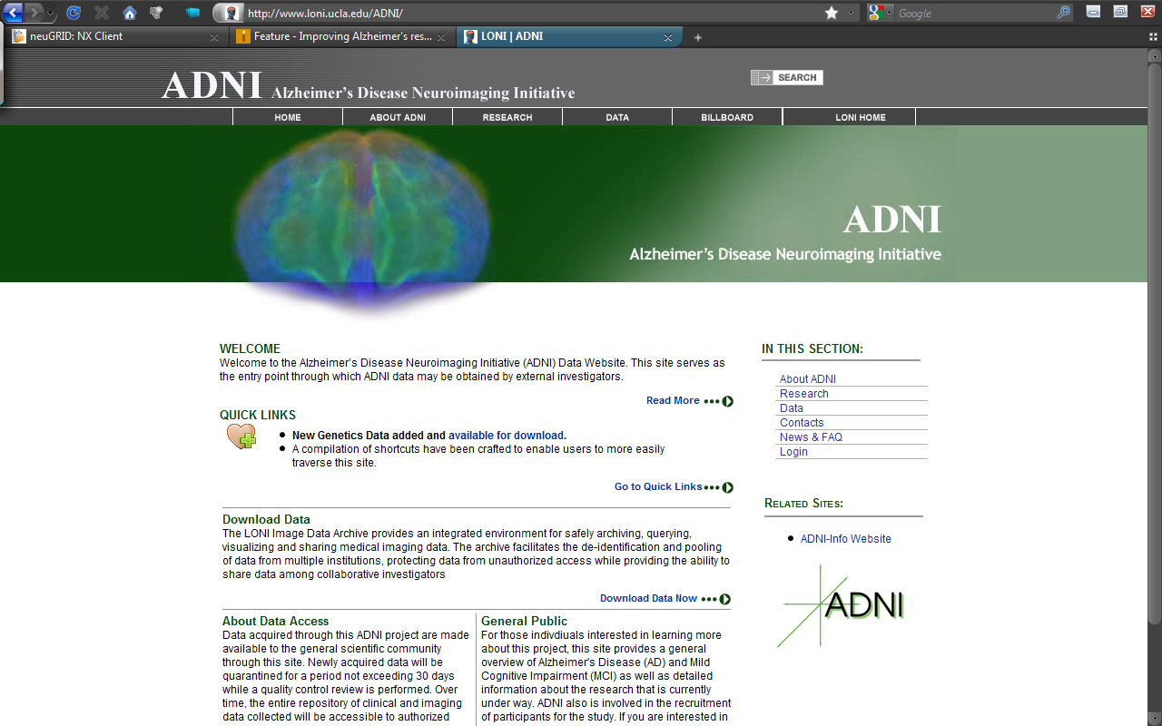
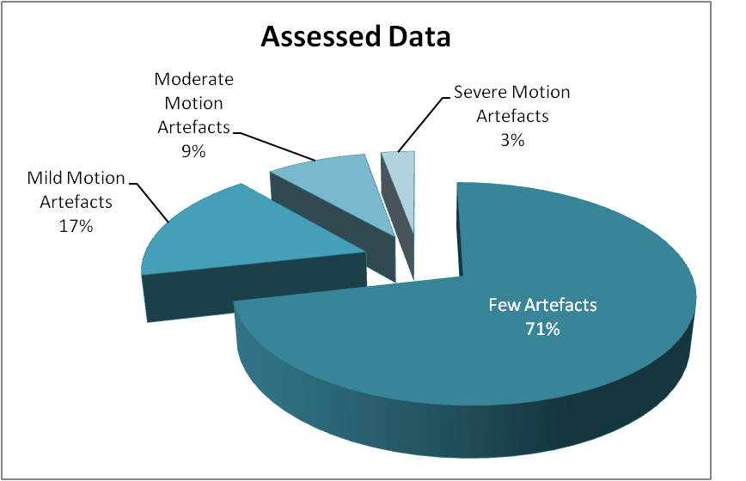
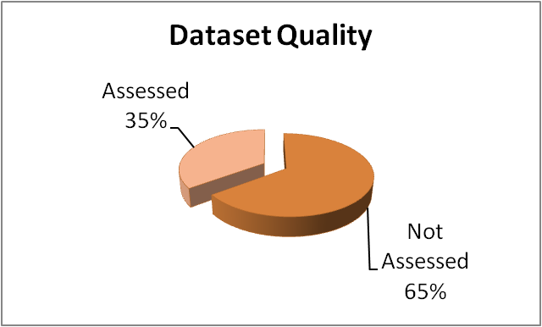

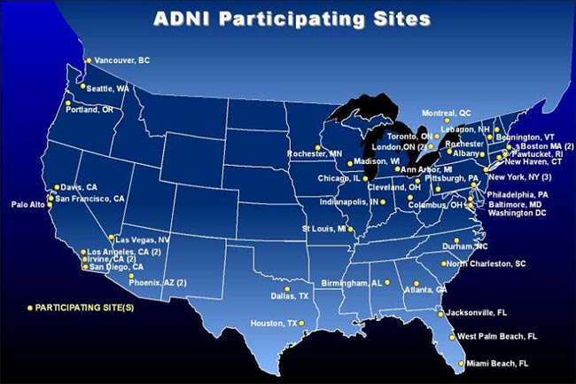
Data Challenge (1/3)
Analyzing the US-ADNI Database
Alzheimer’s Disease Neuroimaging Initiative
  To help researchers and clinicians in developing new treatments and testing their efficacy,
  The ADNI is a multisite, multiyear program which began in October 2004,
  More than 700 subjects recruited, 200 elderly controls, 400 with mild cognitive impairment (MCI) and 200 with Alzheimer's disease (AD)
    Subjects have been followed for 2-3 years and have been seen approximately every 6 months

Slide 26
Data Challenge (2/3)
Facts & Figures
Experiment duration on the Grid | 2 Weeks
Experiment duration on single computer | > 5 Years
Analyzed data Patients MR Scans Images Voxels | 715 6’235 ~1’300’000 ???
Hours of total pipeline processing | 6’300
Total mining operations | 286’810
Operations throughput per hour | 853
Max # of processing cores in parallel | 184
Number of countries involved | 4
Volume of data produced | 1 TB
Expected Results

Slide 27
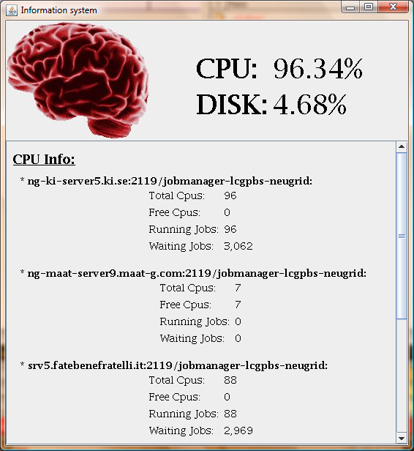
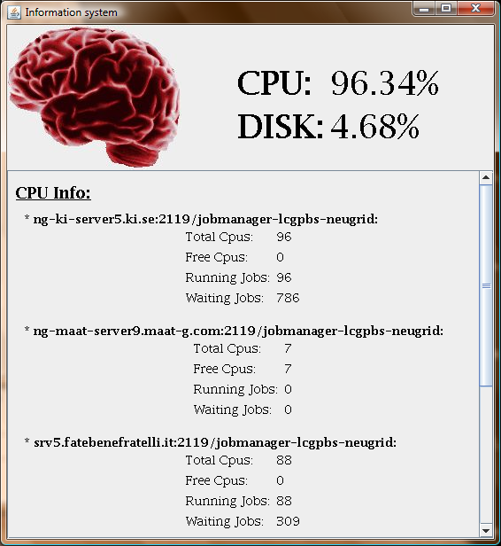
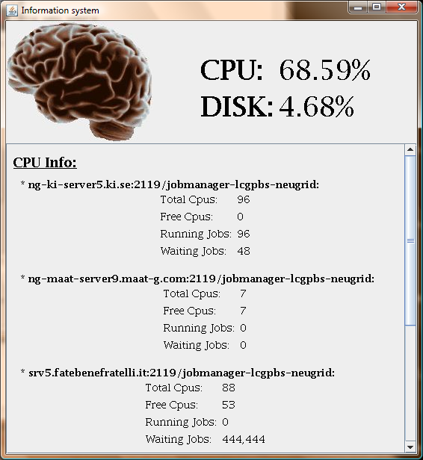



Data Challenge (3/3)
A Difficult Start…
DEFCON3
DEFCON1
DEFCON4
Power cut @ FBF DACS1 site site disappeared from infra, all jobs rescheduled automatically to KI DACS2 site
Live update of FBF DACS1 site from lcg-CE i386 3.1.33-0
to lcg-CE i386 3.1.34-0
Out of Memory @ KI DACS2 site
BUG: WMS Condor-G submits grid_monitor ignoring VOMS FQANs (in the WMS)
t0
t1
t2
t3
t4
t5
t6

Slide 28
Conclusion & Future Work

Slide 29


International Cooperation
Related Initiatives
CBRAIN - Canadian Brain Imaging Research Network
  Recently funded by CANARIE (Canadian Advanced Network and Research for Industry and Education)
UCLA LoNI – Pipeline Environment
Potential infrastructure of:
6’000 Cores for 200TB of storage
Offering advanced capabilities:
State-of-the-art
Main Statistical Toolkits
- A wide range of
generic medical services
A Worldwide Neuroscience Network?

