Slide 1


The last generation of CPU processor for server farm. New challenges
Michele Michelotto

Slide 2
Thanks
Gaetano Salina – referee dell’esperimento HEPMARK in CSN5 dell’INFN
CCR – Per supporto a HEPiX
Alberto Crescente – installazione sistemi operativi e configurazione HEP-SPEC06
Intel e AMD
Colleghi INFN e HEPiX per idee e discussioni
Caspur che ospita: http://hepix.caspur.it/benchmarks
Manfred Alef (GRIDKA – FZK)
Roger Goff (DELL): slides su networking
Eric Bonfillou (CERN): slides su SSD

Slide 3
The HEP server for CPU farm
Two socket
Rack mountable: 1U, 2U, dual twin, blade
Multicore
About 2GB per logical cpu
x86-64
Support for virtualization
Intel or AMD

Slide 4
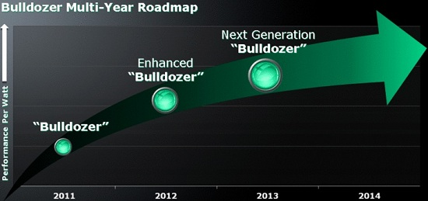
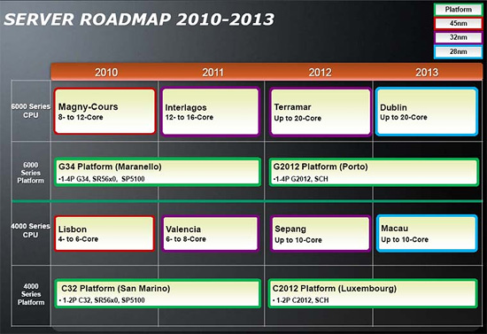
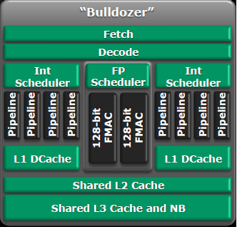
AMD

Slide 5
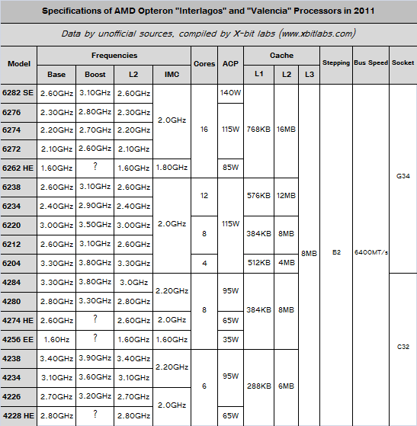
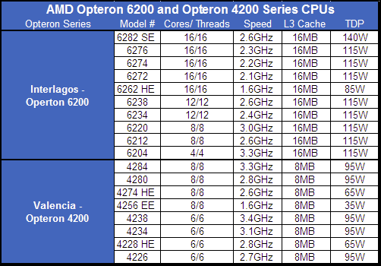
Interlagos

Slide 6
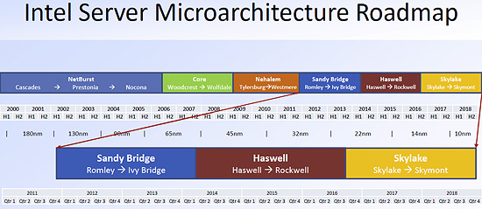
Intel roadmap

Slide 7
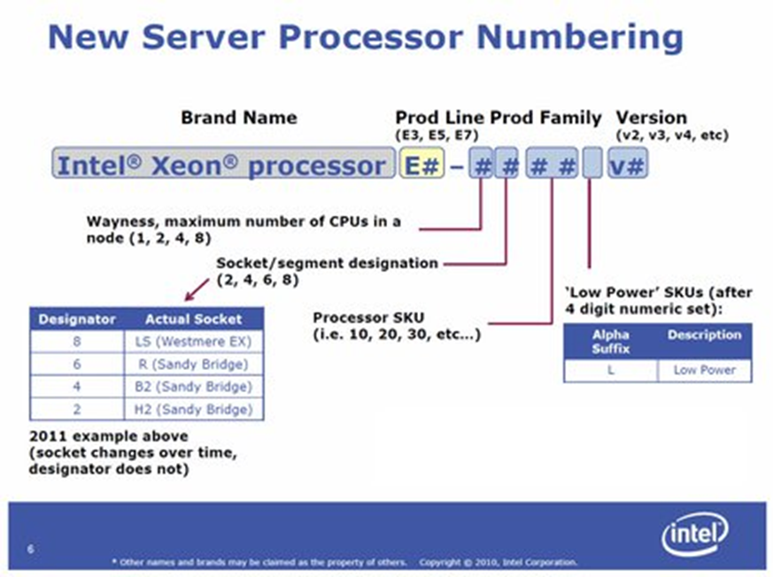
New Intel Naming
After Several generation of Xeon 5n xx
51xx (Woodcrest /Core 2c 65nm)
53xx (Clovertown / Core 4c 65nm)
54xx (Harpertown / Penryn 4c 45nm)
55xx (Gainestown / Nehalem 4c/8t 45nm)
56xx (aka Gulftown / Nehalem 6c/12t 45)
Now Xeon E5 26xx “Sandy Bridge” EP 8c/16t ( @32 nm )

Slide 8
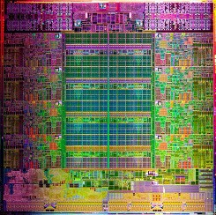
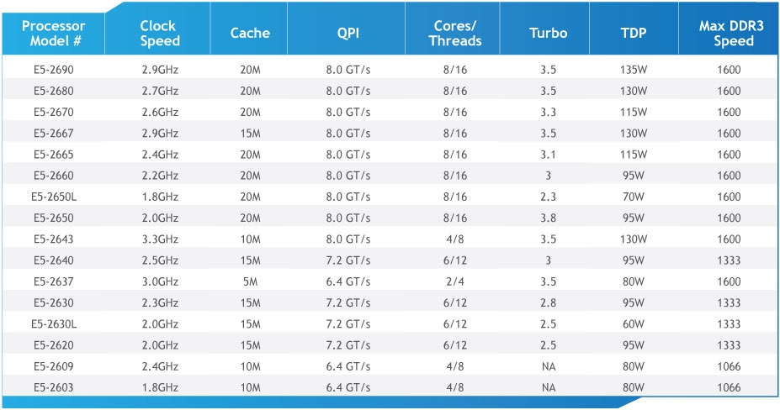
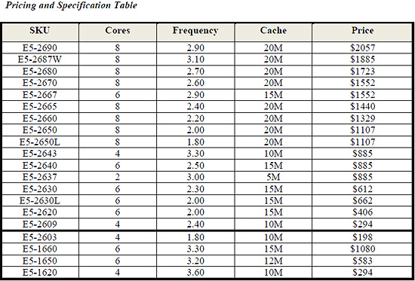
The dual proc Xeon E5 26xx

Slide 9
Configuration Software
Operating System: SL release 5.7 (Boron)
Compiler: gcc version 4.1.2 20080704 (Red Hat 4.1.2-51)
HEP-SPEC06 based on SPEC CPU 1.2 (32bit)
HEP-SPEC06 64 bit (default config + remove “–m32”)
2GB per core unless explicitly stated

Slide 10
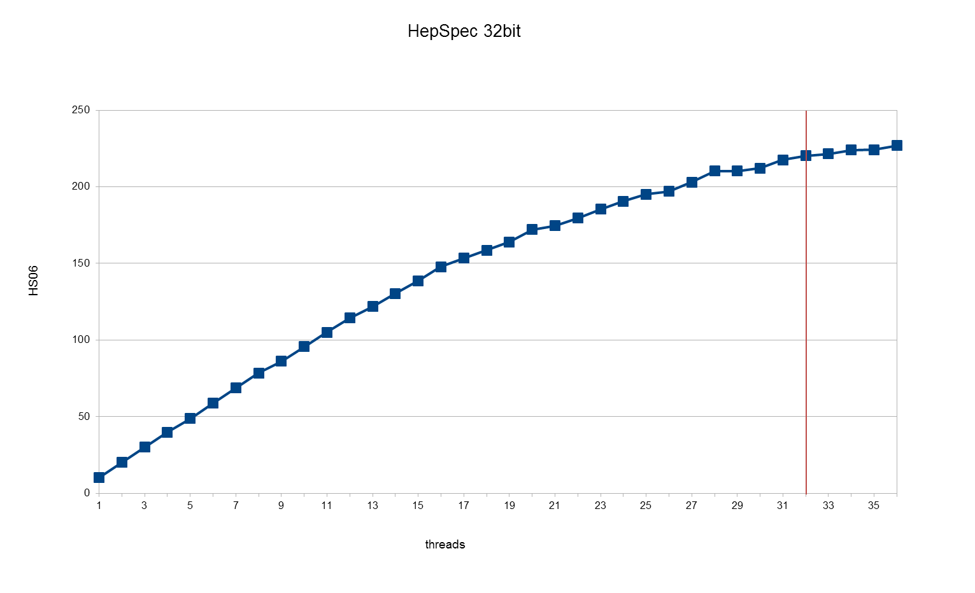
AMD 6272 2x16core 64GB at 2.1( up to 2.6) GHz

Slide 11
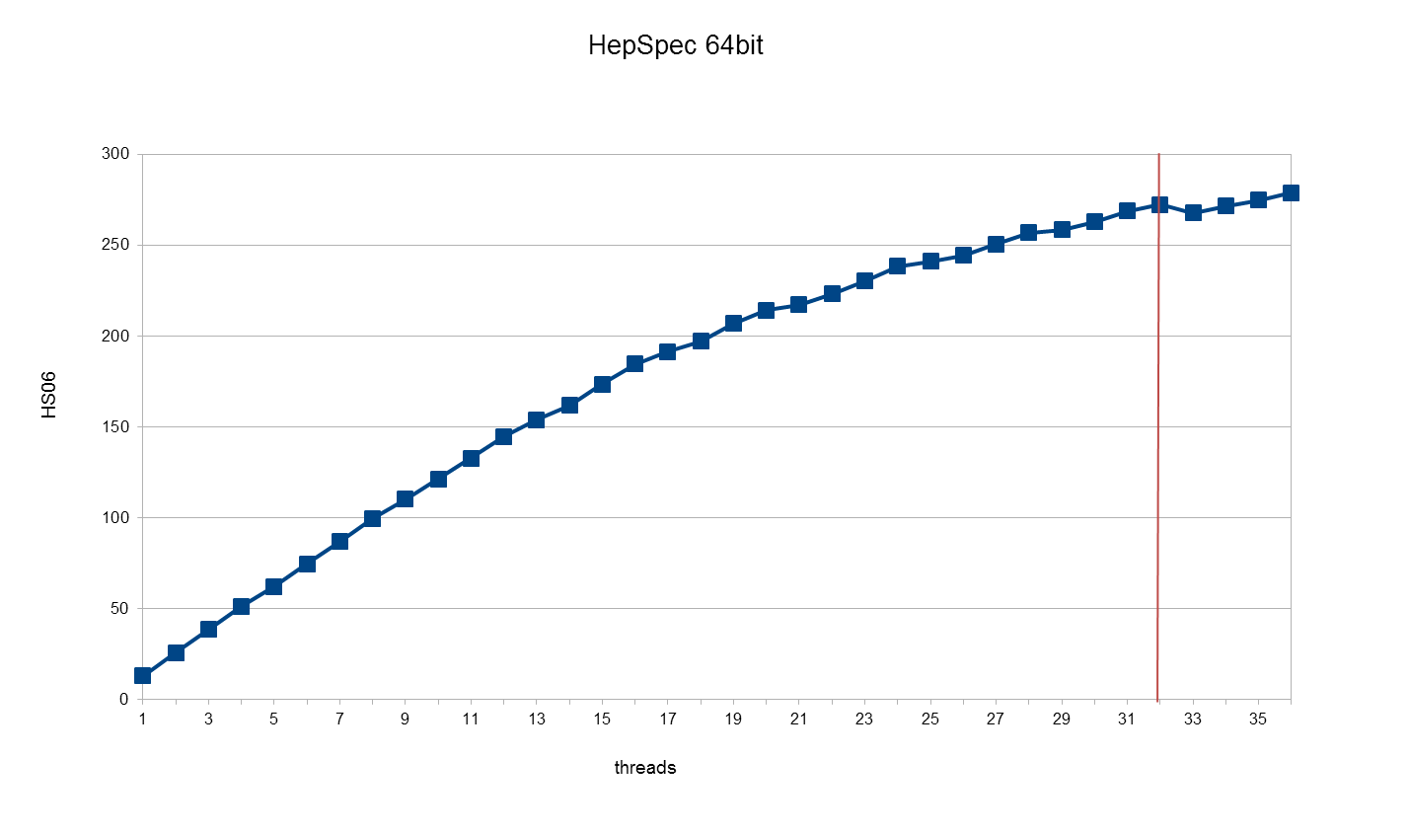
At 64bit

Slide 12
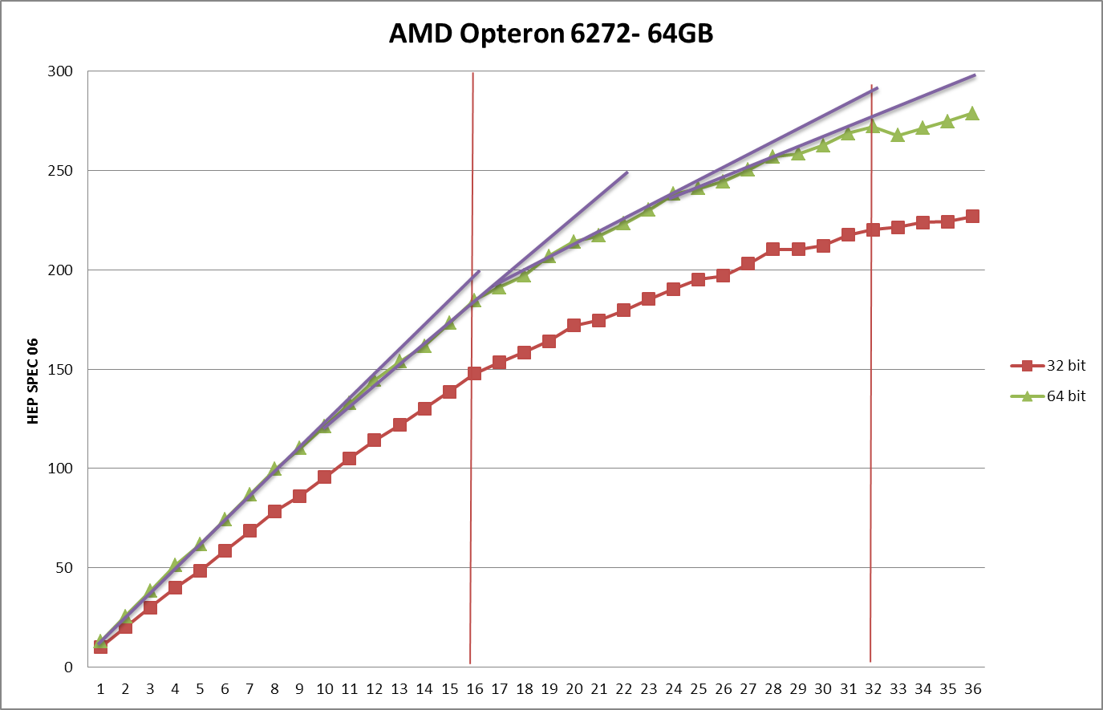
Dynamic clock

Slide 13
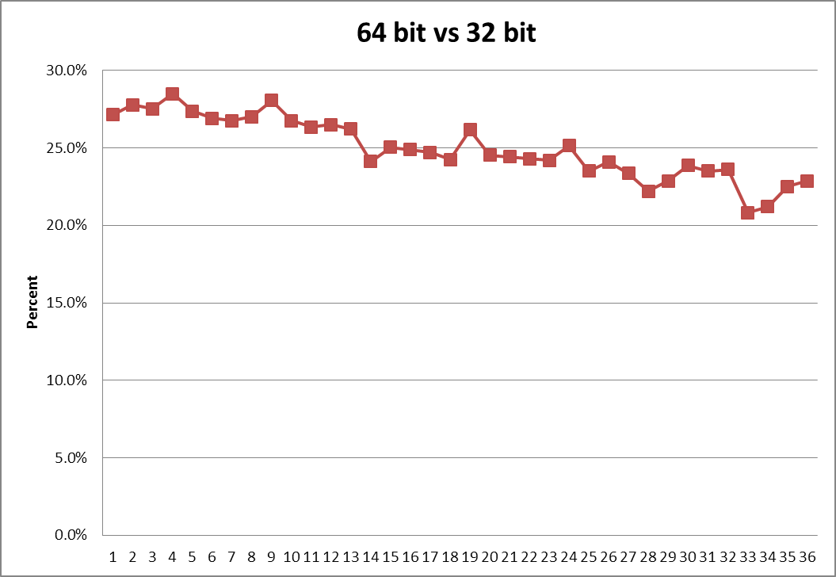
Opteron 6272: from 32 to 64 bit

Slide 14
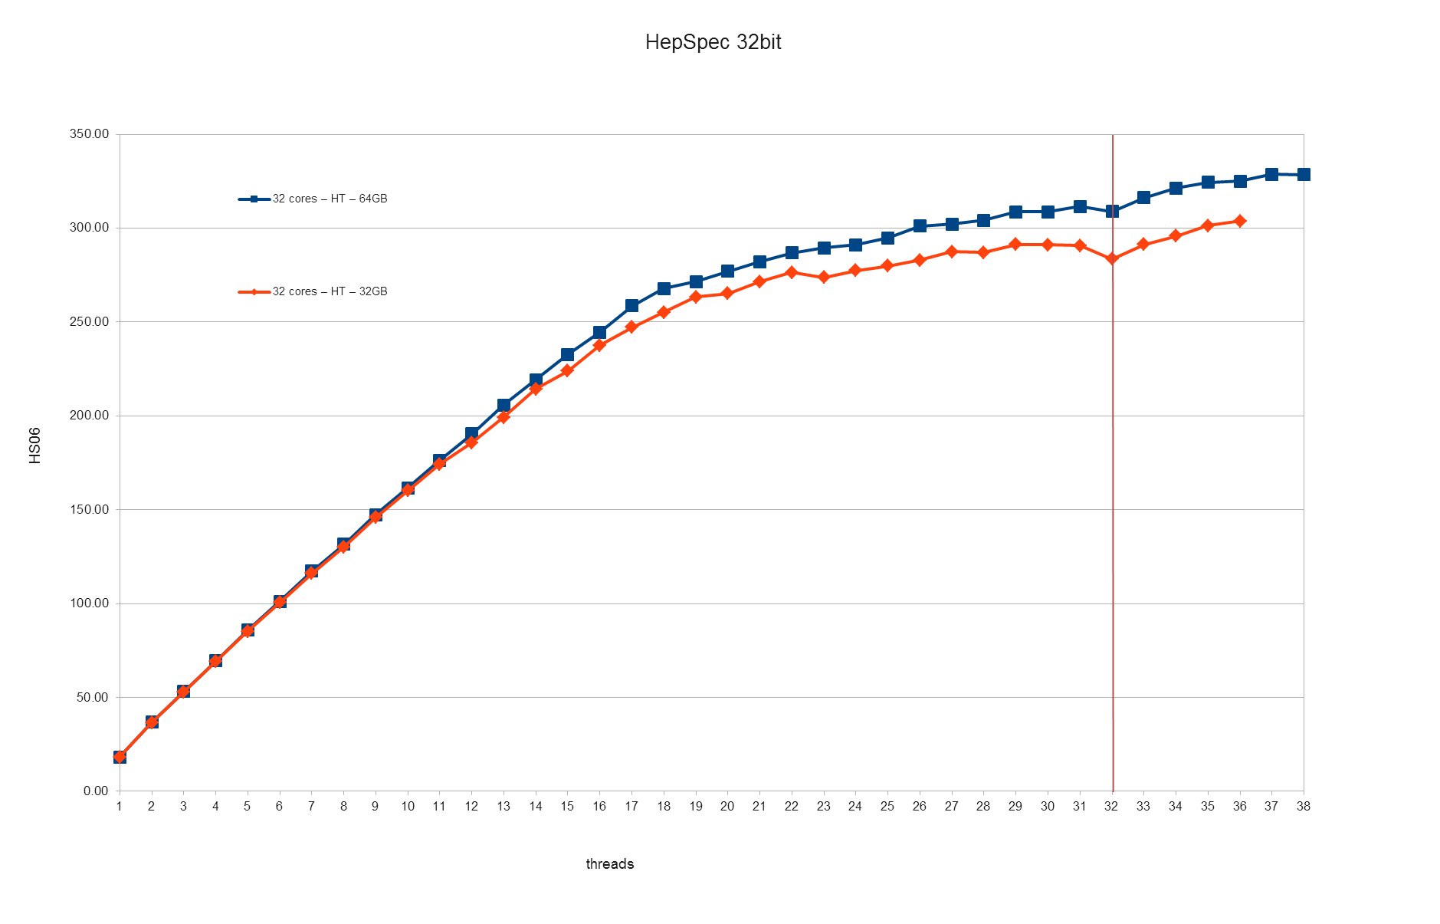
Intel Xeon E5 2660 2x 8c/16t 64GB at 2.2 (up to 2.8) GHz

Slide 15
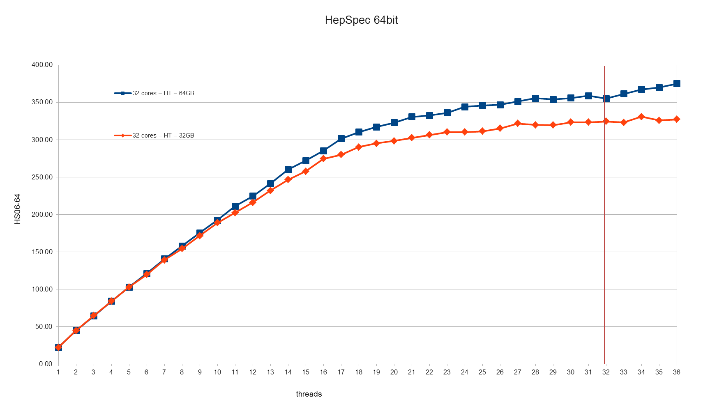
Xeon E5 at 64 bit

Slide 16
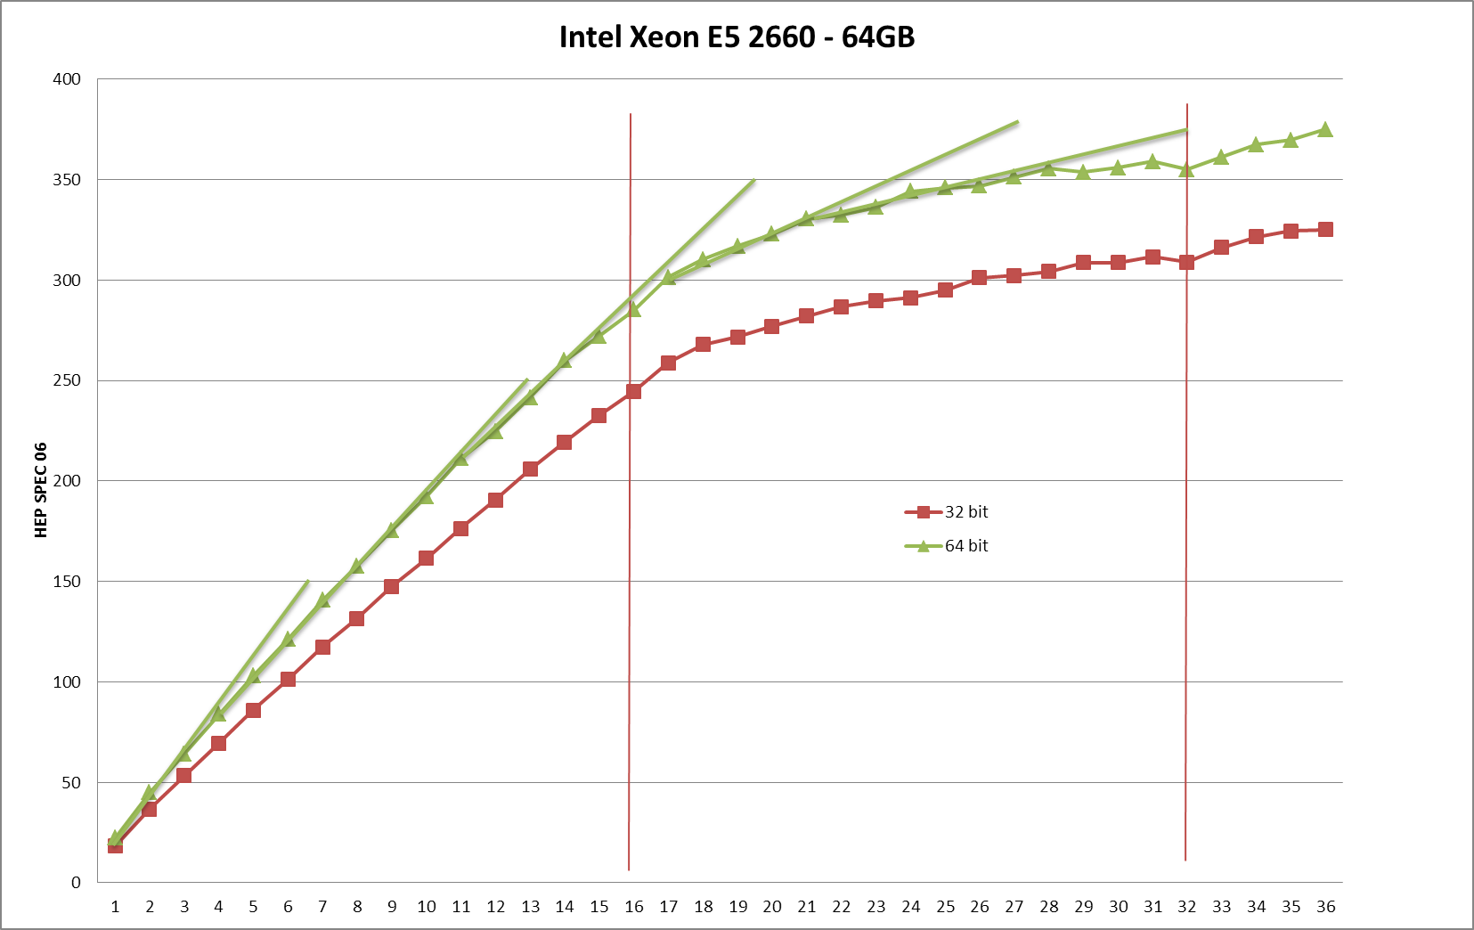
Several slopes due to Turbo Mode

Slide 17
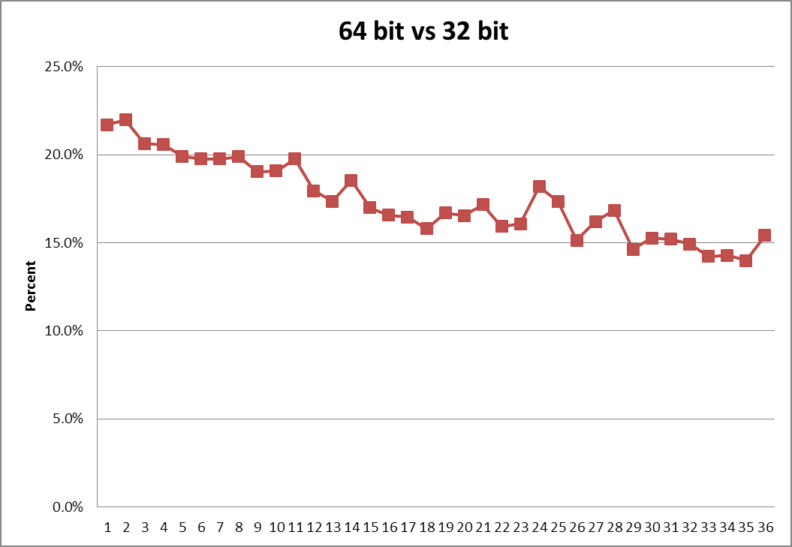
From 32 to 64 bit

Slide 18
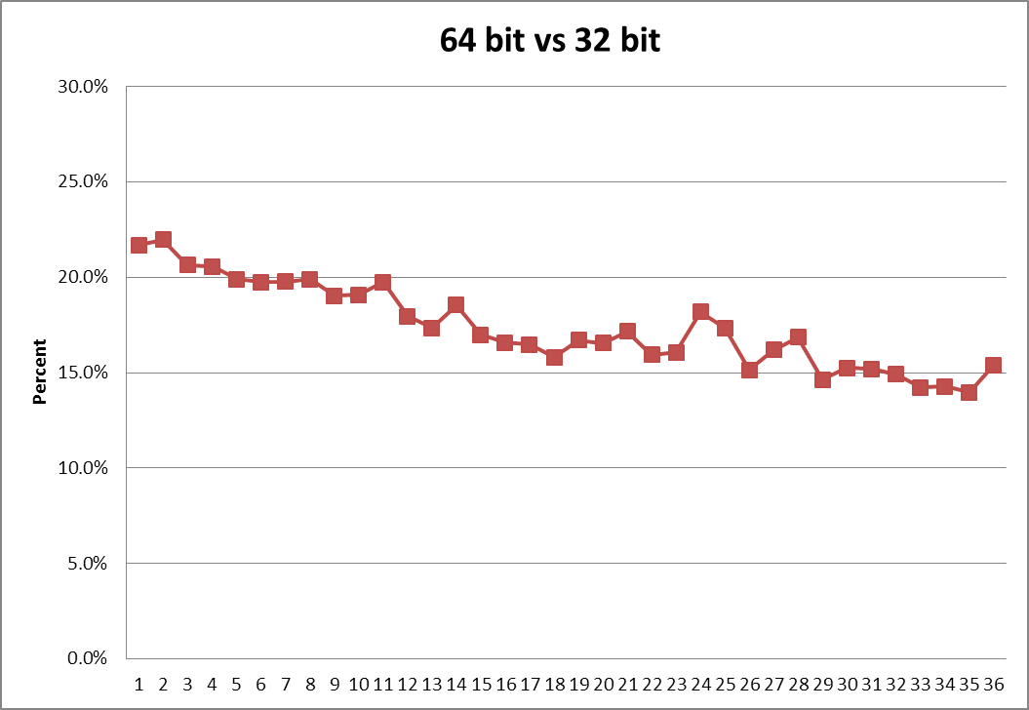
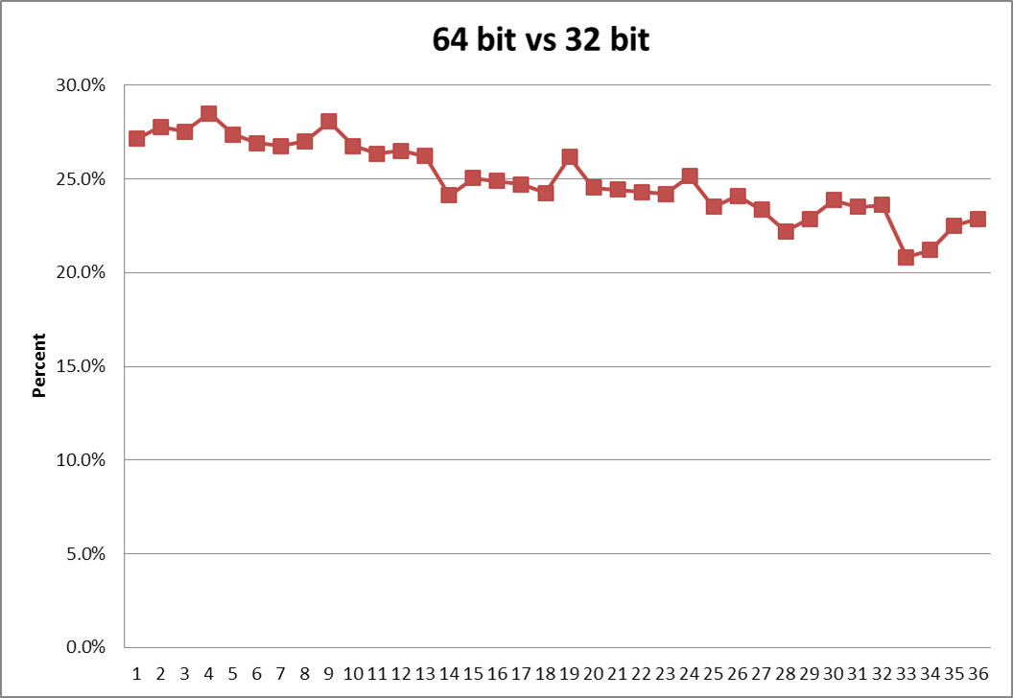
Intel vs AMD
Running 64bit application AMD is better than what one would expect if one measures it with a 32bit benchmark like HS06

Slide 19
Intel Xeon E5 2660 HT ON vs HT OFF
With HT-OFF performances flattens at ~18 log cpu
HT-ON is safe. You can always limit the job slots.

Slide 20
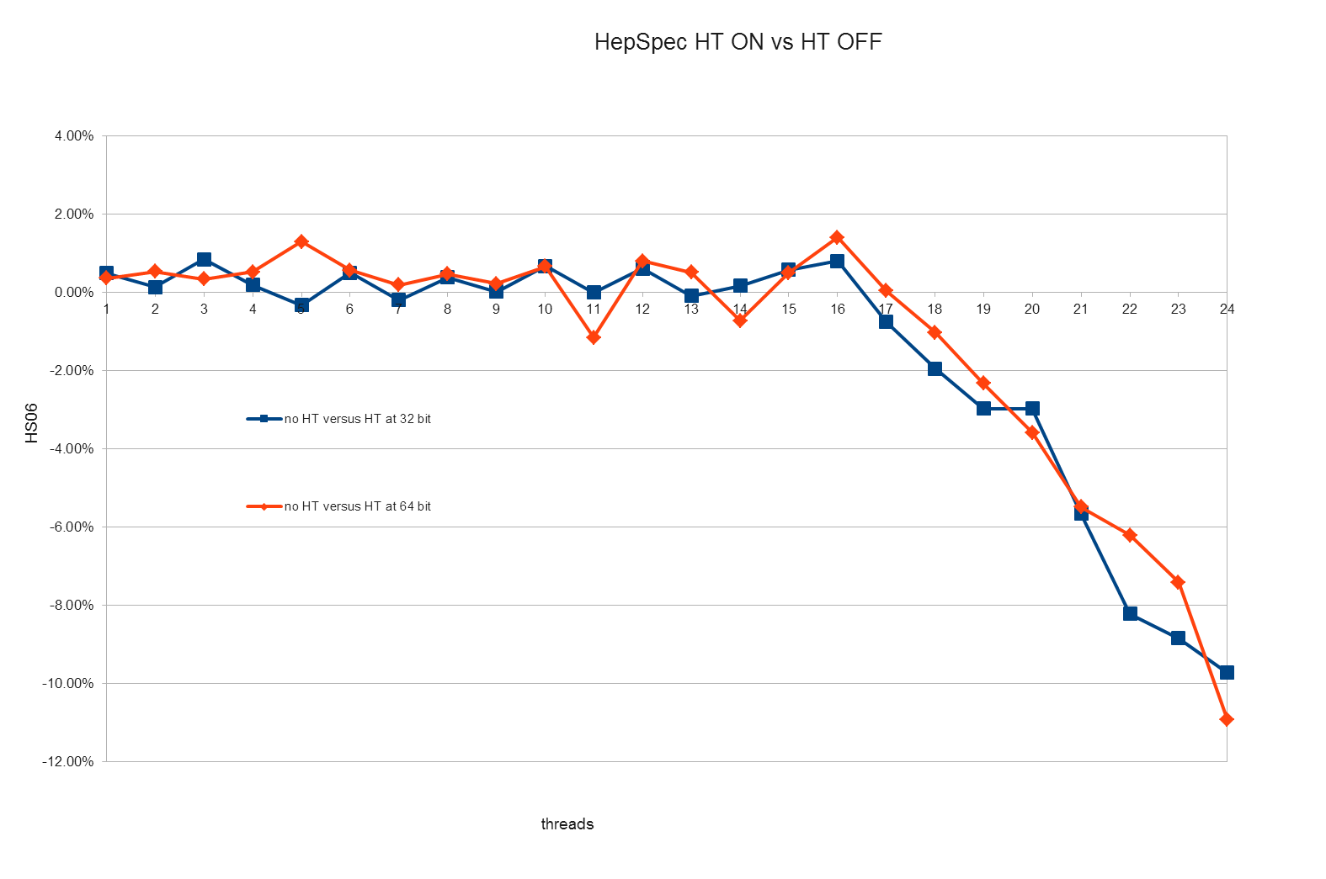
Xeon E5 – HT ON vs HT OFF

Slide 21
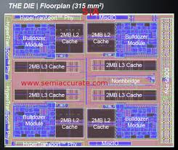
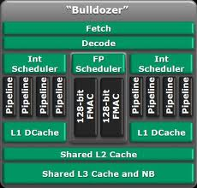
AMD Opteron

Slide 22
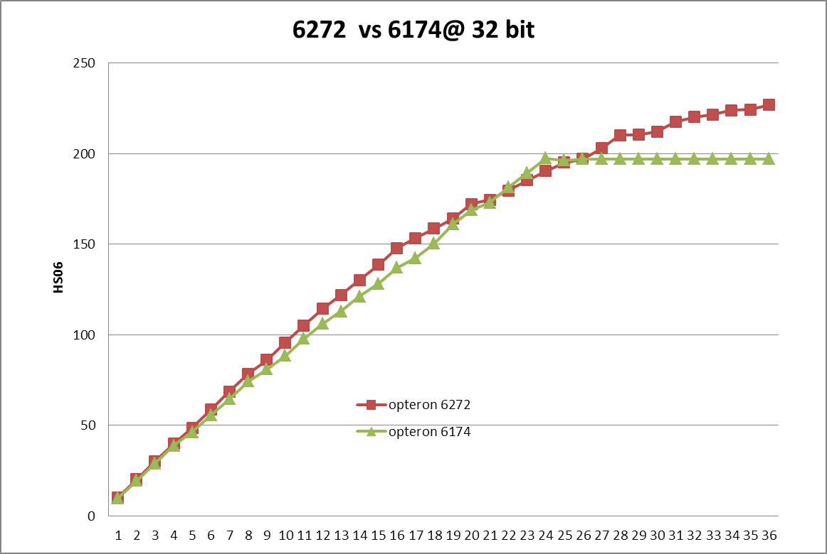
New 6272 2x16core vs old 6174 2x12core

Slide 23
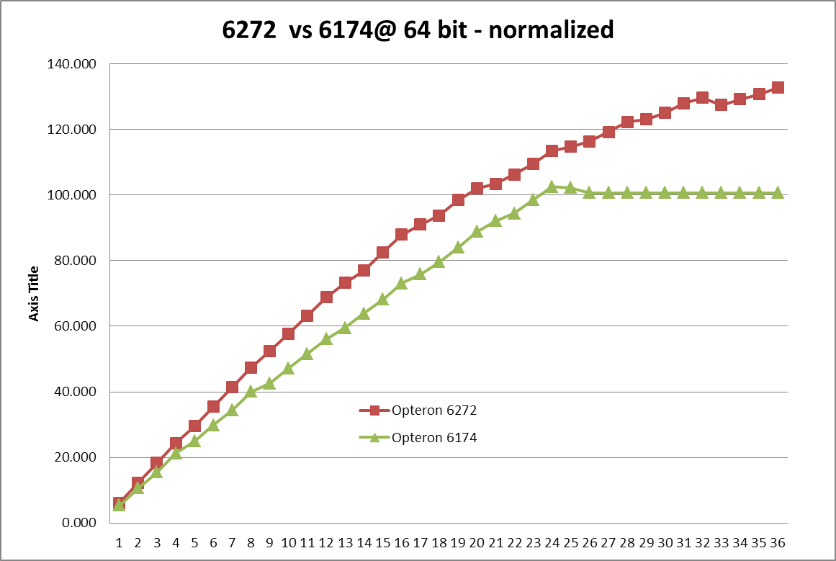
Normalize on the nominal clock 64bit
HS06

Slide 24
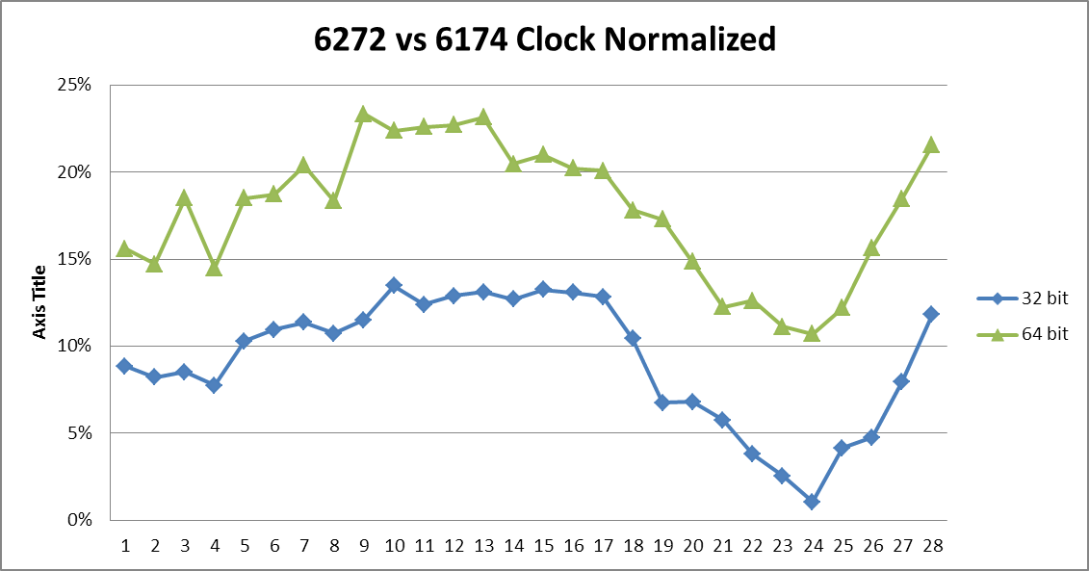
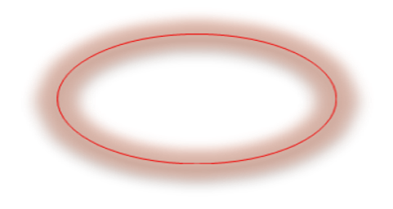

Architectures compared
A Bulldozer core contains the equivalent of 2 cores of the previous generation
They have about the same performances at 24 threads (6174 full loaded)
With less threads better performances due to dynamic clock increase
From 24 to 32 better performances due to the increased number of cores
Increase in performance more visible at 64 bit
relative performance

Slide 25
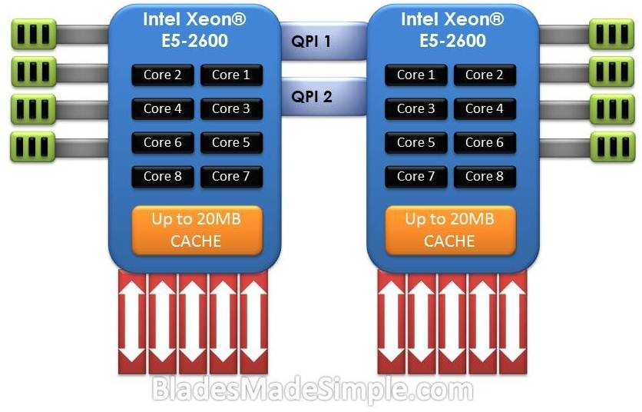
Intel Xeon E5

Slide 26
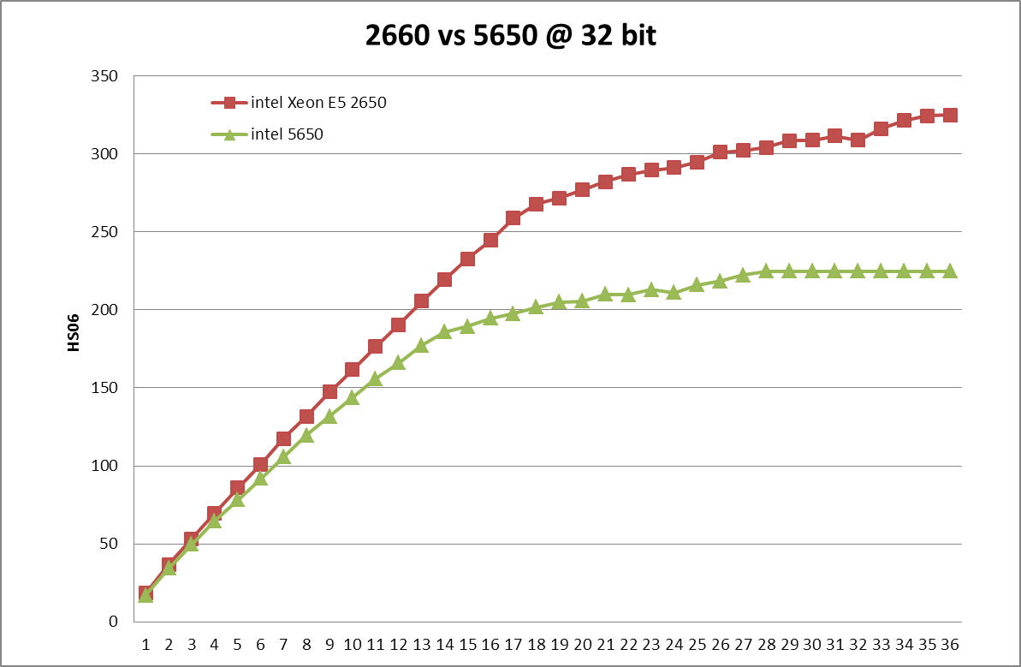
Intel Xeon 2660 @ 2.2 GHz vs Old Xeon 5650 @ 2.66 GHz

Slide 27
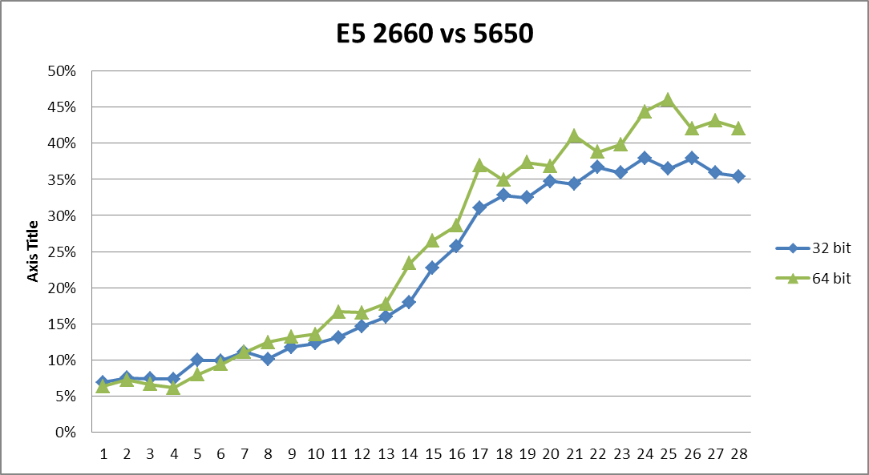
Sandy Bridge 2.2GHz vs Nehalem 2.66 GHz
relative performance

Slide 28
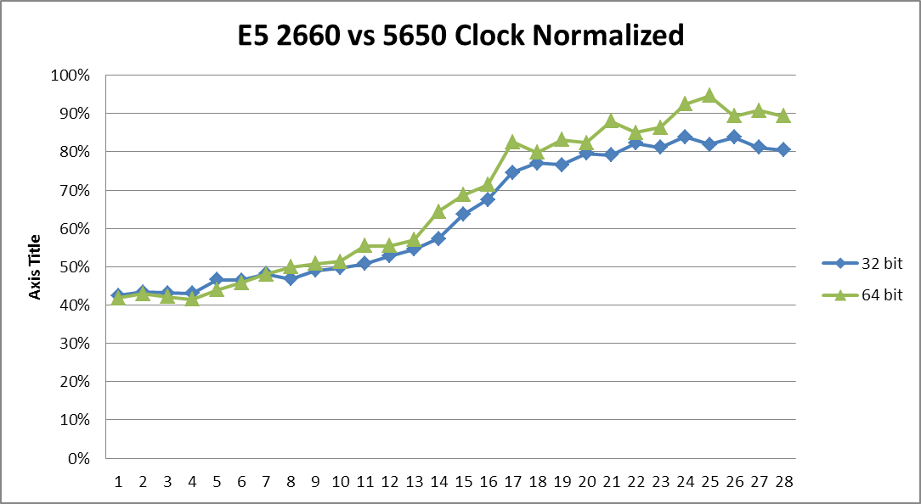

Clock normalization

Slide 29
Architectures compared
A Sandy Bridge core has about 40% more throughput at same clock
Increase in performance slightly better at 64 bit
With more than 12 cores better performances due to the added cores
relative performance

Slide 30
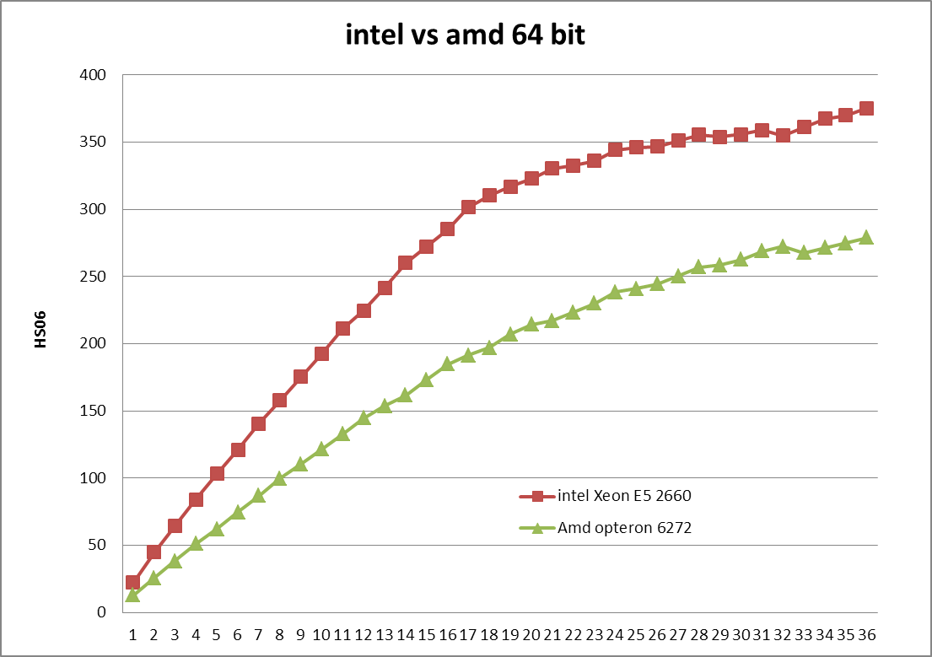
Intel vs. AMD

Slide 31
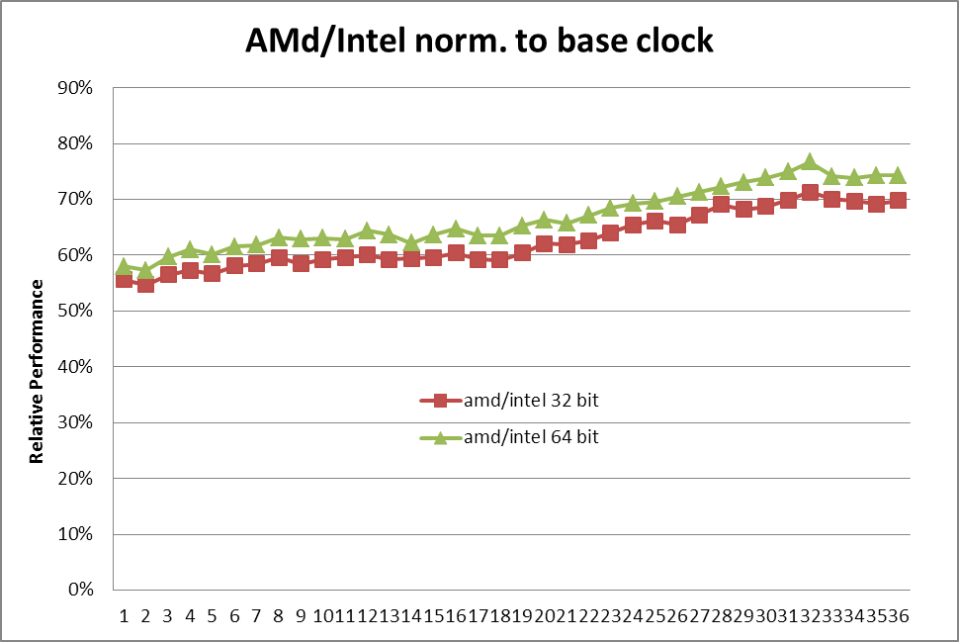
Intel architecture vs. AMD architecture
One AMD core (not a Bulldozer core) gives 70% to 77% of the performances of a Intel Xeon 26xx core
Even less (55%) when the server is mostly idle but our servers usually aren’t
An economic comparison should take in account of cost of procurements (Euro/HS06). The list price of Intel processors is higher than the AMD processor
We didn’t compare the Power consumption (Watt/HS06)

Slide 32
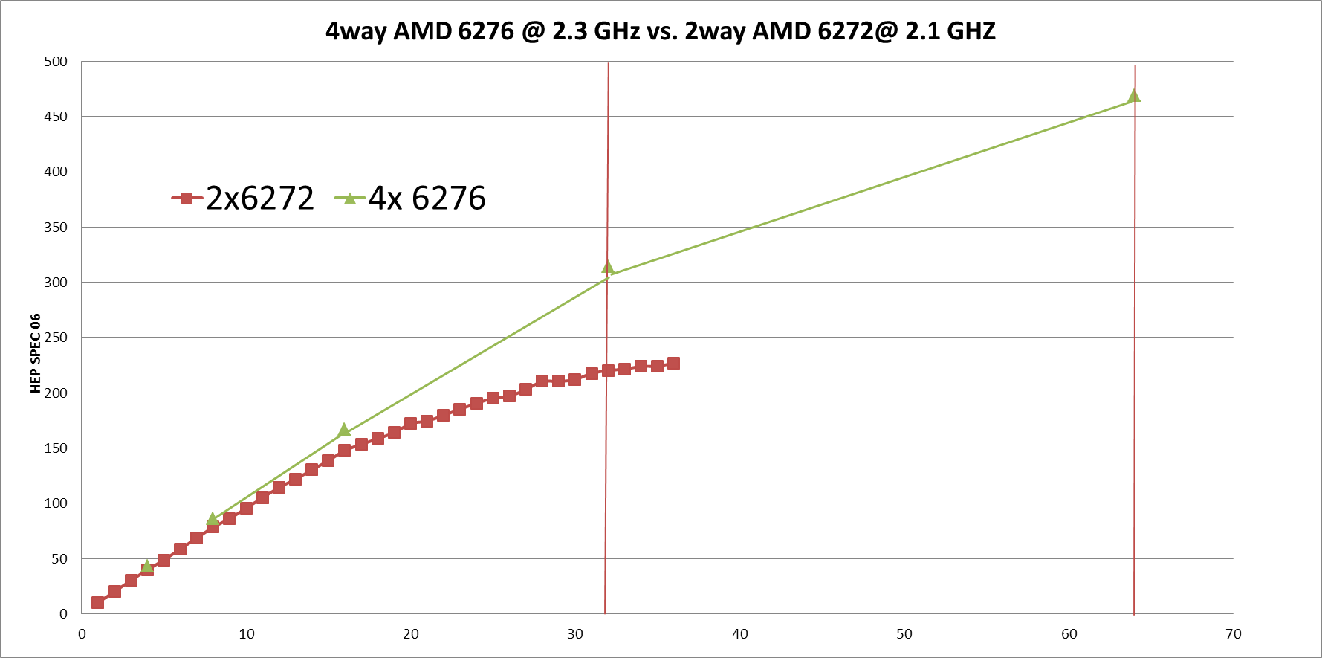
4 way 6276

Slide 33
SL6 vs SL5

Slide 34
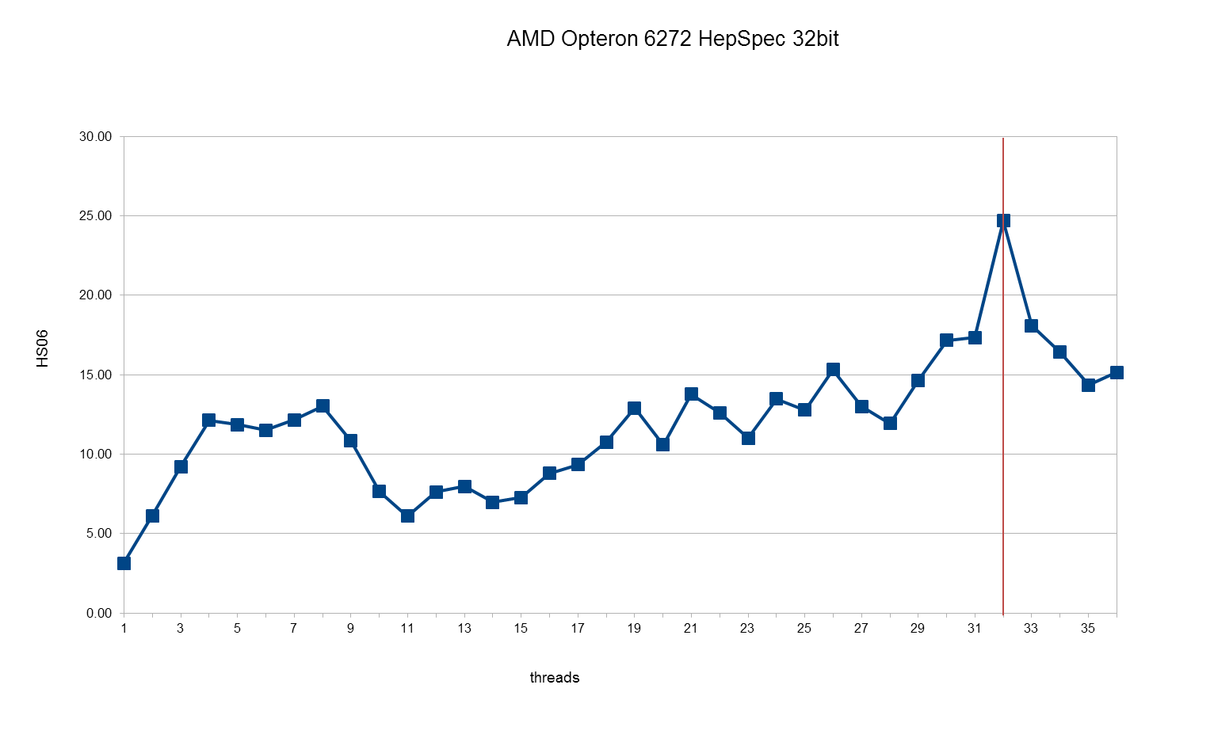
Difference SL6 – SL5

Slide 35
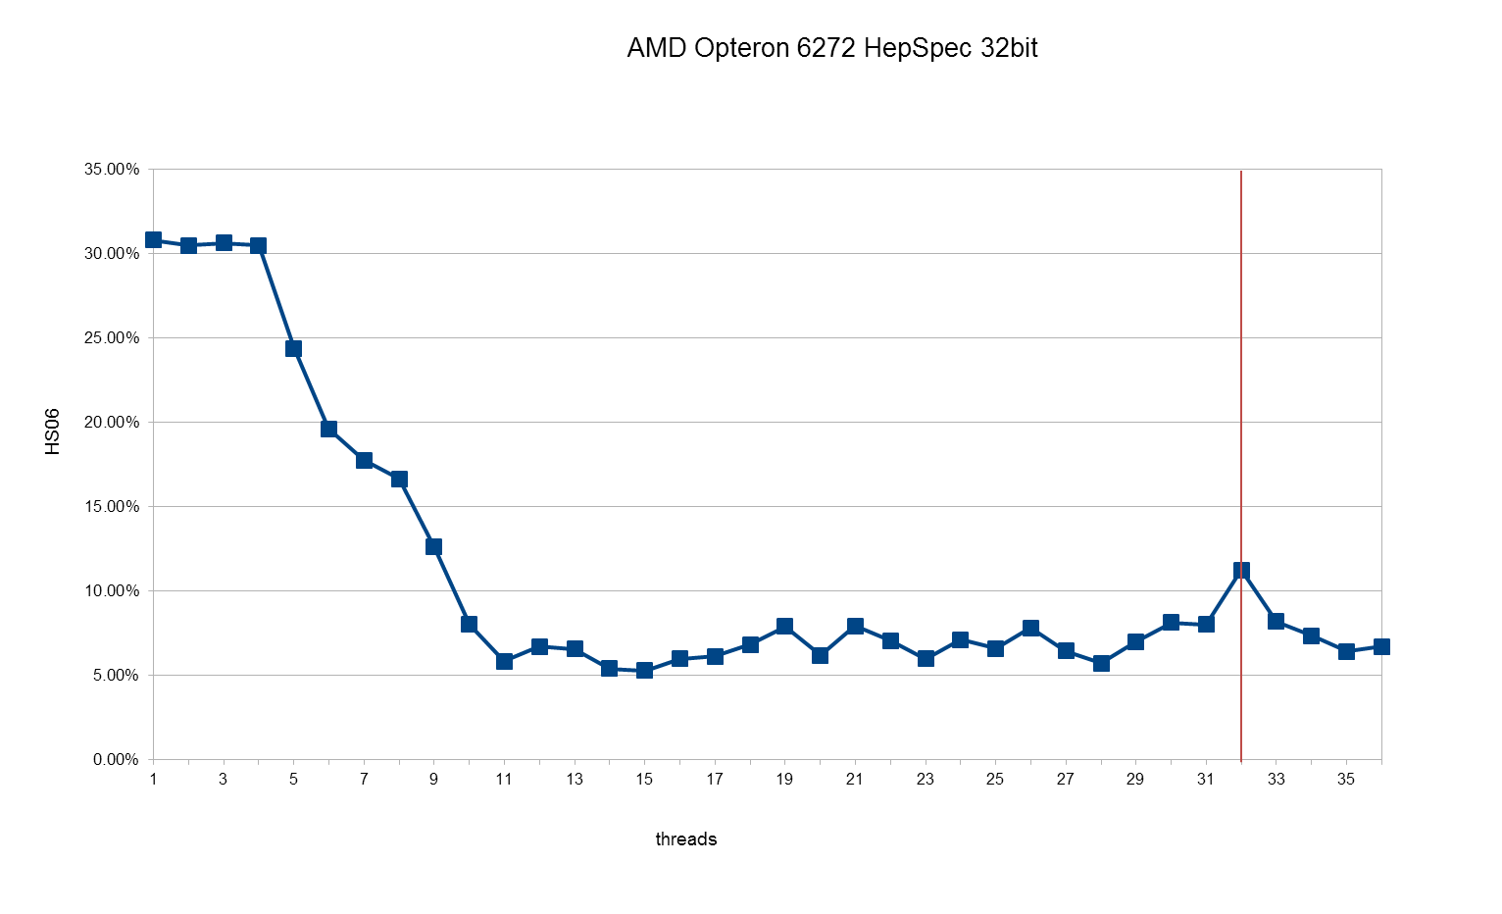
Percent Increase SL6/SL5

Slide 36
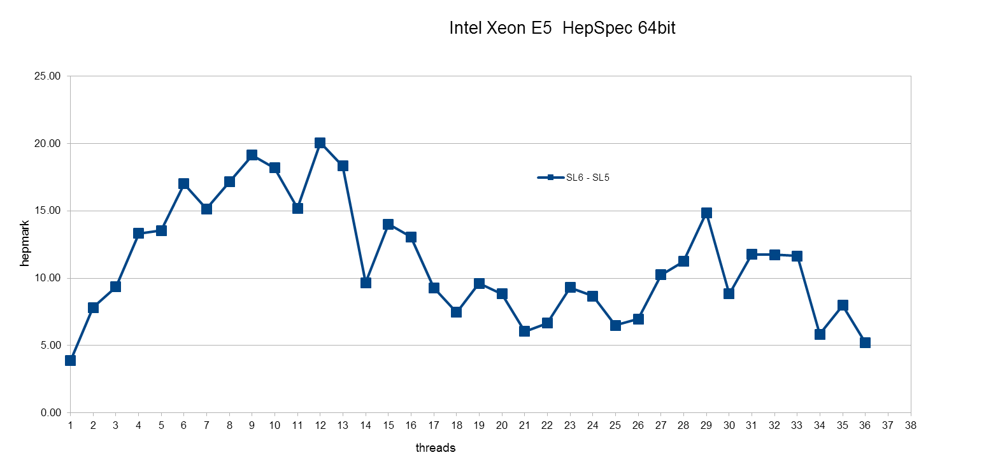
For Intel less evident - difference

Slide 37
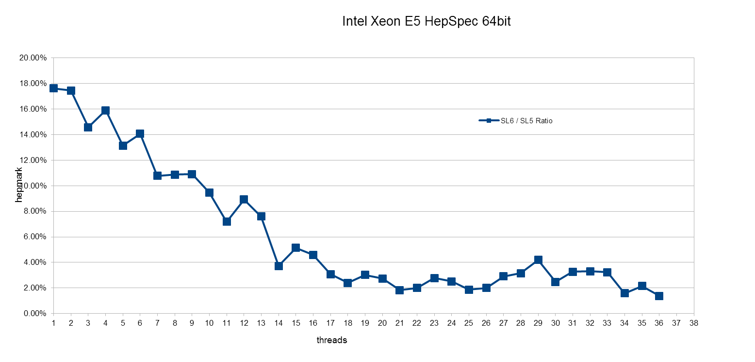
Intel - Percentage

Slide 38
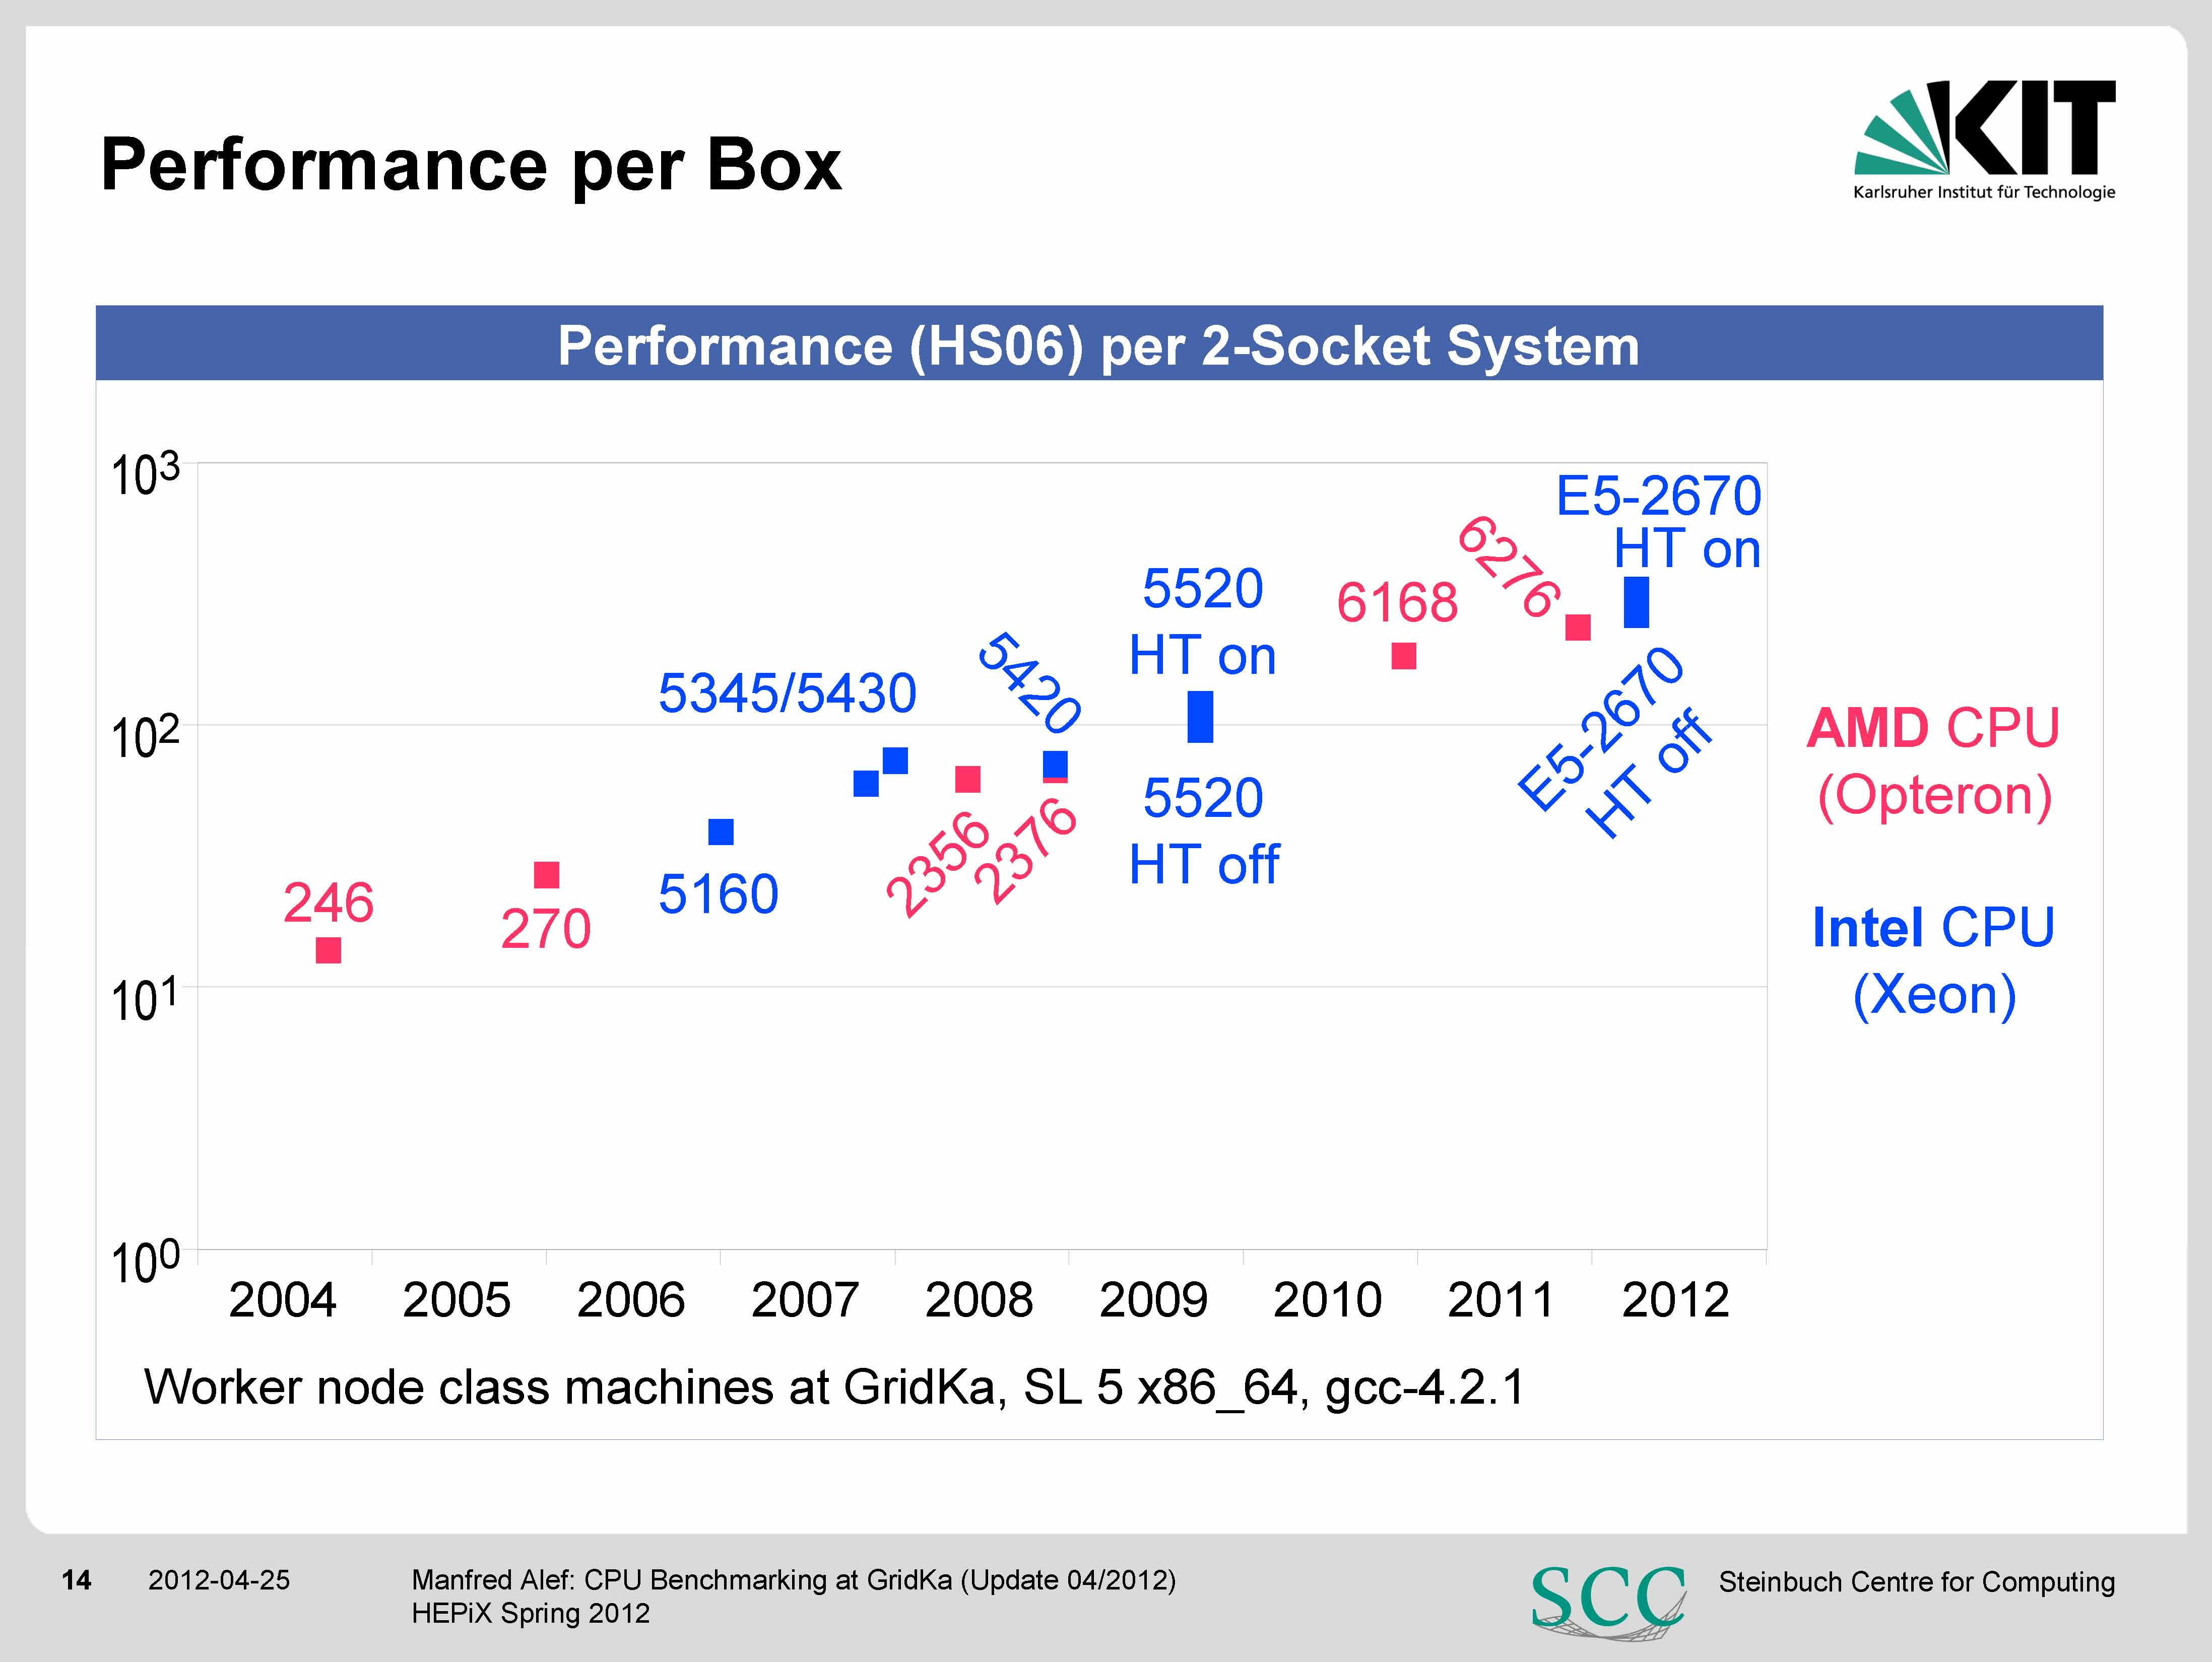

Slide 39
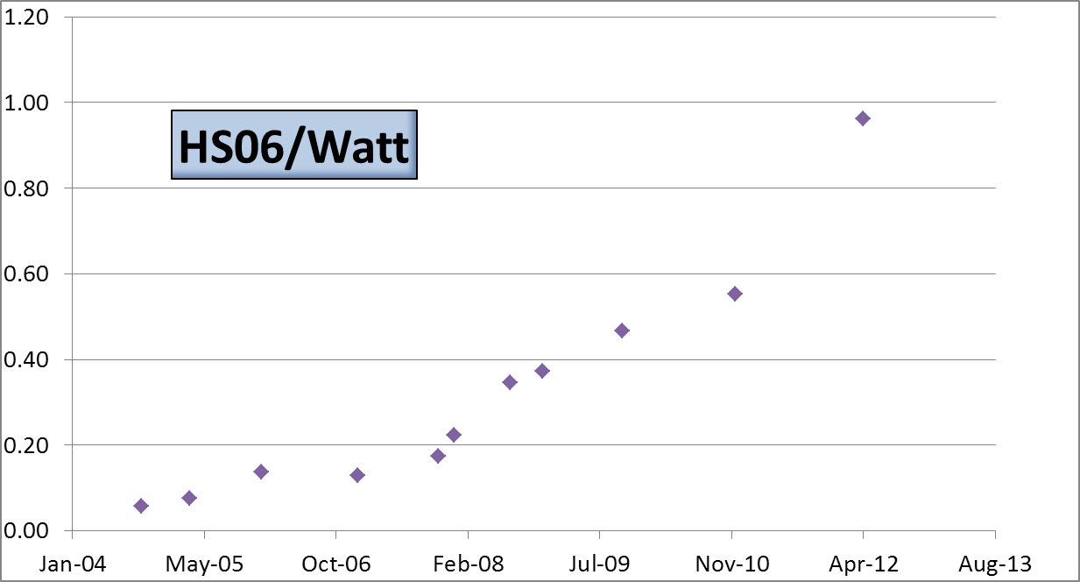
HS06 per Watt

Slide 40
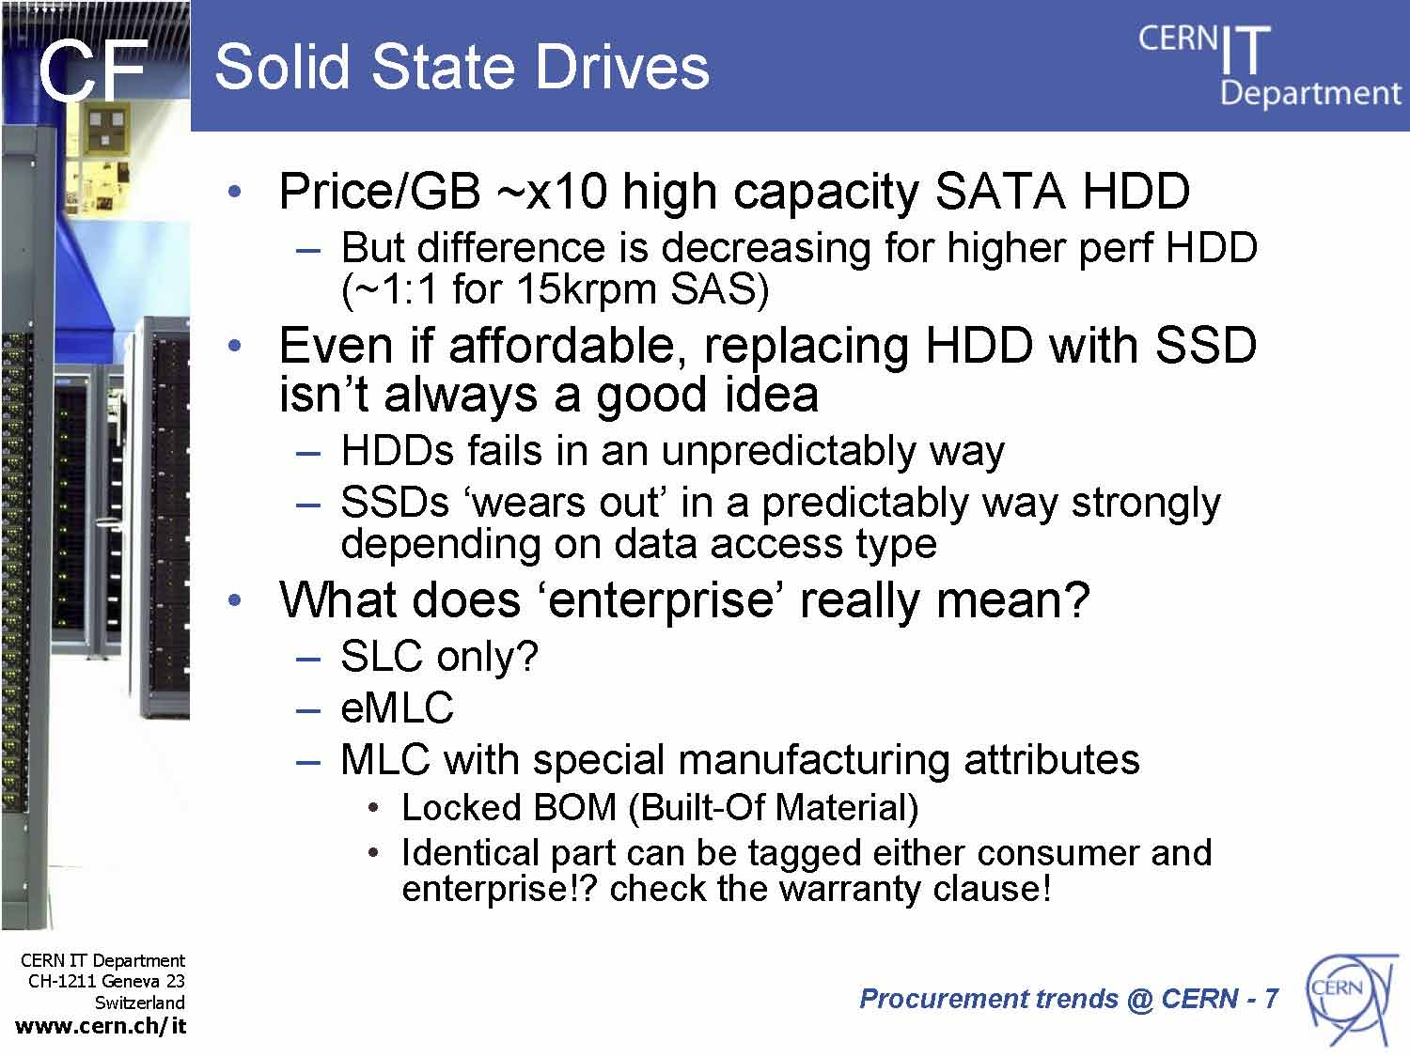

Slide 41
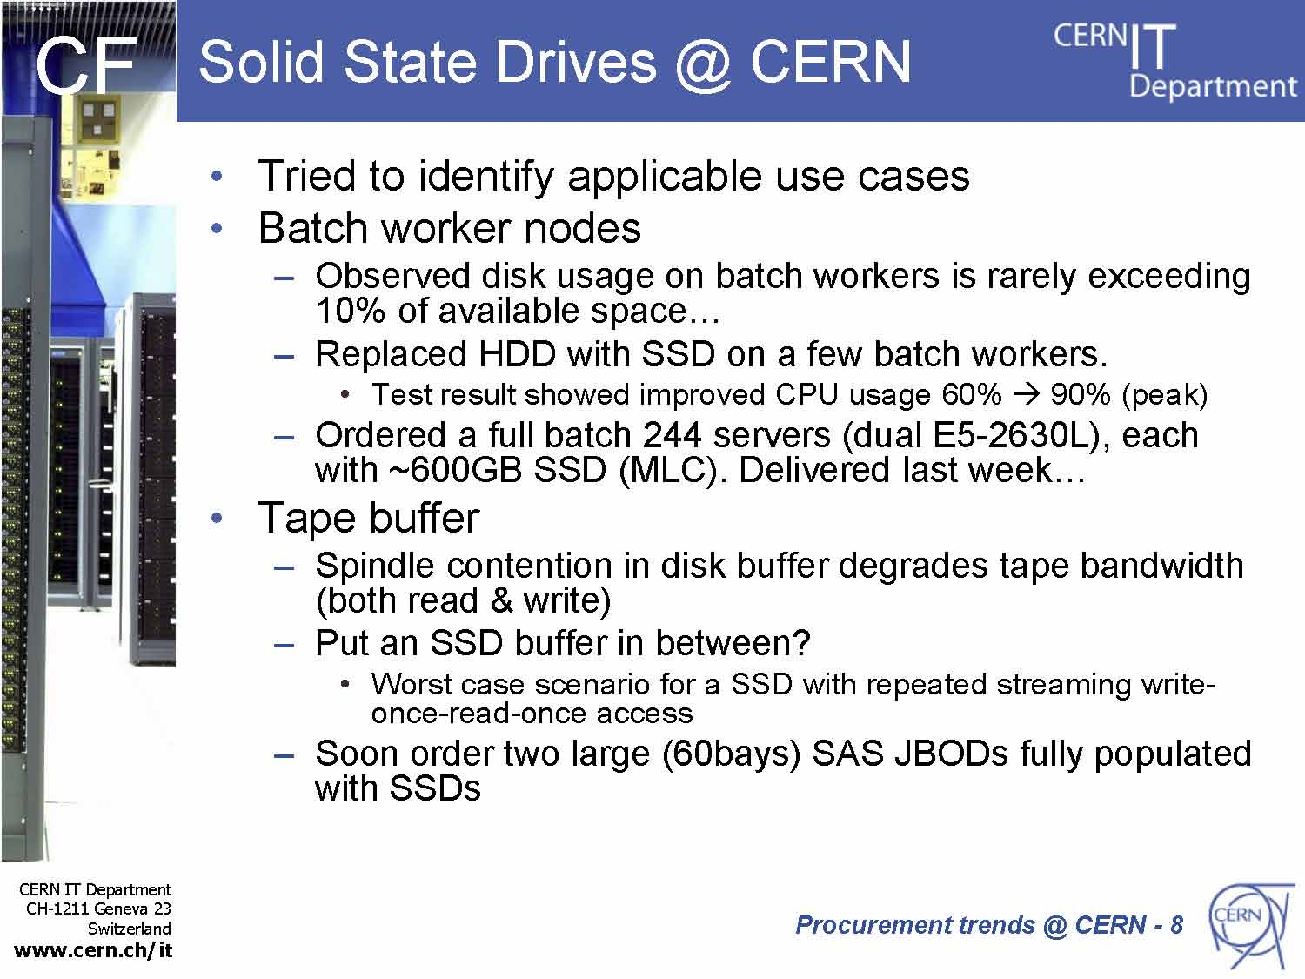

Slide 42
Networking
1Gb still works for many LHC experiment computational models.
Ever increasing processor core counts and quad socket systems creating interest in 10Gb.
  Example: 10GB–20GB data set size for ATLAS analysis jobs with one job per core represents a large amount of data (640GB-1.28TB on current generation quad socket AMD systems).
Challenges:
  Getting from 1Gb to 10Gb on compute nodes while leveraging as much of your current investment as possible.
  Building a network that can scale as you grow.
Solutions?
  Traditional Ethernet multi-tier network
  Stacking switches
  Scalable fat tree network

Slide 43
Networking Terminology Definitions
Non-blocking: For each path into a switch or network, there is an equal path out.
Line speed: The backplane of a switch has enough bandwidth for full speed, full duplex communication from every port. Most fixed configuration switches are line speed within the switch.
Oversubscription: The ratio of total bandwidth into a switch or network to the bandwidth out of the switch or network. Expressed as in to out (ex. 3:1), or percent (1 – (1 out / 3 in)) = 67%).

Slide 44
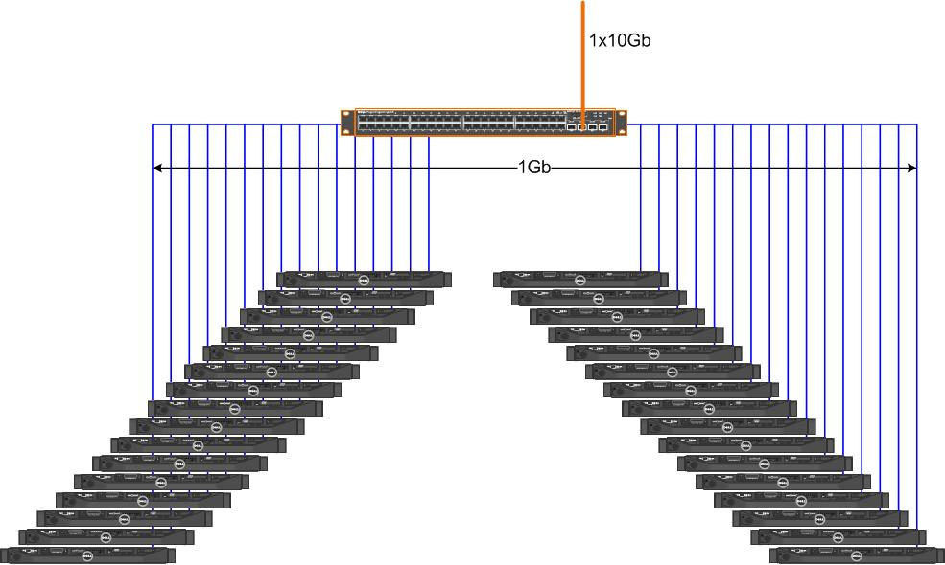
Oversubscription Example
48-port 1 GbE leaf switch
32 compute nodes each with 1Gb link
1 10Gb uplink to spine switch
Oversubscription? 32:10 -> 3.2:1

Slide 45
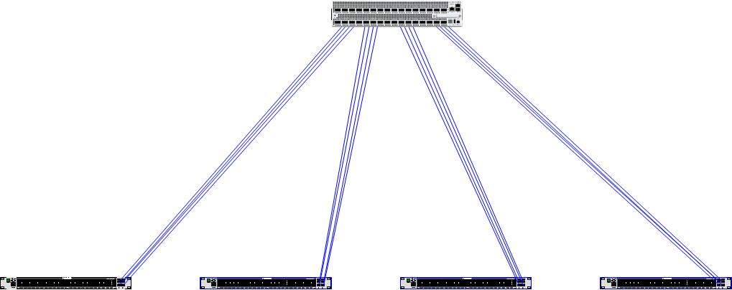
For Moderate to Large Scale Systems
Traditional Multi-tier Ethernet networks
Almost always some level of oversubscription limited by uplink bandwidth
Dell Force10 Z9000
Set of 4x40Gb uplinks
Dell Force10 S4810

Slide 46
What are fat tree networks?
Multi-tiered networks that can scale to thousands of nodes and have an architected level of oversubscription
  Examples:
  2 Tier Network: A network consisting of 2 tiers of switches, leaf switches are connected to the hosts and spine switches connect the leaf switches together
  3 Tier Network: A network consisting of 3 tiers of switches, leaf connected to the hosts, spine connecting leaf switches together and core connecting the spine switches together
Infiniband networks are fat tree networks
Dell Force10 Distributed Core Architecture supports fat tree architectures too!

Slide 47
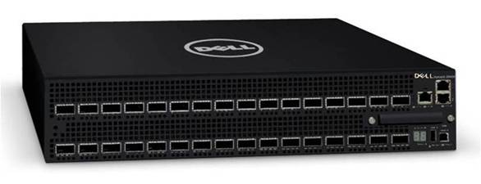
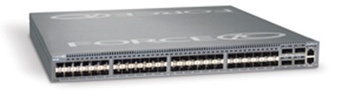
Dell|Force10 Fat Tree Ethernet Components
Z9000 - New!
High Density 2RU ToR Switch
High Density 32 40GbE QSFP+ ports or 128 10GbE SFP+ ports (All Line Rate)
<3us of latency
2.5 Tbps bandwidth
Optimized Hot aisle/Cold aisle design
Fully redundant system – Power and Fan
S4810
High Density 1RU ToR Switch
High Density 48 10GbE SFP+ ports with 4 40GbE QSFP+ ports or 64 10GbE SFP+ ports (All Line Rate)
700 ns of latency
640 Gbps bandwidth
Optimized Hot aisle/Cold aisle design
Fully redundant system – Power and Fan

Slide 48
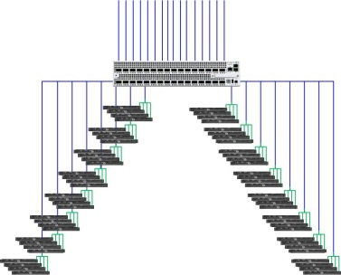
Non-blocking leaf switch configuration
16x40Gb
Dell Force10 Z9000
16x40Gb
QSFP->4xSFP+ splitter cable

Slide 49
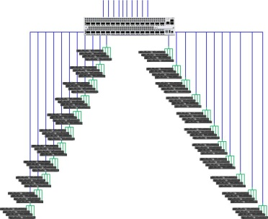
Leaf ~50% Oversubscribed
Actually 2.2:1 oversubscribed
10x40Gb
Dell Force10 Z9000
22x40Gb
QSFP->4xSFP+ splitter cable

Slide 50
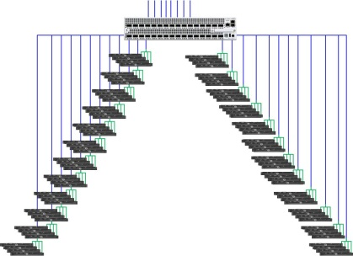
Leaf 67% Oversubscribed
8x40Gb
Dell Force10 Z9000
24x40Gb
QSFP->4xSFP+ splitter cable

Slide 51
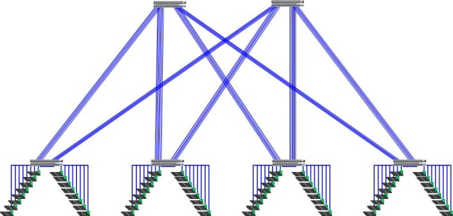
2-Tier Fat Tree Example non-blocking
Spine switches
(Dell Force10 Z9000)
2 sets of 8 40Gb Uplinks
Non-blocking leaf configuration

Slide 52
Machine Room I
Govt provided unexpected capital-only funding via grants for infrastructure
  DRI = Digital Research Infrastructure
  GridPP awarded £3M
  Funding for RAL machine room infrastructure
GridPP - networking infrastructure
  Including cross-campus high-speed links
  Tier1 awarded £262k for 40Gb/s mesh network infrastructure and 10Gb/s switches for the disk capacity in FY12/13
    Dell/Force10 2 x Z9000 + 6 x S4810P + 4 x S60 to compliment the existing 4 x S4810P units.
    ~200 optical transceivers for interlinks

Slide 53

Thank you.
Q & A

Slide 54

Xeon E5 Memory effect

